Slide 1























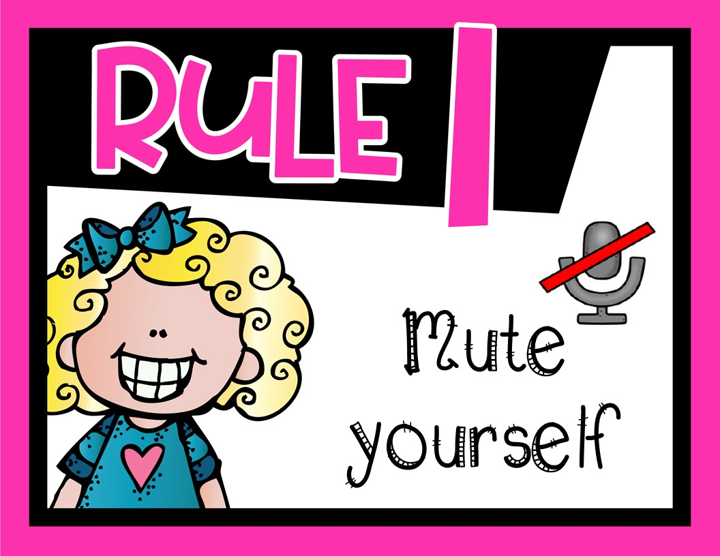

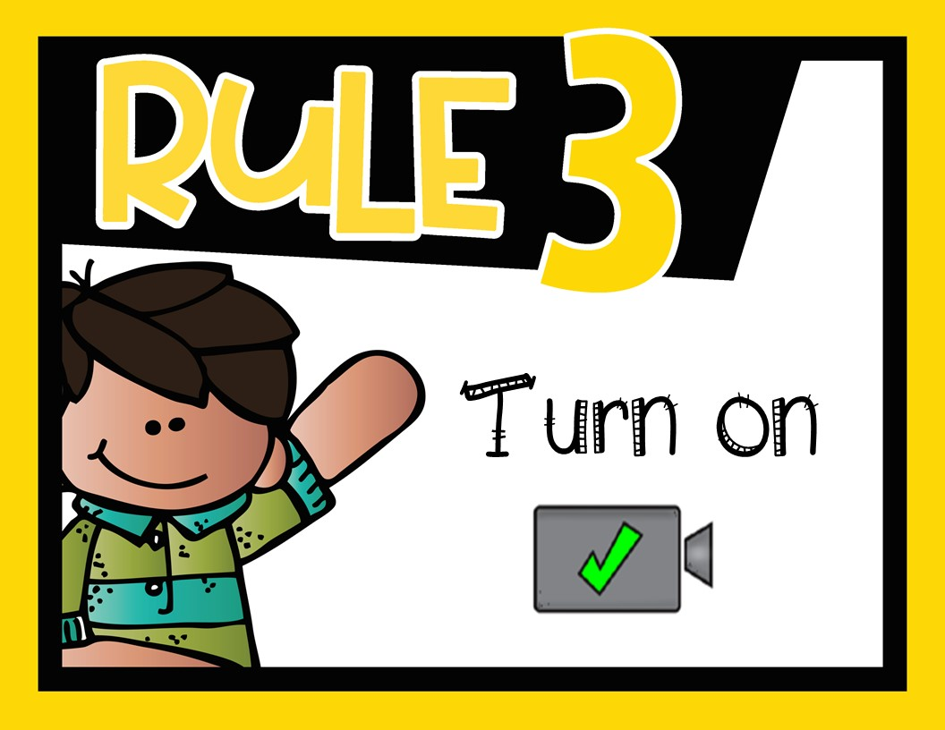
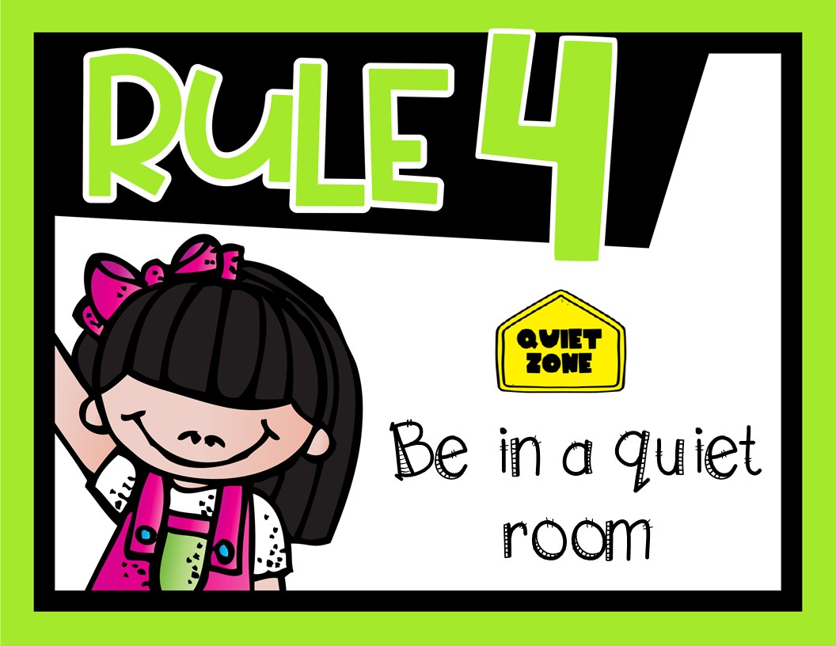



Date:
Text
Title:
Explanation
Text
Example-1
Text
Text
Objective:
Practice-1
Example-2
Text book

Slide 2

Explanation
Example-1
Practice-1
Example-2
Text book

Slide 3
Explanation
Example-1
Practice-1
Example-2
Text book

Slide 4
Explanation
Example-1
Practice-1
Example-2
Text book

Slide 5
Explanation
Example-1
Practice-1
Example-2
Text book

Slide 6
Explanation
Example-1
Practice-1
Example-2
Text book

Slide 7


Slide 10


