Slide 1

















Date:
Text
Title:
Text
Explanation
Example-1
Text
Practice-1
Objective:
Example-2
Text
Text book

Slide 2



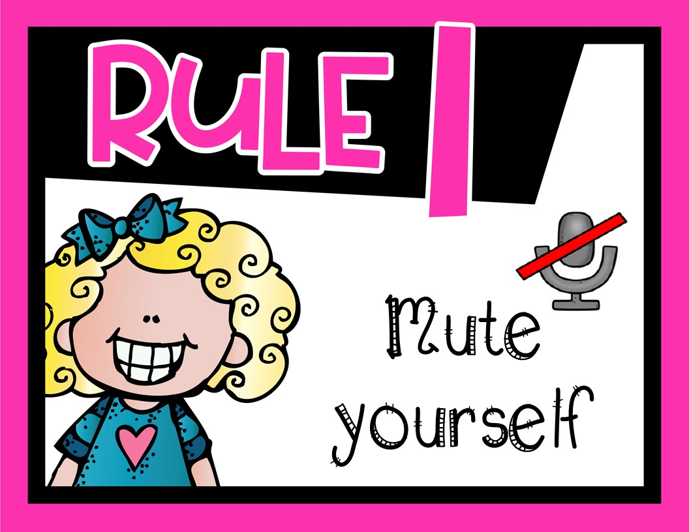

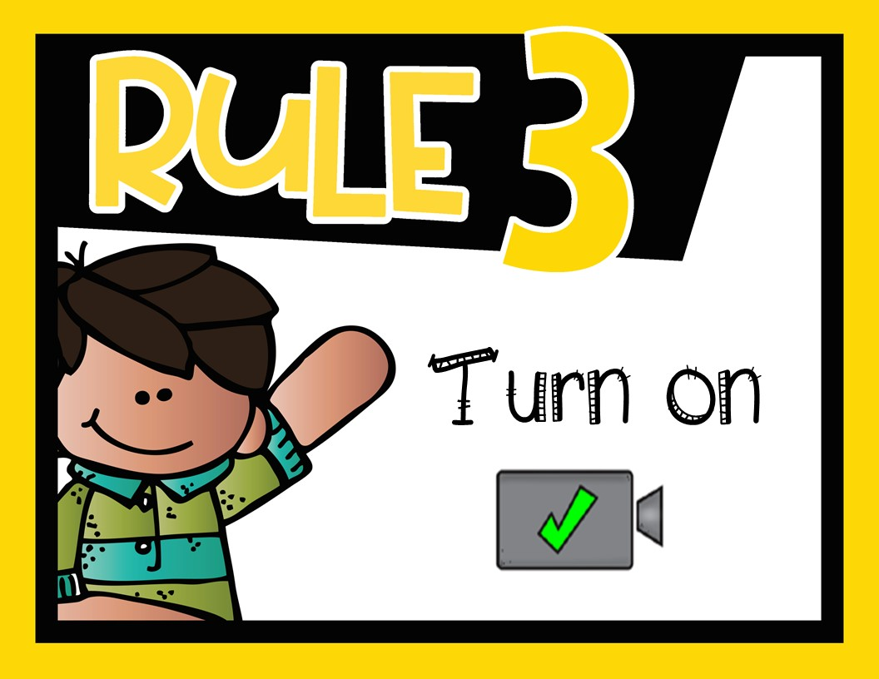
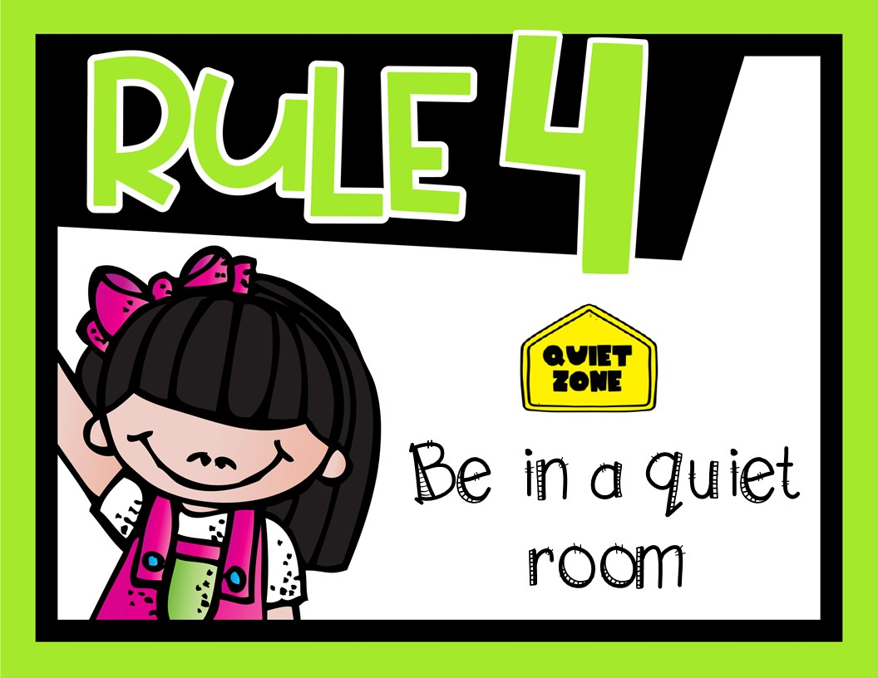

Explanation
Example-1
Practice-1
Example-2
Text book

Slide 3
Explanation
Example-1
Practice-1
Example-2
Text book

Slide 4
Explanation
Example-1
Practice-1
Example-2
Text book

Slide 5
Explanation
Example-1
Practice-1
Example-2
Text book

Slide 6
Explanation
Example-1
Practice-1
Example-2
Text book

Slide 7


Slide 8


Slide 9


Slide 10


