Slide 1
English
Access Book 5
Unit 1: Lesson 2 (pages 3 & 4)
Different Homes
Mr. Michael
Tuesday, September 15th, 2020

Slide 2
Rules & Procedures
Come to class on time.
If you do not respond to me verbally by saying your name or by typing your name in the chat, then you are absent.
Keep your mics on mute, until asked to share. Cameras should be turned on, and uniform shirts should be worn.
Please be on your best behavior.
No inappropriate profile pictures. Only pictures of yourself.
Only educational content to be posted in the chat.

Slide 3
Learning Outcomes
Students will be able to:
Analyze pictures.
Review the grammar points.
Complete the sentences with words from the box.
Read different texts.
Circle the correct words that relate to the texts.
Complete the table with the correct words from the box.
Write sentences about the houses.
Watch a short video on parts of a house.

Slide 4
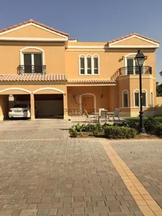
Starter: Look at the picture. What do you see?

Slide 5

Review Grammar Points

Slide 6
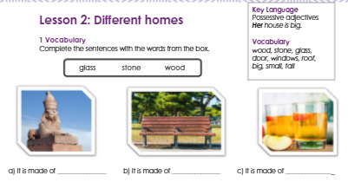
stone
wood
glass

Slide 7
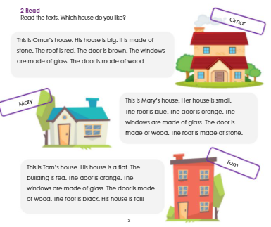

Slide 8
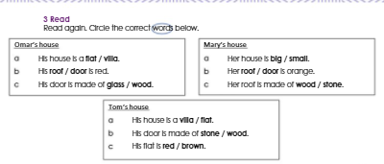

Slide 9
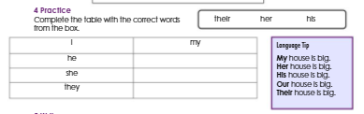
His
Her
Their
Now, repeat after me.

Slide 10
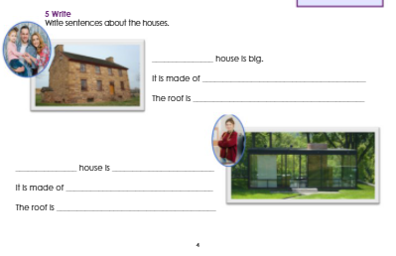
Their
stone
dark brown
Her
small
glass
black

Slide 11

Plenary: Watch the short video

Slide 12

Self-Evaluation
Evaluate your learning for today in the chat:
Type a 1 if you are confused.
Type a 2 if you are getting there.
Type a 3 if you got it!

