Slide 1
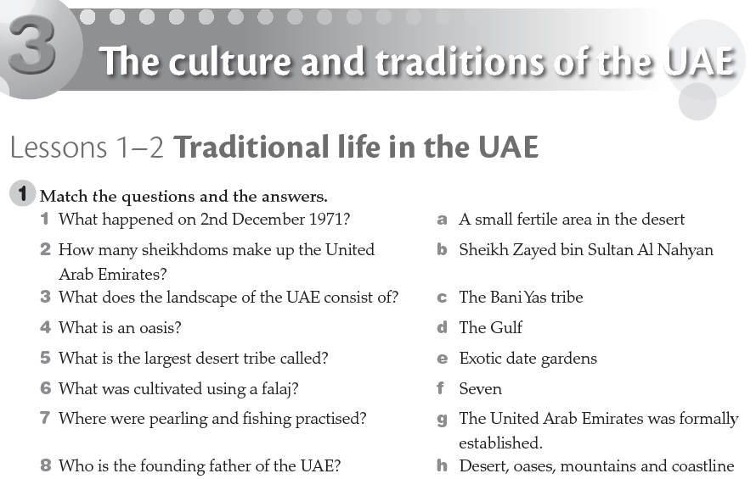
g
f
h
a
c
e
d
b
Workbook Unit 3 P. 36

Slide 2
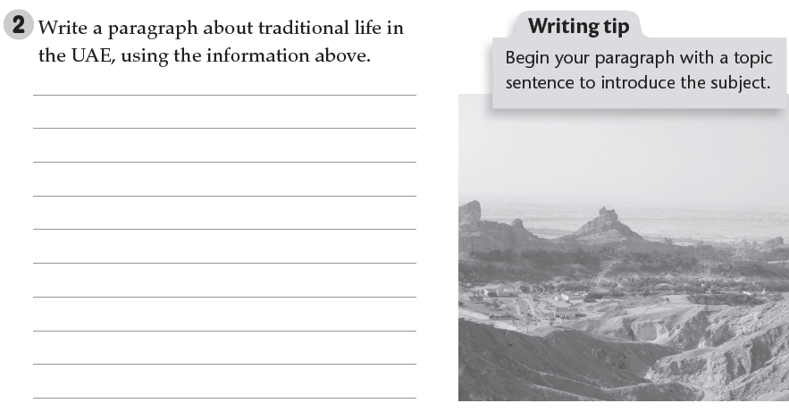
On the 2nd Dec. 1971, the seven sheikhdoms of Emirates united to form the UAE. The UAE is a land consists of desert, oases, mountains and coast. The biggest tribe is called the Bani Yas tribe. They cultivated the oasis to plant exotic dates.
Workbook Unit 3 P. 36

Slide 3
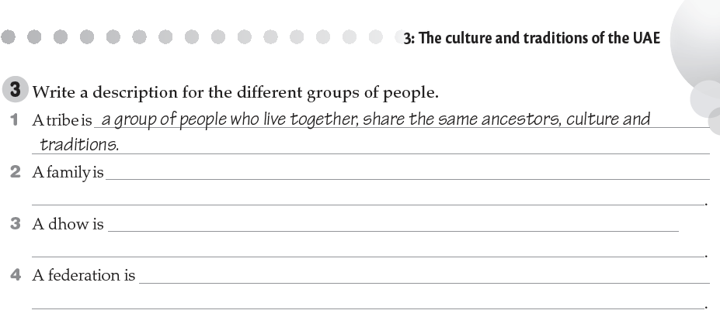
a group of people live in a house together.
a traditional boat.
a group of cities with a central government.
Workbook Unit 3 P. 37

Slide 4
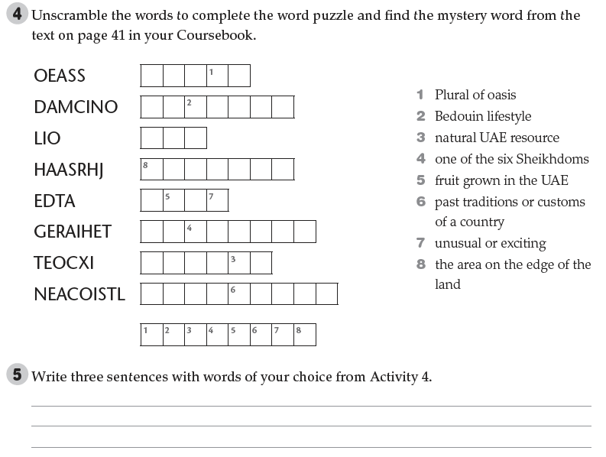
O A S E S
N O M A D I C
O I L
S H A R J A H
D A T E
H E R I T A G E
E X O T I C
C O A S T L I N E
E M I R A T E S
Oases have a lot of exotic date gardens.
Workbook Unit 3 P. 37
We have a very rich cultural heritage.
Oil is one of the main sources of the national income in the UAE.

Slide 5
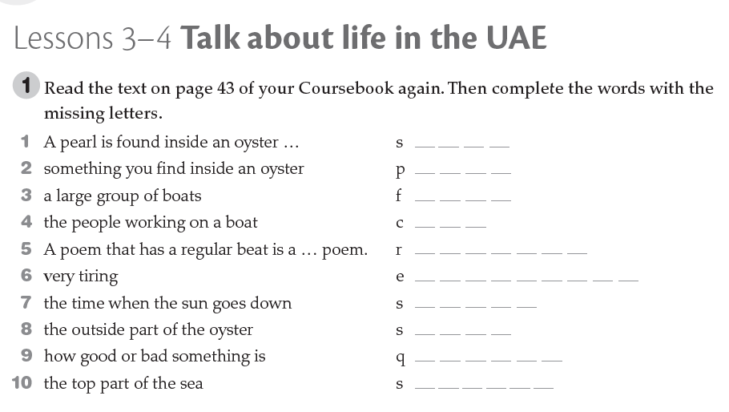
h e l l
e a r l
l e e t
r e w
h y t h m i c
x h a u s t i n g
u n s e t
h e l l
u a l i t y
u r f a c e
Workbook Unit 3 P. 38

Slide 6
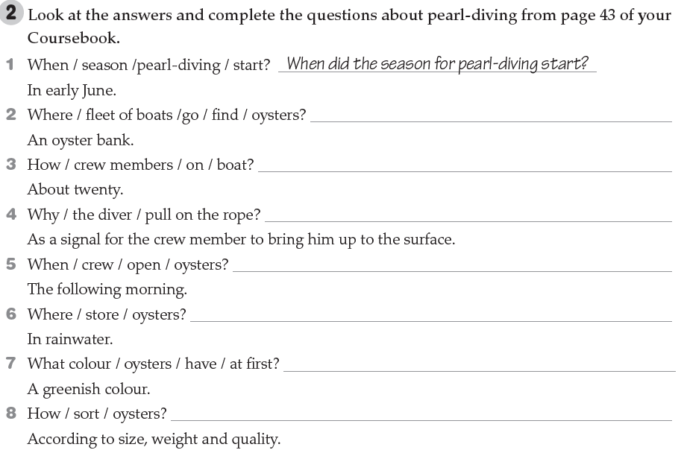
Where did the fleet of boats go to find oysters?
How many crew members were there on the boat?
Why did the diver pull on the rope?
When did the crew open the oysters?
Where did they store the oysters?
What colour did the oysters have at first?
How did they sort the oysters?
Workbook Unit 3 P. 38

Slide 7
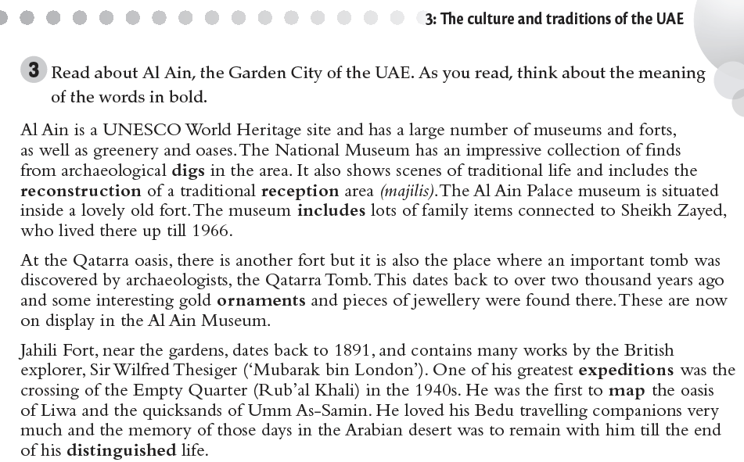
Workbook Unit 3 P. 39

Slide 8
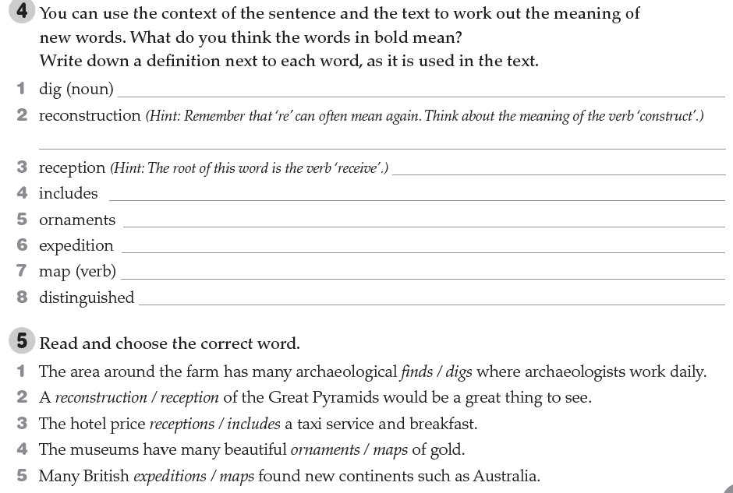
the careful removal of soil and objects from an area
The process of building or creating something again
Entrance of a place
to contain something as a part of something else
an object which is beautiful rather than useful
an organized journey for a particular purpose
to represent an area of land in the form of a map
Different and special
Workbook Unit 3 P. 39

Slide 9
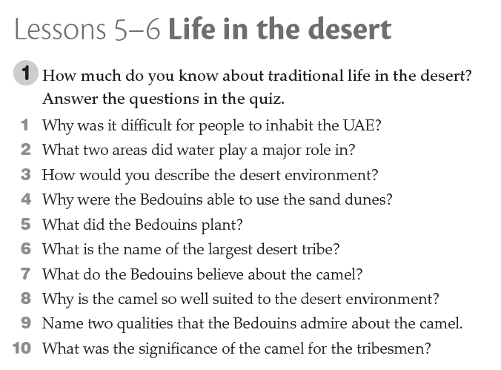
Most of the country is sandy desert.
Economical life – social structure
Tough - endurance
Discover water
Date garden
Bani-Yas
Gift from Allah
endurance
Endurance - speed
Sign of wealth
Workbook Unit 3 P. 40

Slide 10
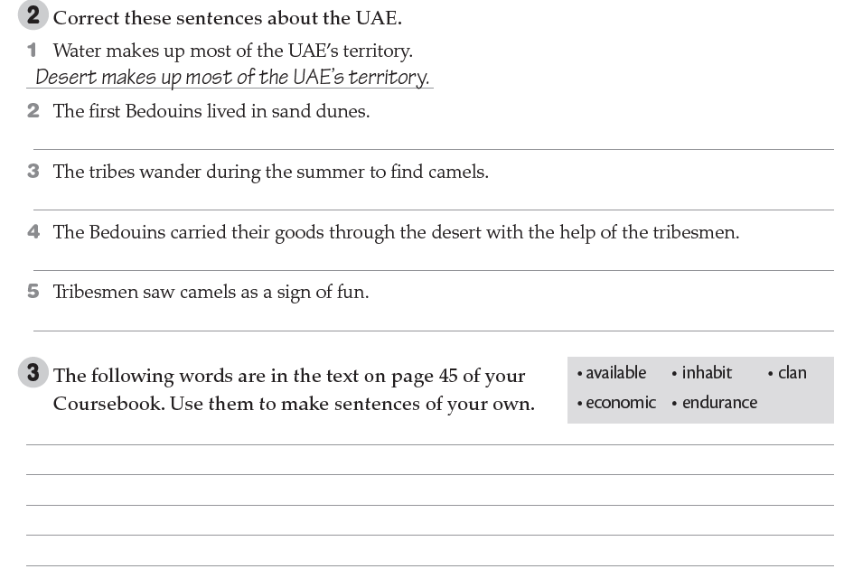
The first Bedouins discovered source of water in sand dunes.
The tribes wander during the summer to find grazing.
The Bedouins carried their goods through the desert with the help of the camels.
Tribesmen saw camels as a sign of wealth.
The books are available for you on the LMS channel.
People inhabit on the banks of the rivers in the past.
There are a lot of clans in the Arabian Peninsula.
The economic development in the UAE is clear via technology and construction.
Running a marathon is a test of the human endurance.
Workbook Unit 3 P. 40

Slide 11
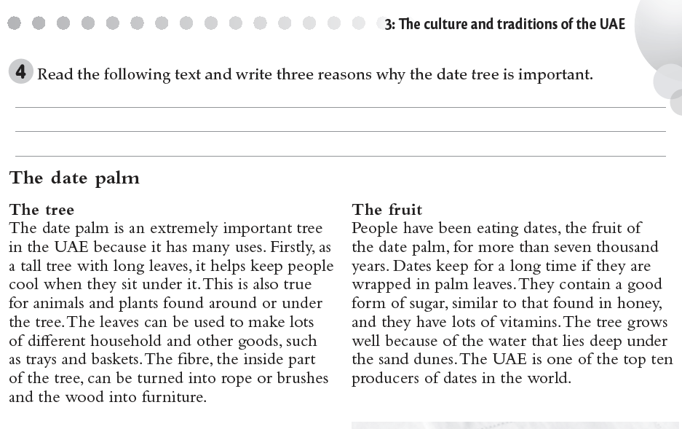
It helps keep people cool when they sit under it.
The leaves can be used to make lots of different household and other goods.
The fruit is healthy because it has lot of vitamins.
Workbook Unit 3 P. 41

Slide 12
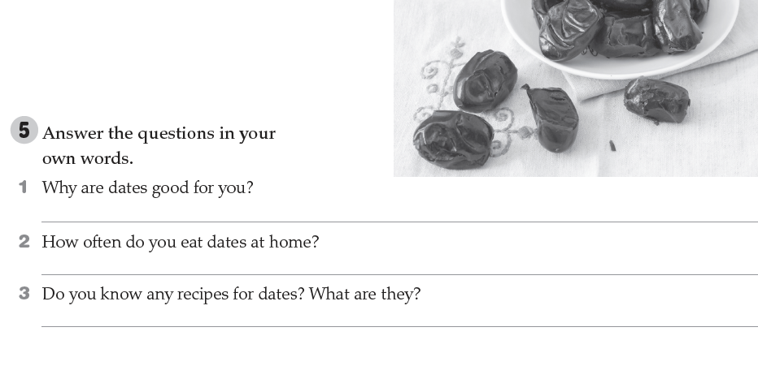
Because they contain lots of vitamins and they are delcious.
Once a day
Yes. You can mix dates with milk. It’s tasty.
Workbook Unit 3 P. 41

Slide 13
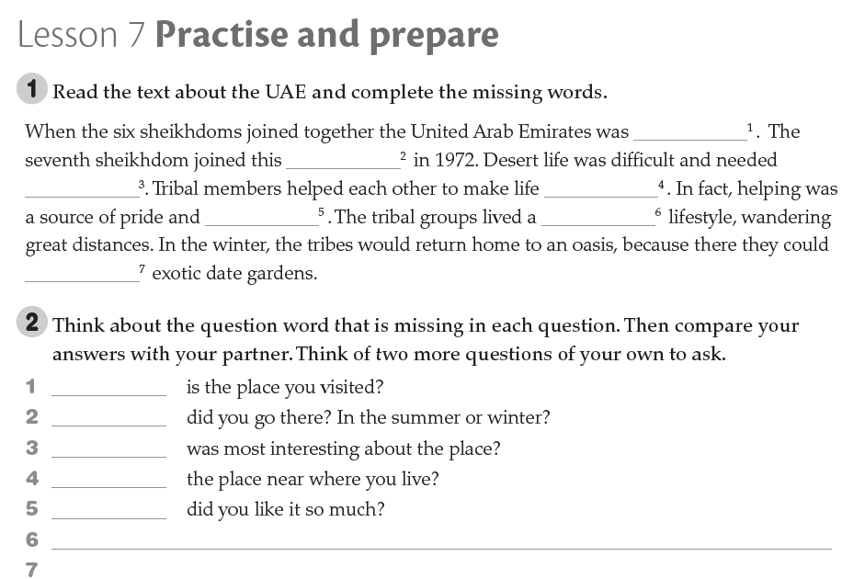
Cancelled
Workbook Unit 3 P. 42

Slide 14
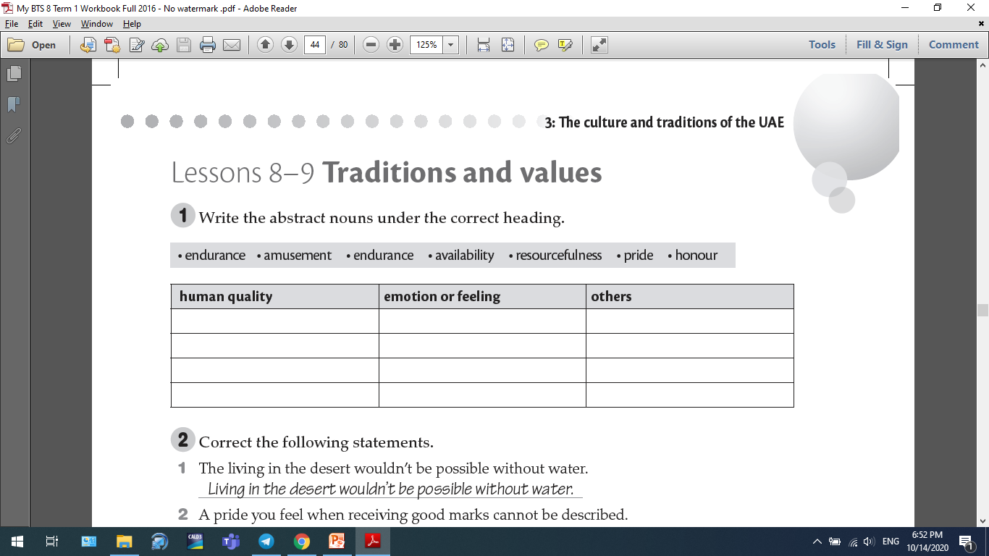
resilience
endurance
amusement
availability
resourcefulness
pride
resilience
honour
Workbook Unit 3 P. 43

Slide 15
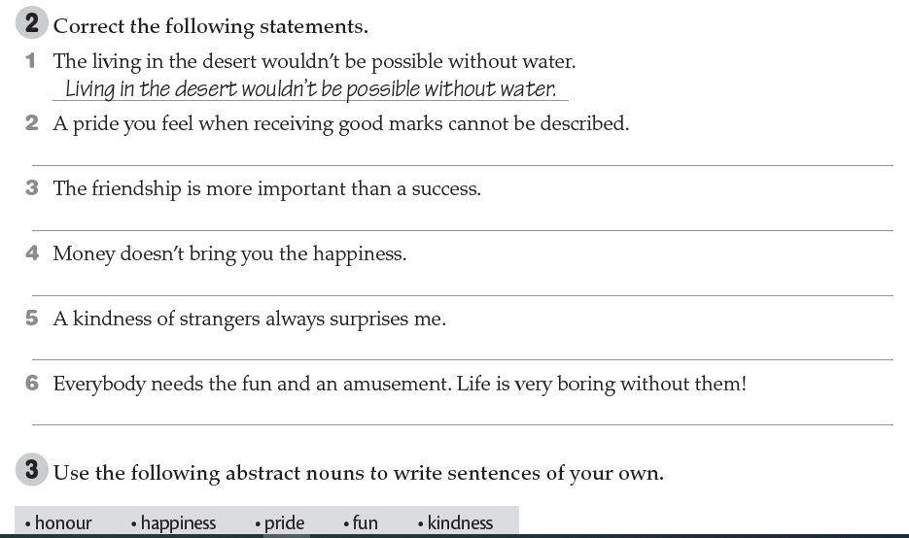
ꭕ
The
ꭕ
ꭕ
ꭕ
ꭕ
The
ꭕ
ꭕ
Workbook Unit 3 P. 43

Slide 16
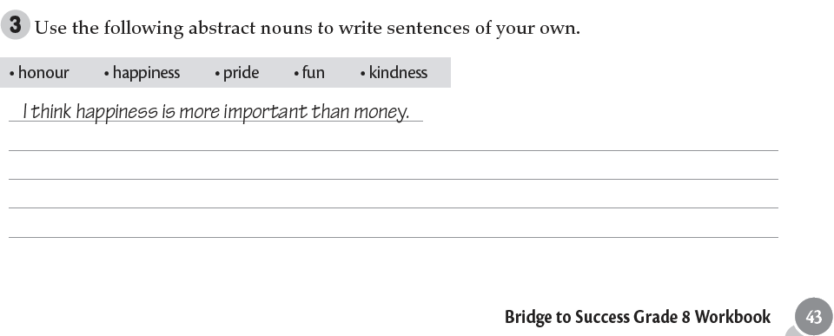
He received a medal of honour at Paris, in 1900.
I would give my life for the happiness of them both.
I know his pride will not let him express his feelings.
We had fun together.
Workbook Unit 3 P. 43

Slide 17
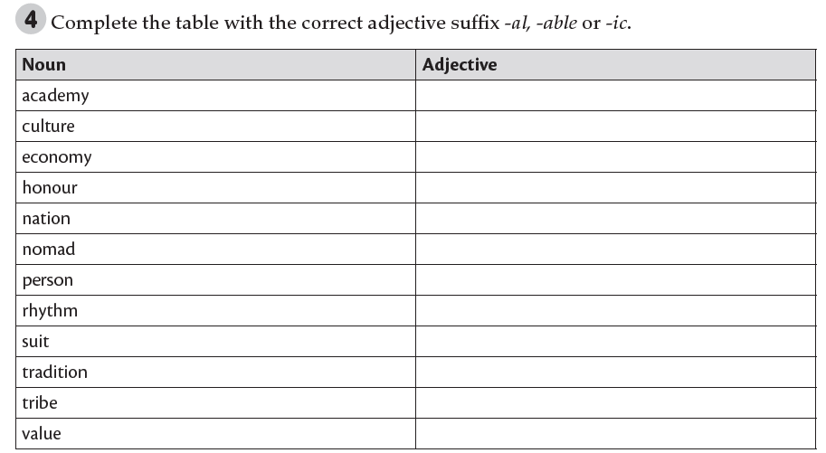
academic
cultural
economic – economical
honourable
national
nomadic
personal
rhythmic
suitable
traditional
tribal
valuable
Workbook Unit 3 P. 44

Slide 18
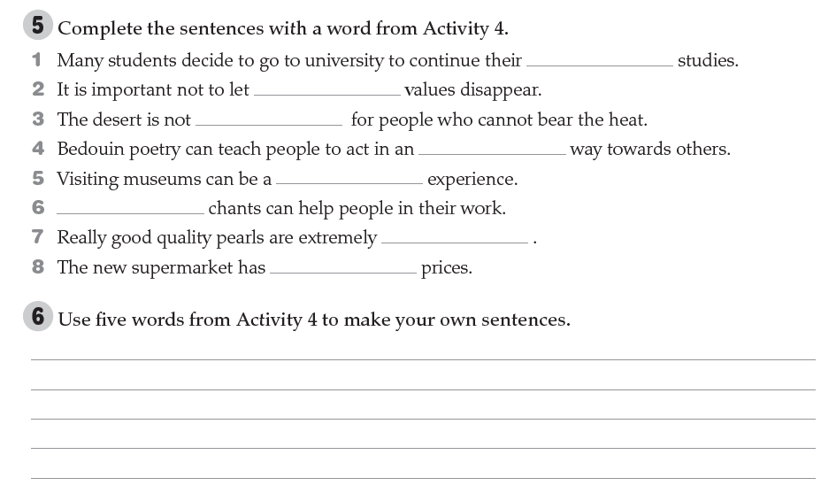
academic
traditional
suitable
honourable
cultural
Rhythmic
valuable
Shopping in the supermarket is very economical.
There are large numbers of private schools, in art, music and academic studies.
Well, the traditional roles of men and women have changed in the last generation.
Then she would have to buy some clothes suitable for climbing in the hills.
They selected the most valuable food items and buried them.
Workbook Unit 3 P. 44

Slide 19
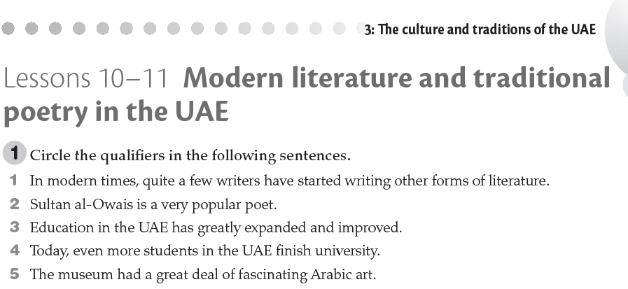
Workbook Unit 3 P. 45

Slide 20
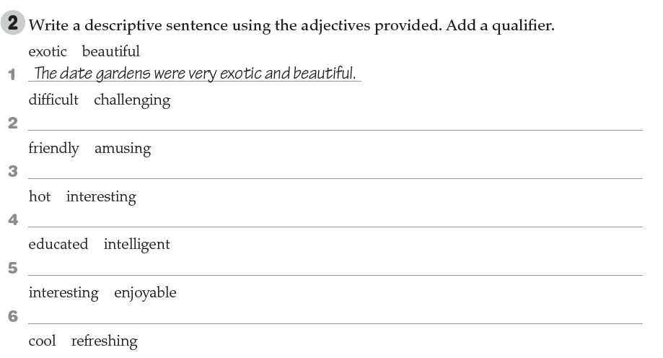
It’s difficult to understand the danger in challenging me.
My neighbours are friendly and amusing.
It was hot. However, we had an interesting time in the park.
My penpal is educated and intelligent.
Leaning English is so interesting and enjoyable.
Drinking apple juice is cool and refreshing.
Workbook Unit 3 P. 45

Slide 21
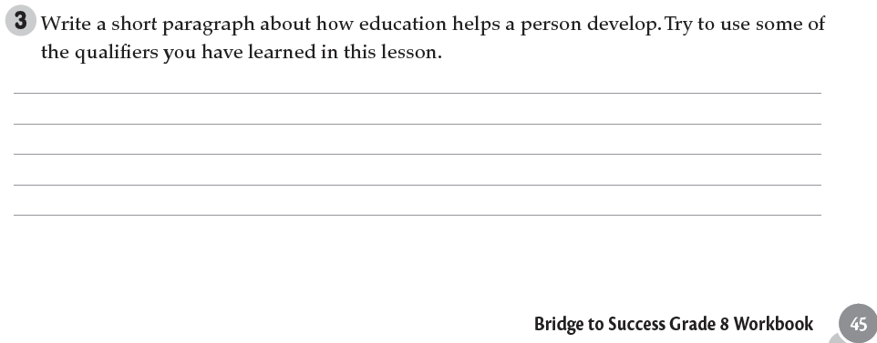
Education is extremely important in our life in order to succeed. If are well-educated, surely, you will be a very successful person. For example, you will probably get a well-paid job. Thus, you can achieve your goals.
Workbook Unit 3 P. 45

Slide 22
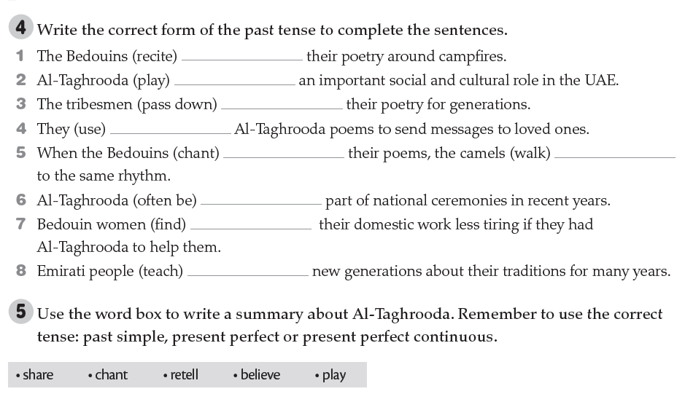
recited
has played
have passed down
used
chanted
walked
has often been
found
taught
Workbook Unit 3 P. 46

Slide 23
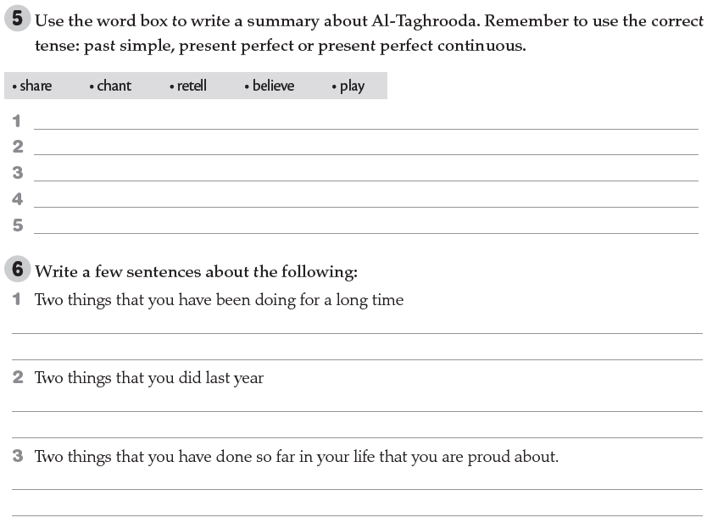
The Bedouins have shared the tradition of chanting poetry for centuries.
The tribesmen chanted the poetry around campfires.
The Bedouins have been re-telling their past history in this way for generations.
The Bedouins believed that chanting poetry made the camels walk in time to the rhythm.
Al-Taghrooda has played an important cultural role in the UAE.
I have been studying online for 7 months.
I have been studying English for 25 minutes.
I visited my cousins in Dubai last year.
I passes all my exams easily last year.
I have visited many countries around the world.
I have attended an English Course in the British Council.
Workbook Unit 3 P. 46

Slide 24
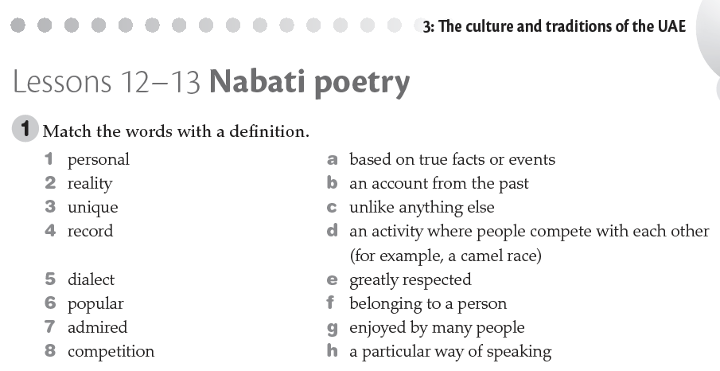
F
A
C
H
G
E
D
Workbook Unit 3 P. 47

Slide 25
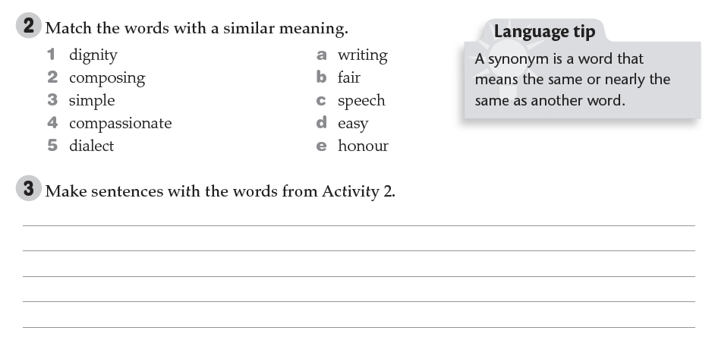
E
A
D
B
C
That speech was full of dignity and greatness.
He was composing a song for his wedding.
Students were given a simple skills test.
The public’s response to the crisis appeal was generous and compassionate.
Workbook Unit 3 P. 47

Slide 26
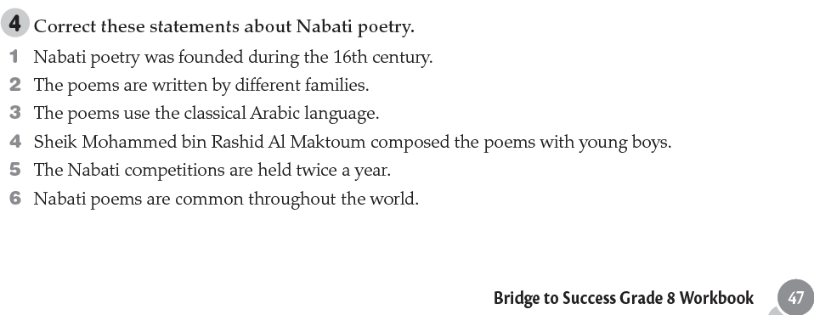
1 Nabati poetry goes back to the 17th century.
16th
2 They are handed down from
generation to generation. 3 They use a dialect different from classical Arabic. 4 The
Sheik began composing as a young boy. 5 The competitions are held once a year.
6 They are unique to the UAE.
Workbook Unit 3 P. 47

Slide 27
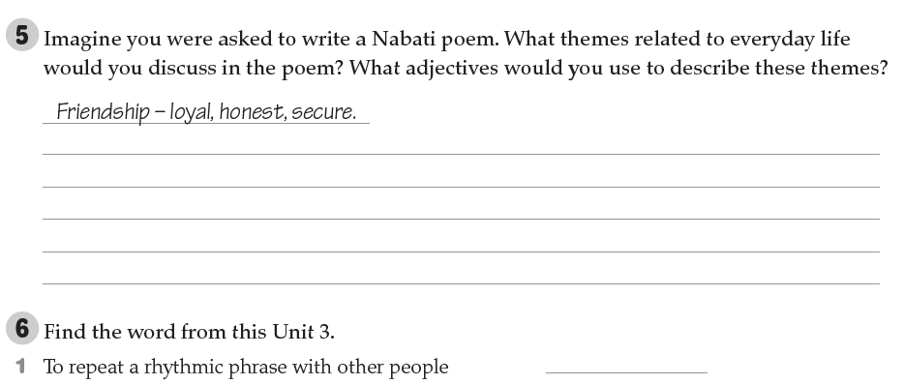
Workbook Unit 3 P. 48

Slide 28
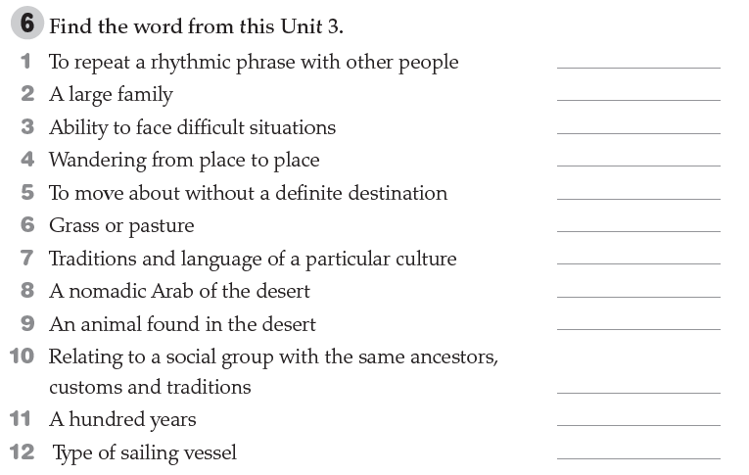
Workbook Unit 3 P. 48

Slide 29
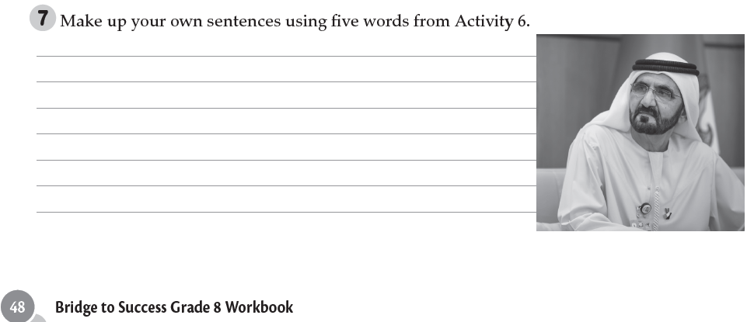
Workbook Unit 3 P. 48

Slide 30
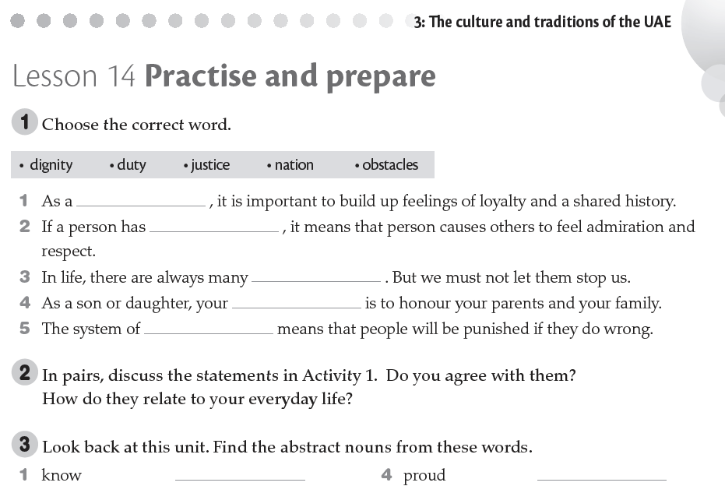
Workbook Unit 3 P. 49

Slide 31
The end of Unit 3
Thanks for watching

