Slide 1
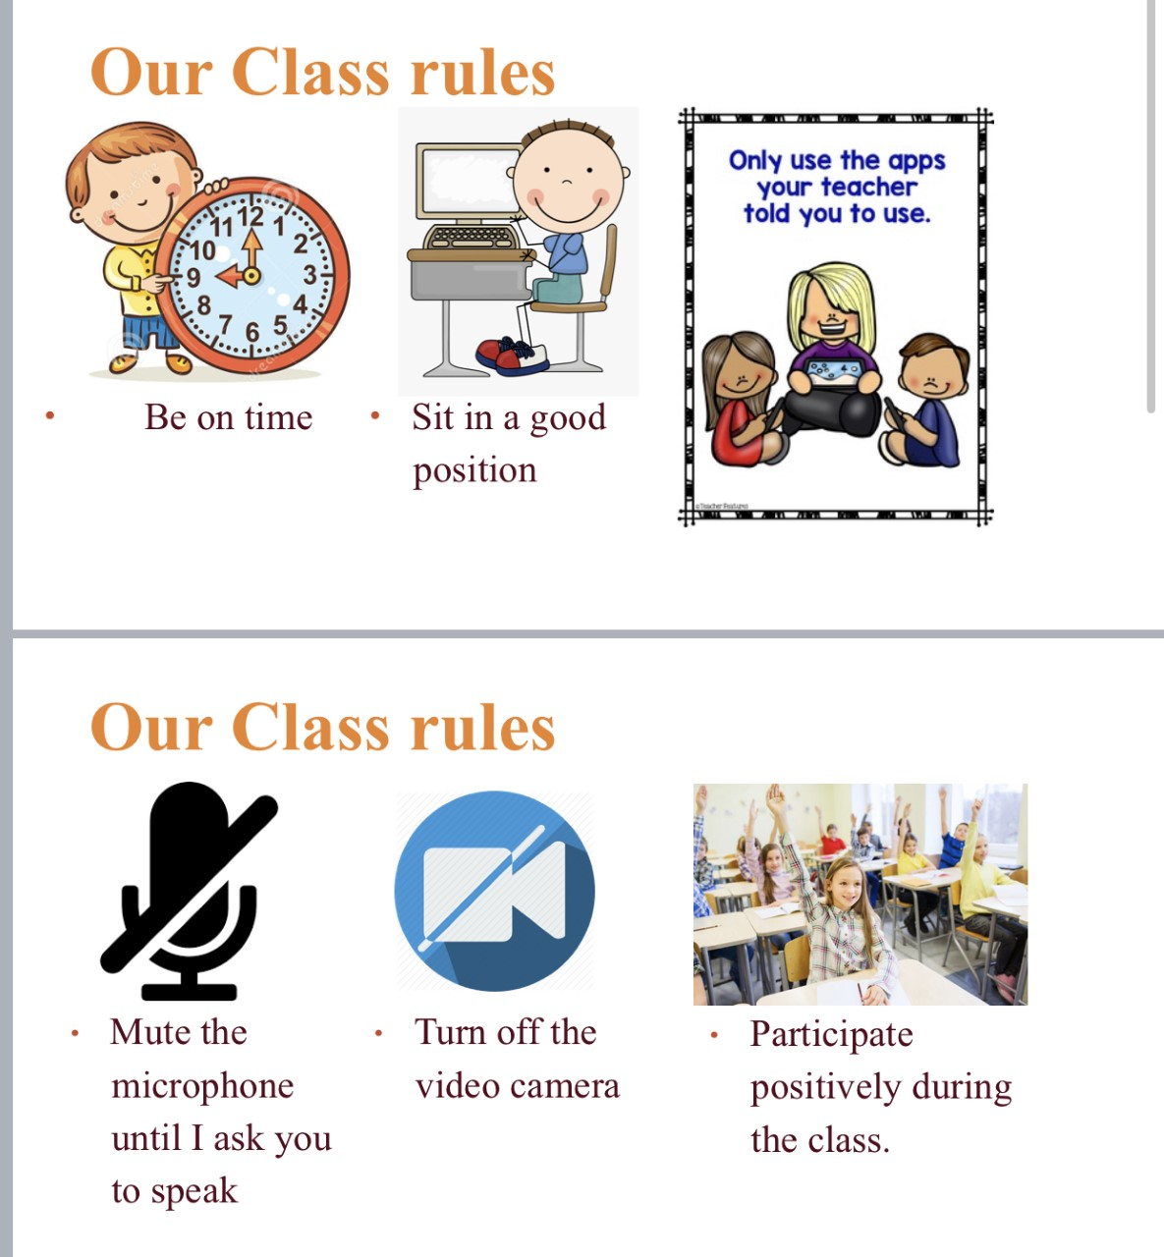
Our online class rules:
1
2
3
4
5
6

Slide 2
Unit 1 Lesson5
Homes

Slide 3
Learning outcomes
Using There is & There are to talk about objects in a place .
Learn the new vocabulary words : room , table , sofa ,chair ,Shelf , toys

Slide 4
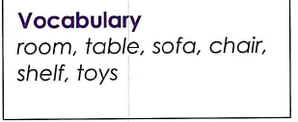
Read and understand the new words
New Vocabulary

Slide 5
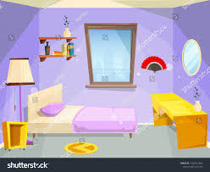
room
This is my bedroom .

Slide 6
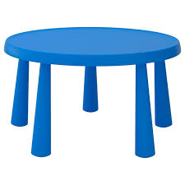
There is a blue table .
table

Slide 7
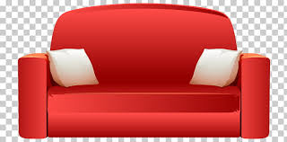
sofa
There is a red sofa in my bedroom .

Slide 8

shelf
There are many books on the shelf .

Slide 9
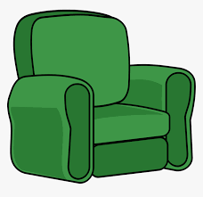
chair
There is an armchair in the living room .

Slide 10

toys
There are some toys on the floor.

Slide 11


https://www.youtube.com/watch?v=ffRjdYA5yCM

Slide 12
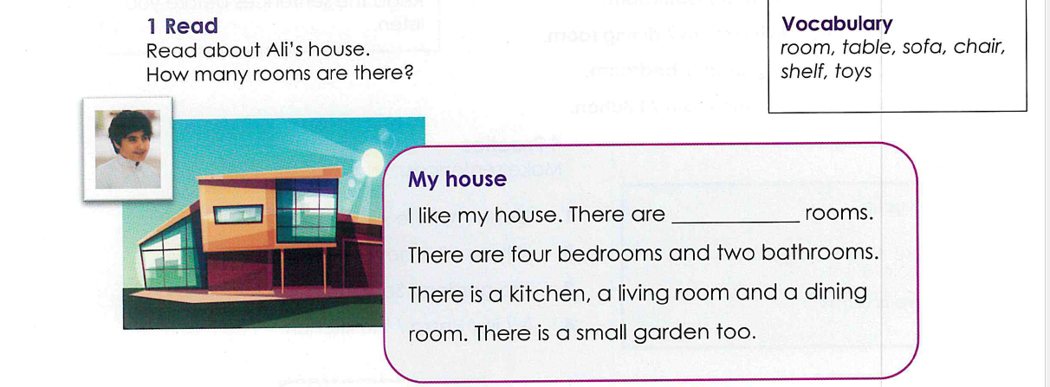
Activity 1, page 9
nine

Slide 13
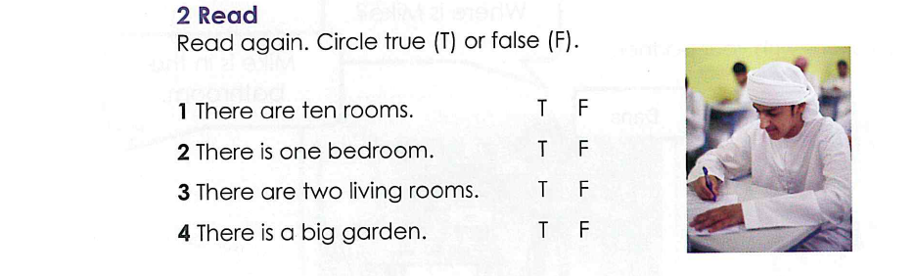
Activity 2 , page 9

Slide 14
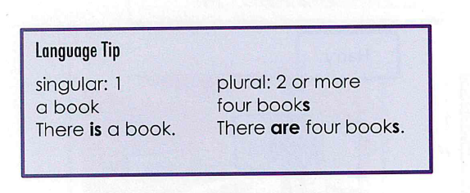
Read the language tip carefully and watch the video to understand more :

Slide 15


Slide 16
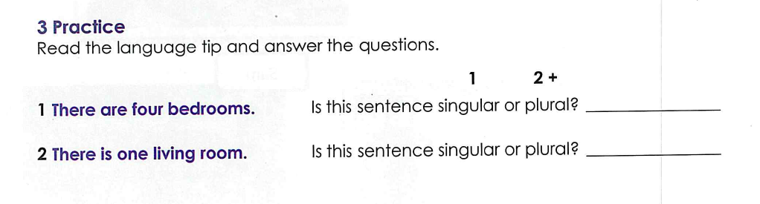
Write singular or plural in the space :
Activity 3 , page 9
plural
singular

Slide 17
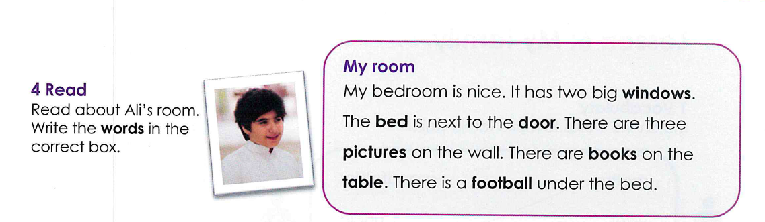
Activity 4 , page 10

Slide 18
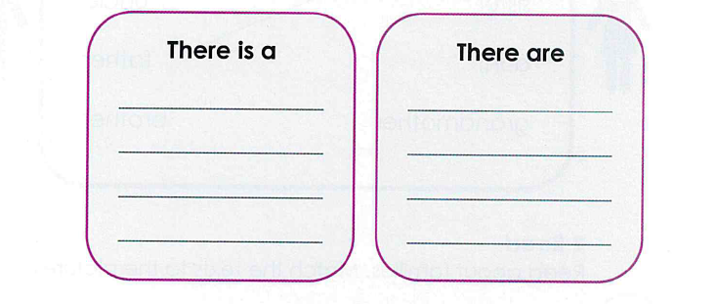
bed
windows
door
pictures
table
books
football

Slide 19
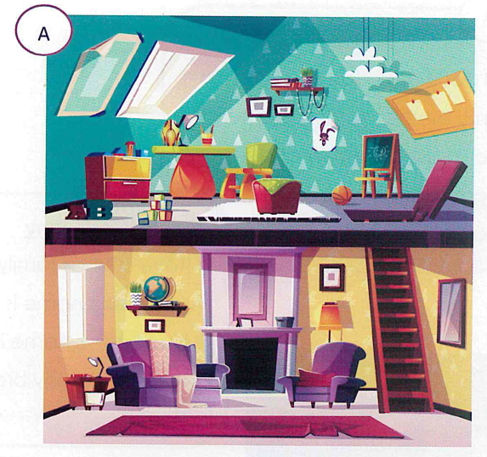
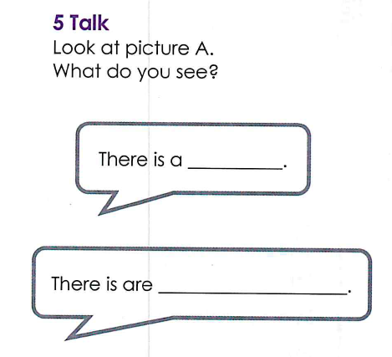
Activity 5 , page 10

Slide 20
Activity 5 , page 10
There is a stand board .
There are some blocks on the ground .
There is a sofa .
There are two pictures on the wall .
There is a ball on the floor .
There are two windows upstairs .
There is a shelf on the wall .

Slide 21
Click on the link to do the interactive worksheet
Time to practice
https://www.liveworksheets.com/worksheets/en/English_as_a_Second_Language_(ESL)/There_is_-_there_are/House_and_Furniture_rb754812ld
https://www.liveworksheets.com/worksheets/en/English_as_a_Second_Language_(ESL)/There_is_-_there_are/there_is_there_are_yy3060yh
https://www.liveworksheets.com/worksheets/en/English_as_a_Second_Language_(ESL)/There_is_-_there_are/There_is-are_gm725626rt

Slide 22
Click on the link to play
https://wordwall.net/resource/606266/there-there
https://wordwall.net/resource/1535515/super-minds-1/there-there
https://wordwall.net/resource/403390/inglese/house-rooms-furniture

Slide 23

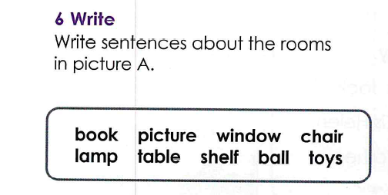
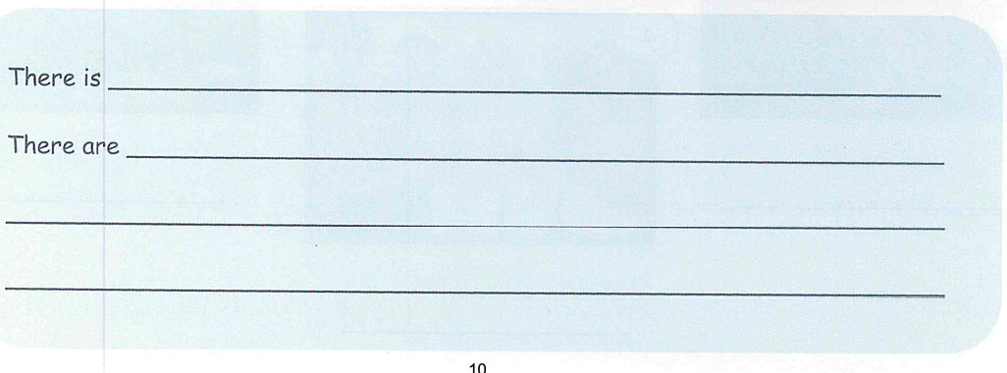
Activity 5 , page 10
a picture on the wall .
some toys on the floor .
There is a ball on the ground .
There are two windows .

