Slide 1
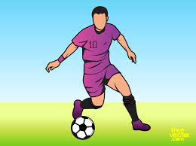
Grade 7 Unit 1
Lesson 3
Language focus: Present simple
I play football everyday.

Slide 2
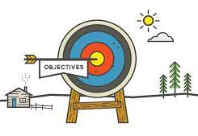
Lesson objectives
to write sentences in the present simple tense

Slide 3
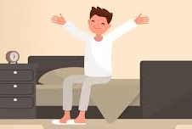

I get up at 5:30 everyday.
She has black hair.
We use the present simple to talk about things we do everyday, and things that are true.
The Present Simple Tense

Slide 4
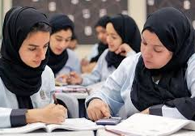
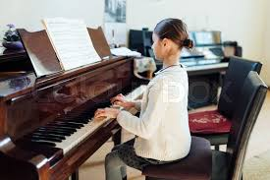
We have English class 6 times a week
She plays the piano
Present simple verbs change with the subject:
I/ you/ we/ they play
he/ she/ it plays
have
has

Slide 5
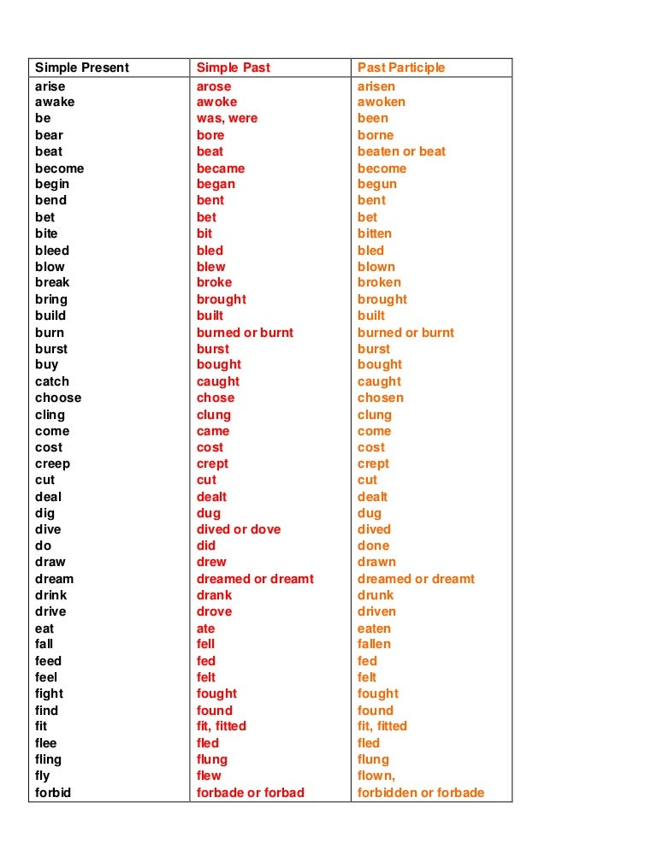
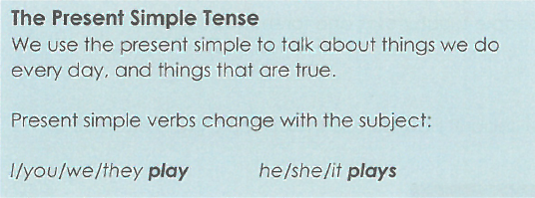

Slide 6

https://quizlet.com/_bvxr4s?x=1qqt&i=2mwdtw

Slide 7
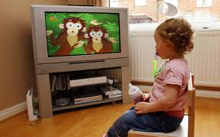
to watch

Slide 8
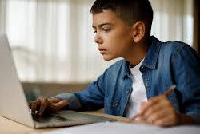
Student

Slide 9
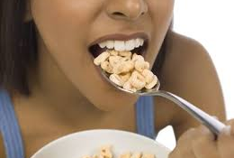
to eat

Slide 10

to go

Slide 11
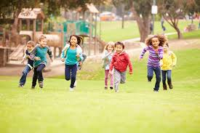
to play

Slide 12
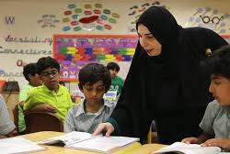
to study

Slide 13

school

Slide 14
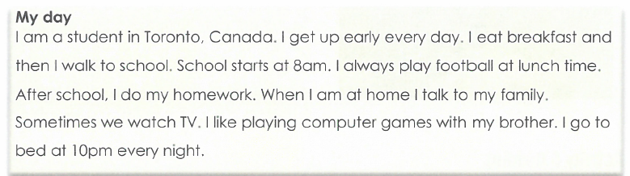

Slide 15
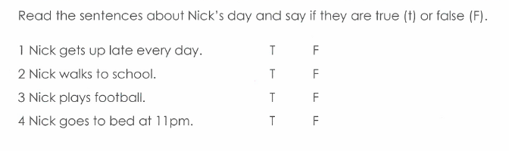

Slide 16
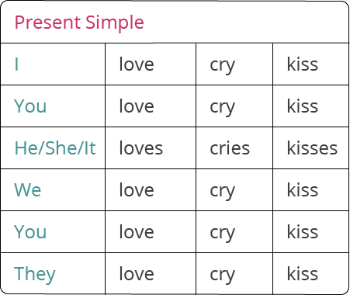
eat
eat
eat
eats
eat
eat
eat

Slide 17
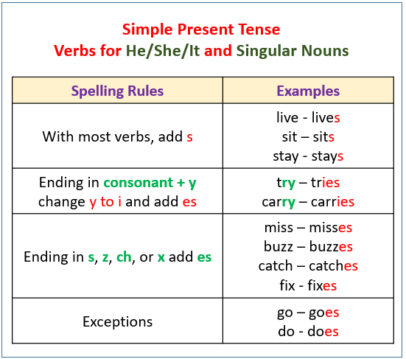
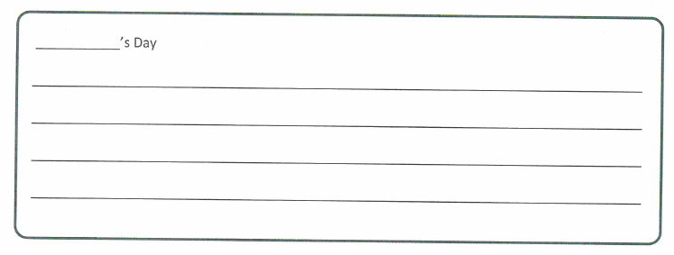
Write sentences about your partner.
Use examples on page 6 to help you.
Fatima goes to school.
Activity 5
study - studies
She studies English.
She goes to bed at 9:00pm.
She eats sushi.

Slide 18
Activity 3 Practice
get up play eat
study go to bed
Activity 3 Practice
.
What do you do everyday?
Write sentences below.
Use the verbs in the box to help you.
I get up at 5:30am.
I talk to my friends everyday.
I do my homework everyday.

Slide 19
Let’s practice!
I go to school and do my homework.
What do you do everyday?
I eat breakfast at 6:30am.

Slide 20


