Slide 1


Level 2.2
Writing Programme
Task 2

Slide 2
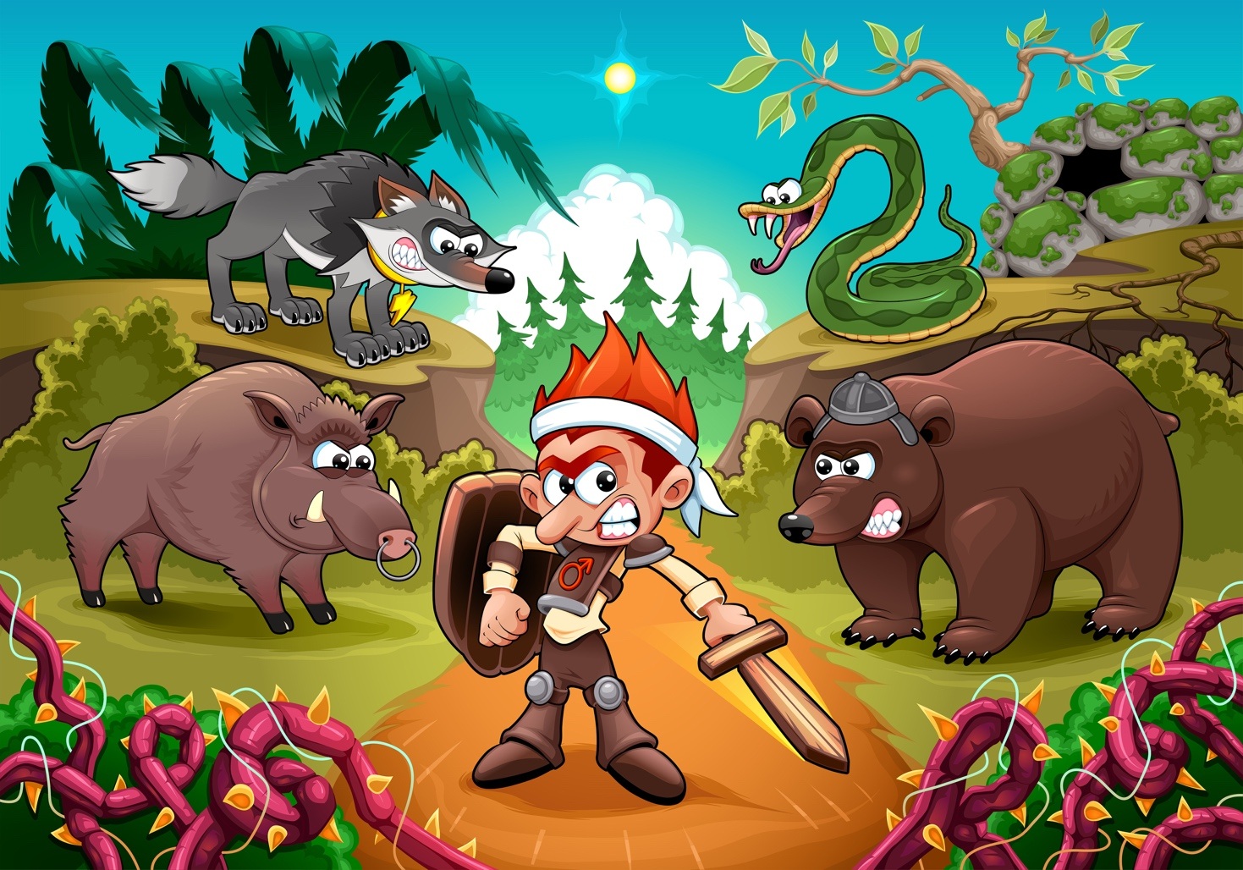

Activity 1 Discussion
Use the words to talk about the pictures.
enormous angry kind strong
quiet scary friendly helpful

Slide 3
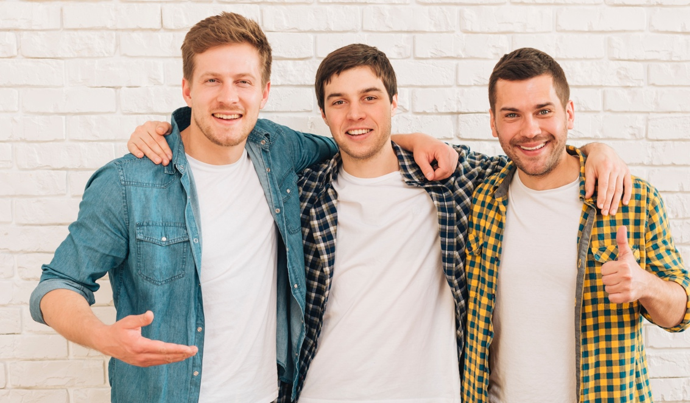

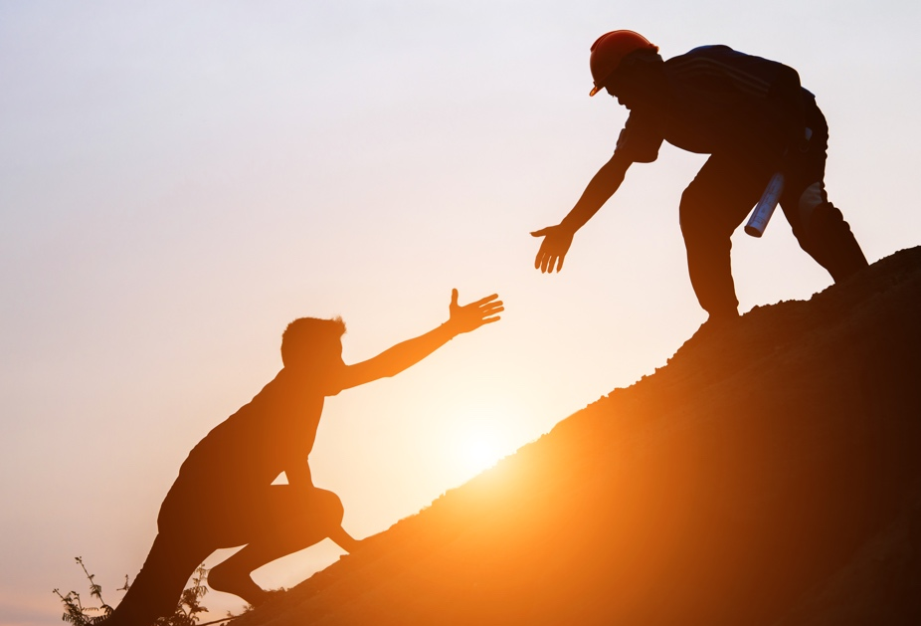
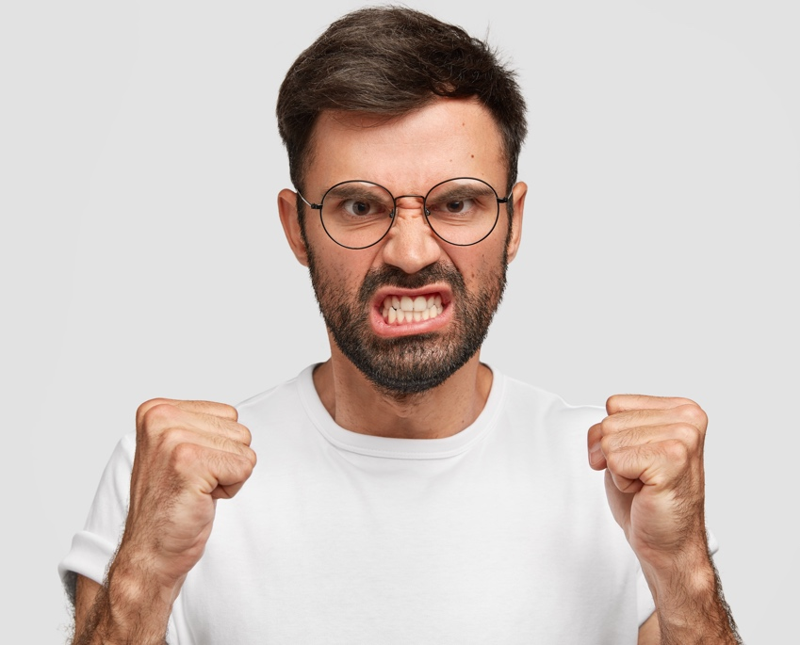
Activity 2 Describing People
Answer the questions by describing the pictures.
We use different phrases to describe people.
What is he/she like? He/she is_______. He/she has_____.
1. What are the boys like?
3. What is your sister like?
2. What is your friend like?
4. What is your teacher like?
To learn more about describing people, click here.

Slide 4
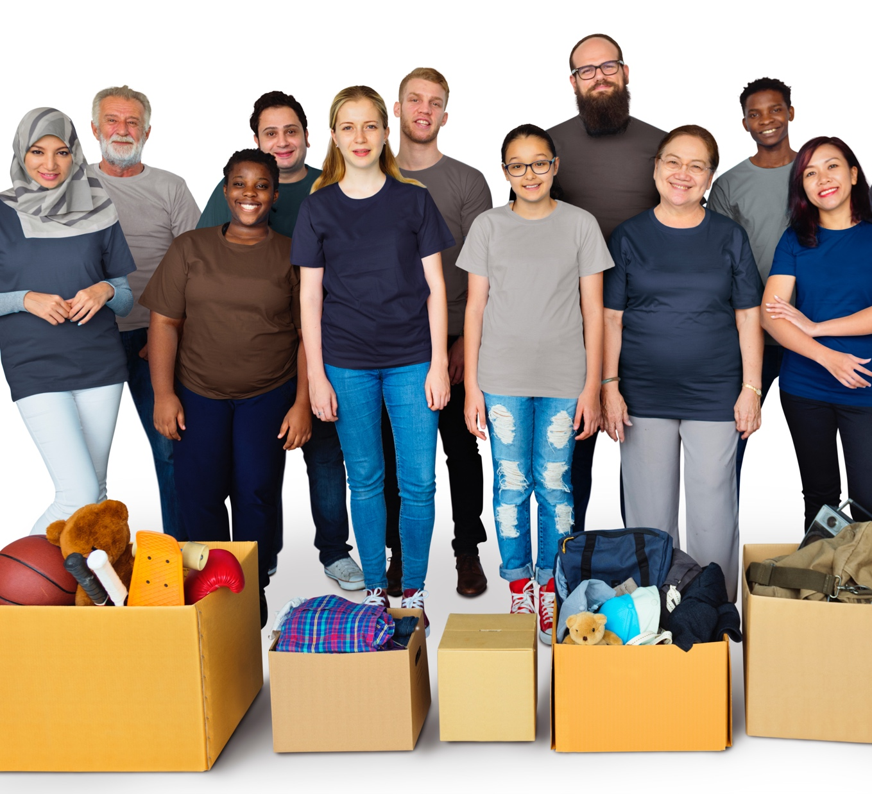
Activity 3 Interesting Phrases
Choose interesting phrases to describe the pictures.
1. My friends give charity to people in need. They _______
a. are very kind and helpful.
b. are good.

Slide 5
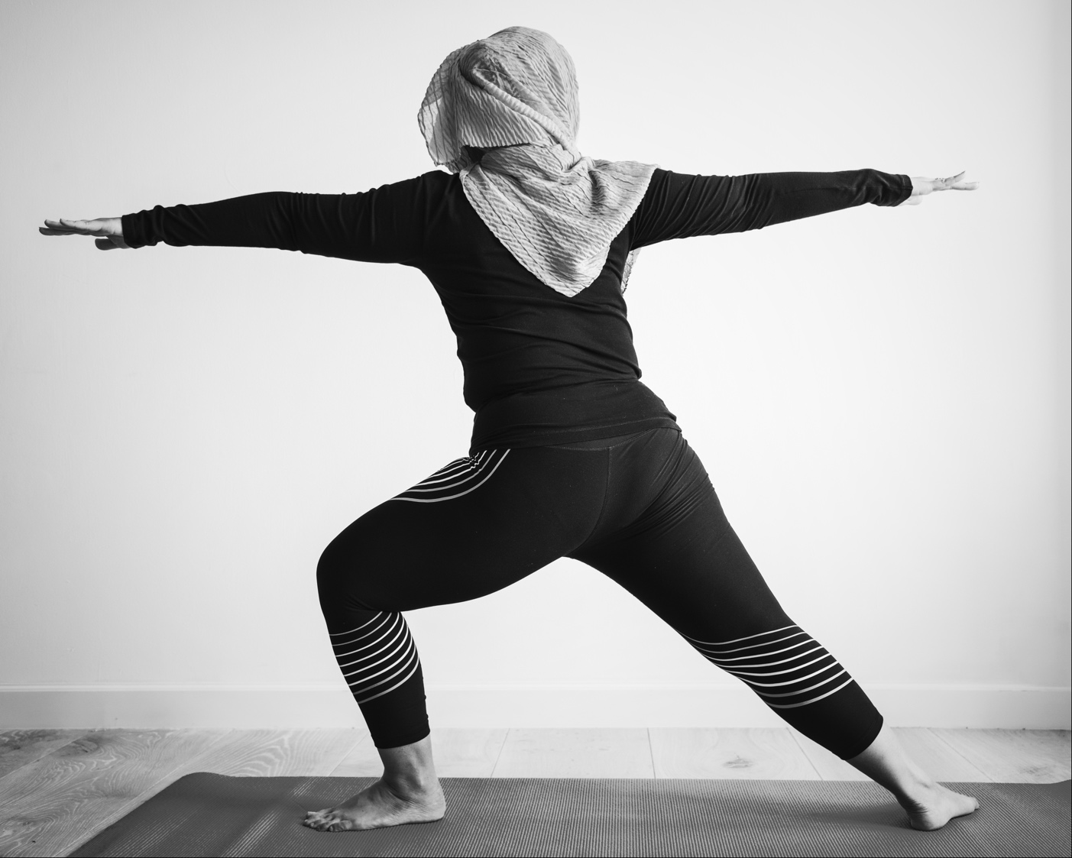
Activity 3 Interesting Phrases
Choose interesting phrases to describe the pictures.
2. My mum likes to do yoga. It _______
a. makes her feel strong and peaceful.
b. makes her feel good.

Slide 6
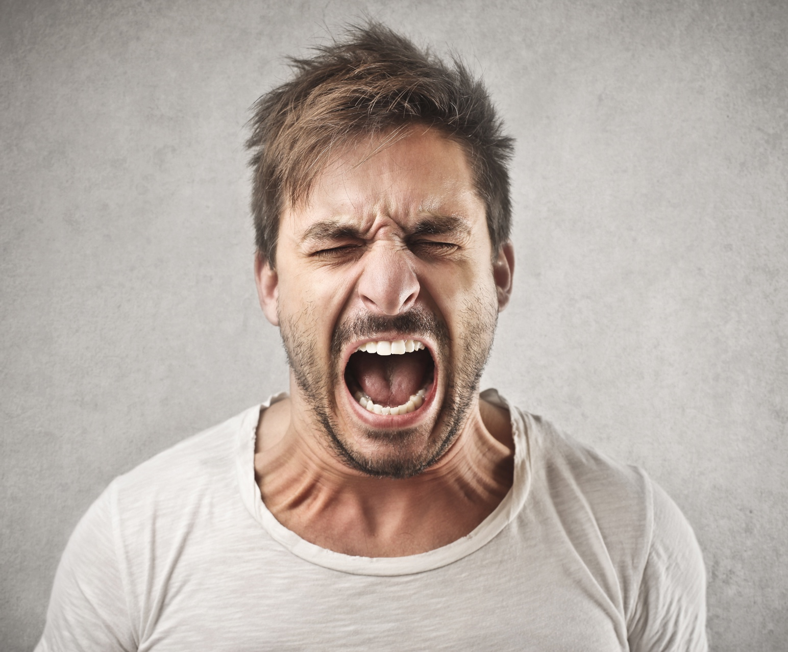
Activity 3 Interesting Phrases
Choose interesting phrases to describe the pictures.
3. My uncle gets angry sometimes. He _______
a. is enormous.
b. can be scary when he is angry.

Slide 7
Activity 4 Character Profiles
Fill in the boxes to describe your character.
Name:
Age:
What is he/she like?
Picture:
Hobbies:
Friends:

Slide 8

Activity 5 Write a Paragraph
Using the character profile in Activity 4, write a short paragraph about your character.
What’s your character’s name?
How old is he/she?
What is he/she like?
What does he/she like?

