Slide 1
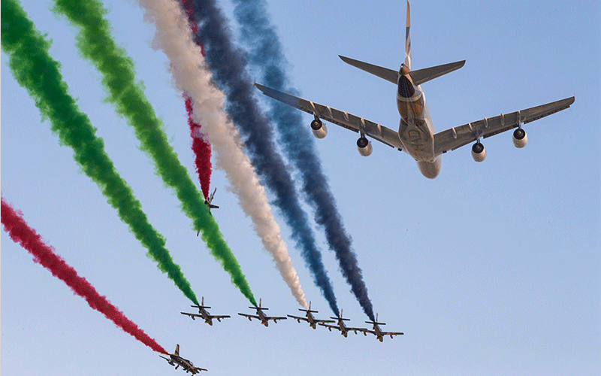

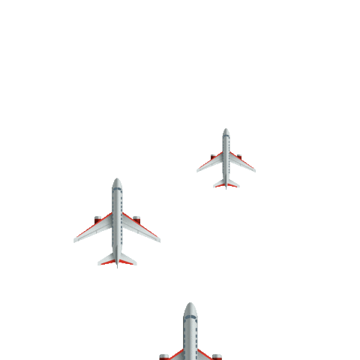






grade
Unit
Lesson :
5
8 Access
Class
8/1- 8/2
4
Day----
Date----

Slide 2
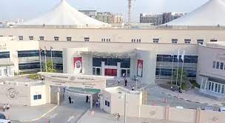
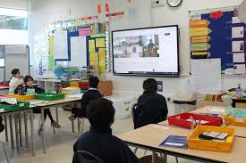
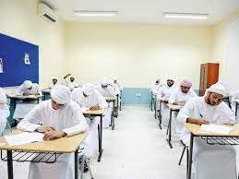
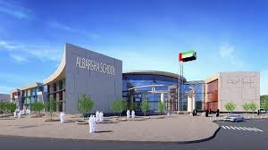
Unit 4 : Buildings and structures
Lesson 5: A New School
P: 69 &70

Slide 3


Discussion
Is it a modern or a traditional building?
What is your school like?
SPIN
Do the classrooms have nature light?
Is there enough space in and around the school?
Is there an area for sport?
tekhnologic
Notes:
Click to spin wheel. Call on one student at a time to answer. OR click to spin wheel and have all students write their answers in the chat.

Slide 4

New Vocabulary

Slide 5
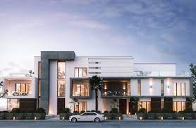
modern

Slide 6
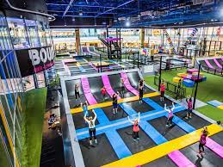
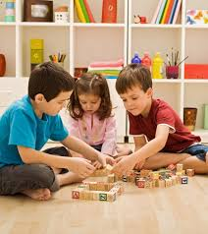
indoor

Slide 7
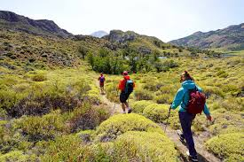
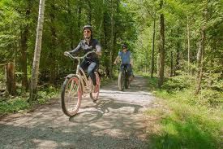
outdoor

Slide 8
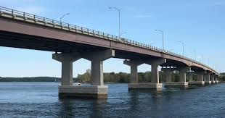
bridge

Slide 9

space

Slide 10
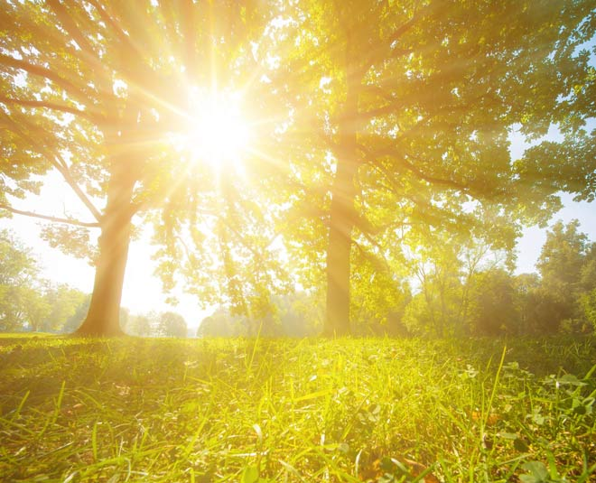
natural light

Slide 11
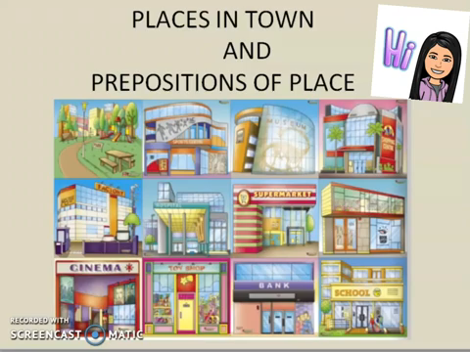

Slide 13
bridge
outdoor
farm
parking
cycle

Slide 14


https://www.liveworksheets.com/worksheets/en/English_as_a_Second_Language_(ESL)/School_rooms_and_places/Rooms_in_a_school_building_rz1385688rk
https://quizizz.com/join?gc=551155

Slide 15
Two floors
Trees
When the weather is nice
Chickens and goats
Teachers and parents

Slide 16
My school building has two floors. All classrooms are on the first floor. You can see the playing area from the windows. Students can go to other classrooms through a long hallway that connects between the school rooms and admin offices. There is a gym where students play football, badminton, gymnastics, and volleyball. Also, there is a large parking where teachers and parents can park their cars in front of the school building.

Slide 17
Describe your school in short words?

