Slide 1
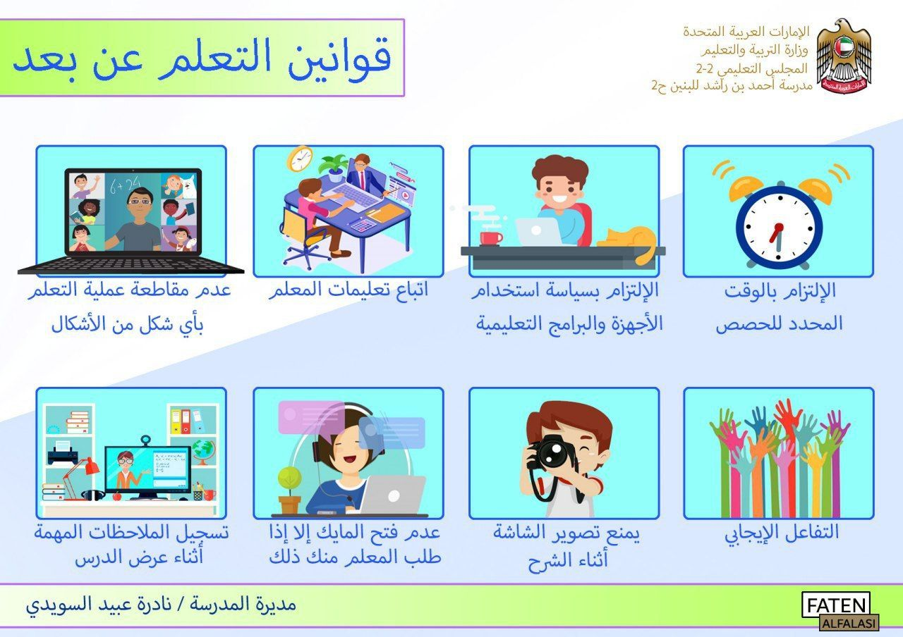

Online Learning Rules
Follow the teacher’s instructions.
Follow the MOE rules
Be punctual.
Do not interrupt the lesson.
Write down the important notes.
Switch on your camera
Do not take photos.
Interact positively.
CLICK HERE
English Teacher: Ms. Olivia

Slide 2


Good Morning!

Slide 3
GROUPS

Slide 5
Unit 7
Lesson 3

Slide 6
Language Focus

Slide 7
Objectives
Past simple “I played”
What we do at home
Listen and respond to a text

Slide 8
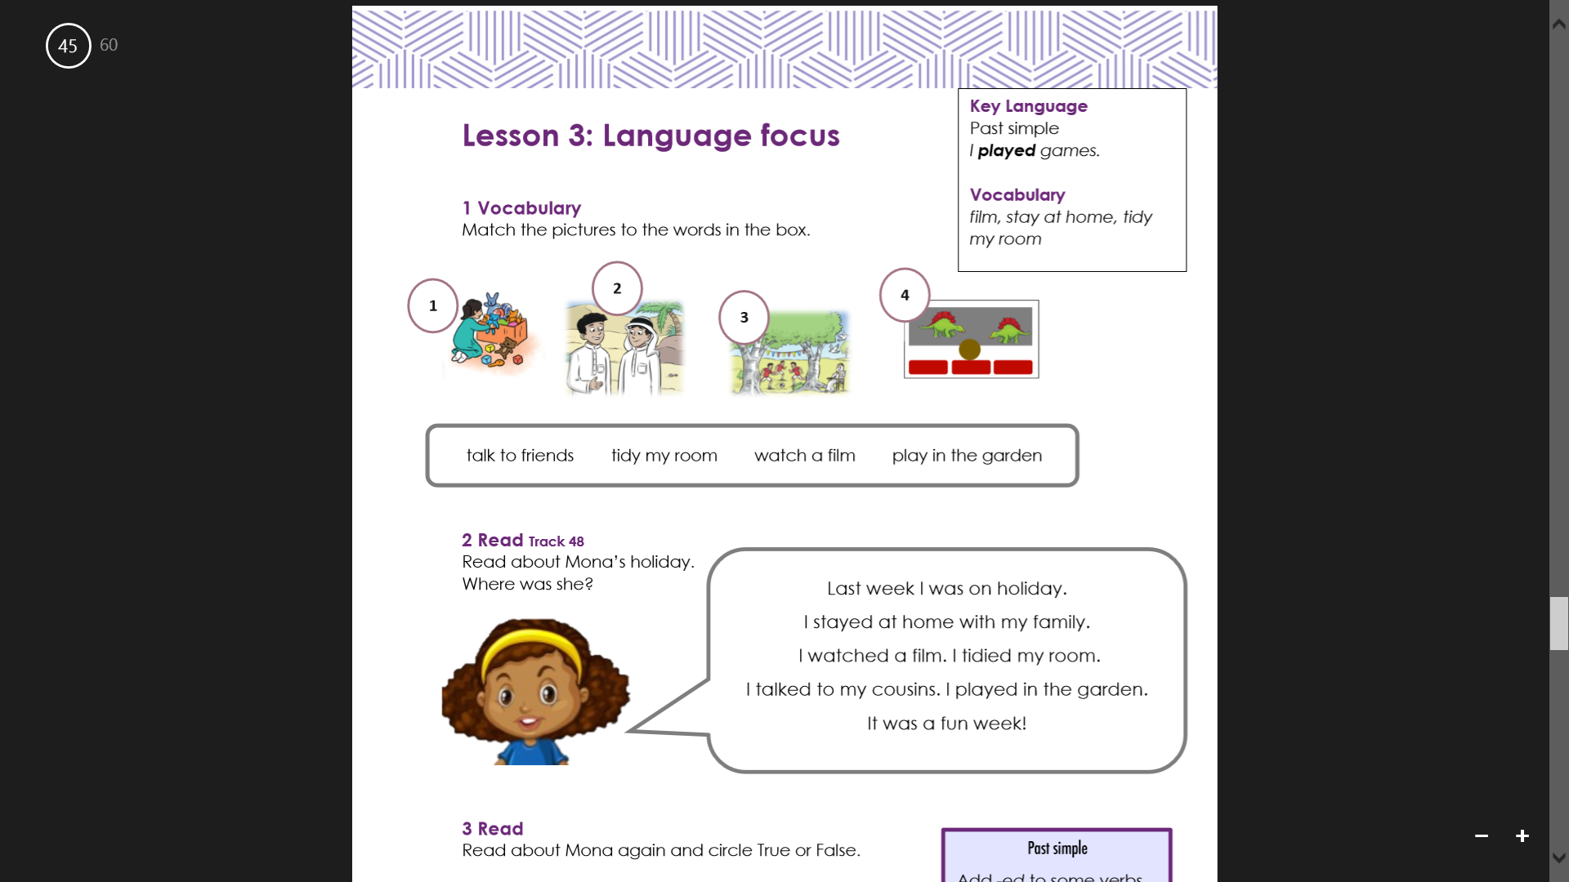

Slide 9

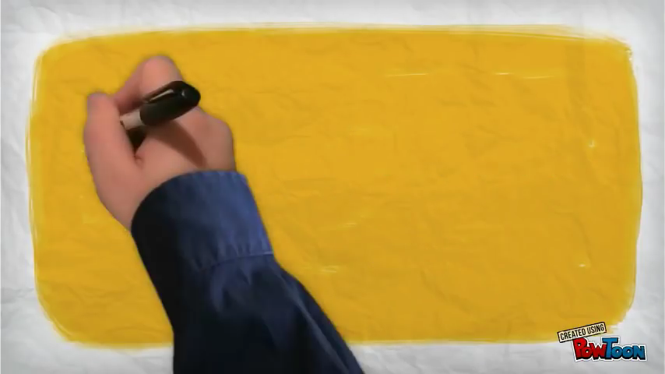

Slide 10

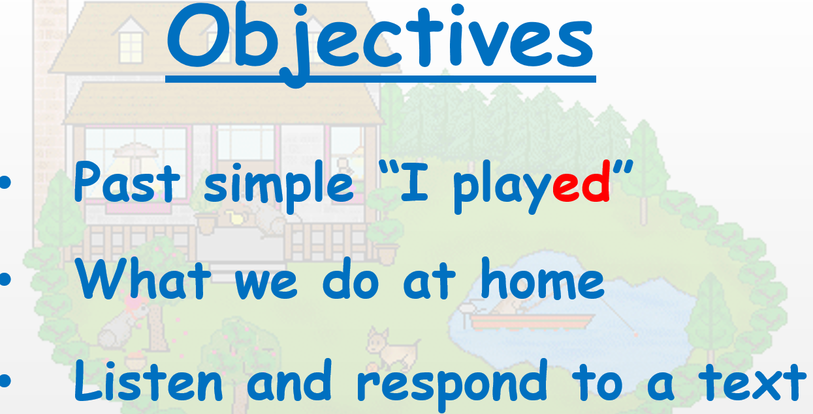
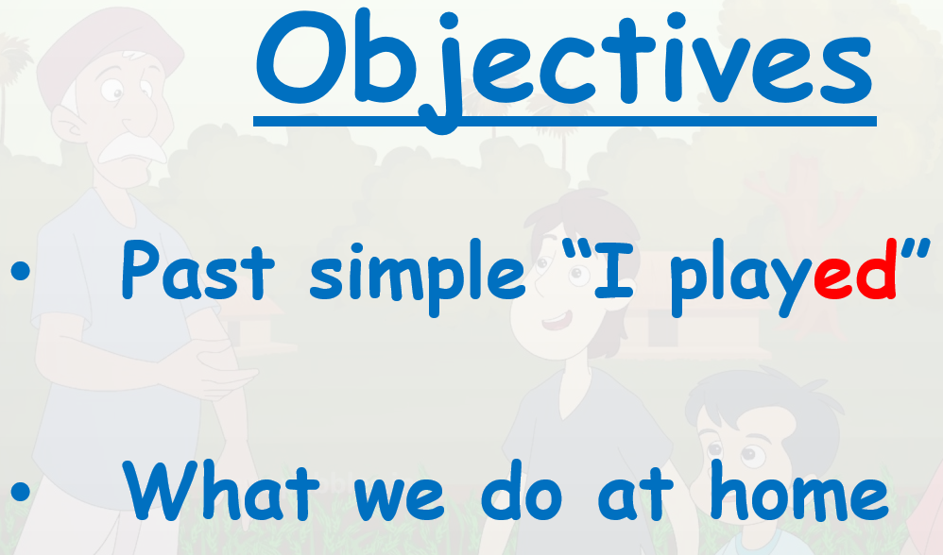
ACCESS
P45/46
End
1
2
3
4
5
6
7
8
9
10
11
12
13
14
15
16
17
18
19
20
21
22
23
24
25
26
27
28
29
30

Slide 11
Vocabulary
PURPLE
RED
SPIN
ORANGE
BLUE
GREEN
YELLOW
2
1
4
3

Slide 12
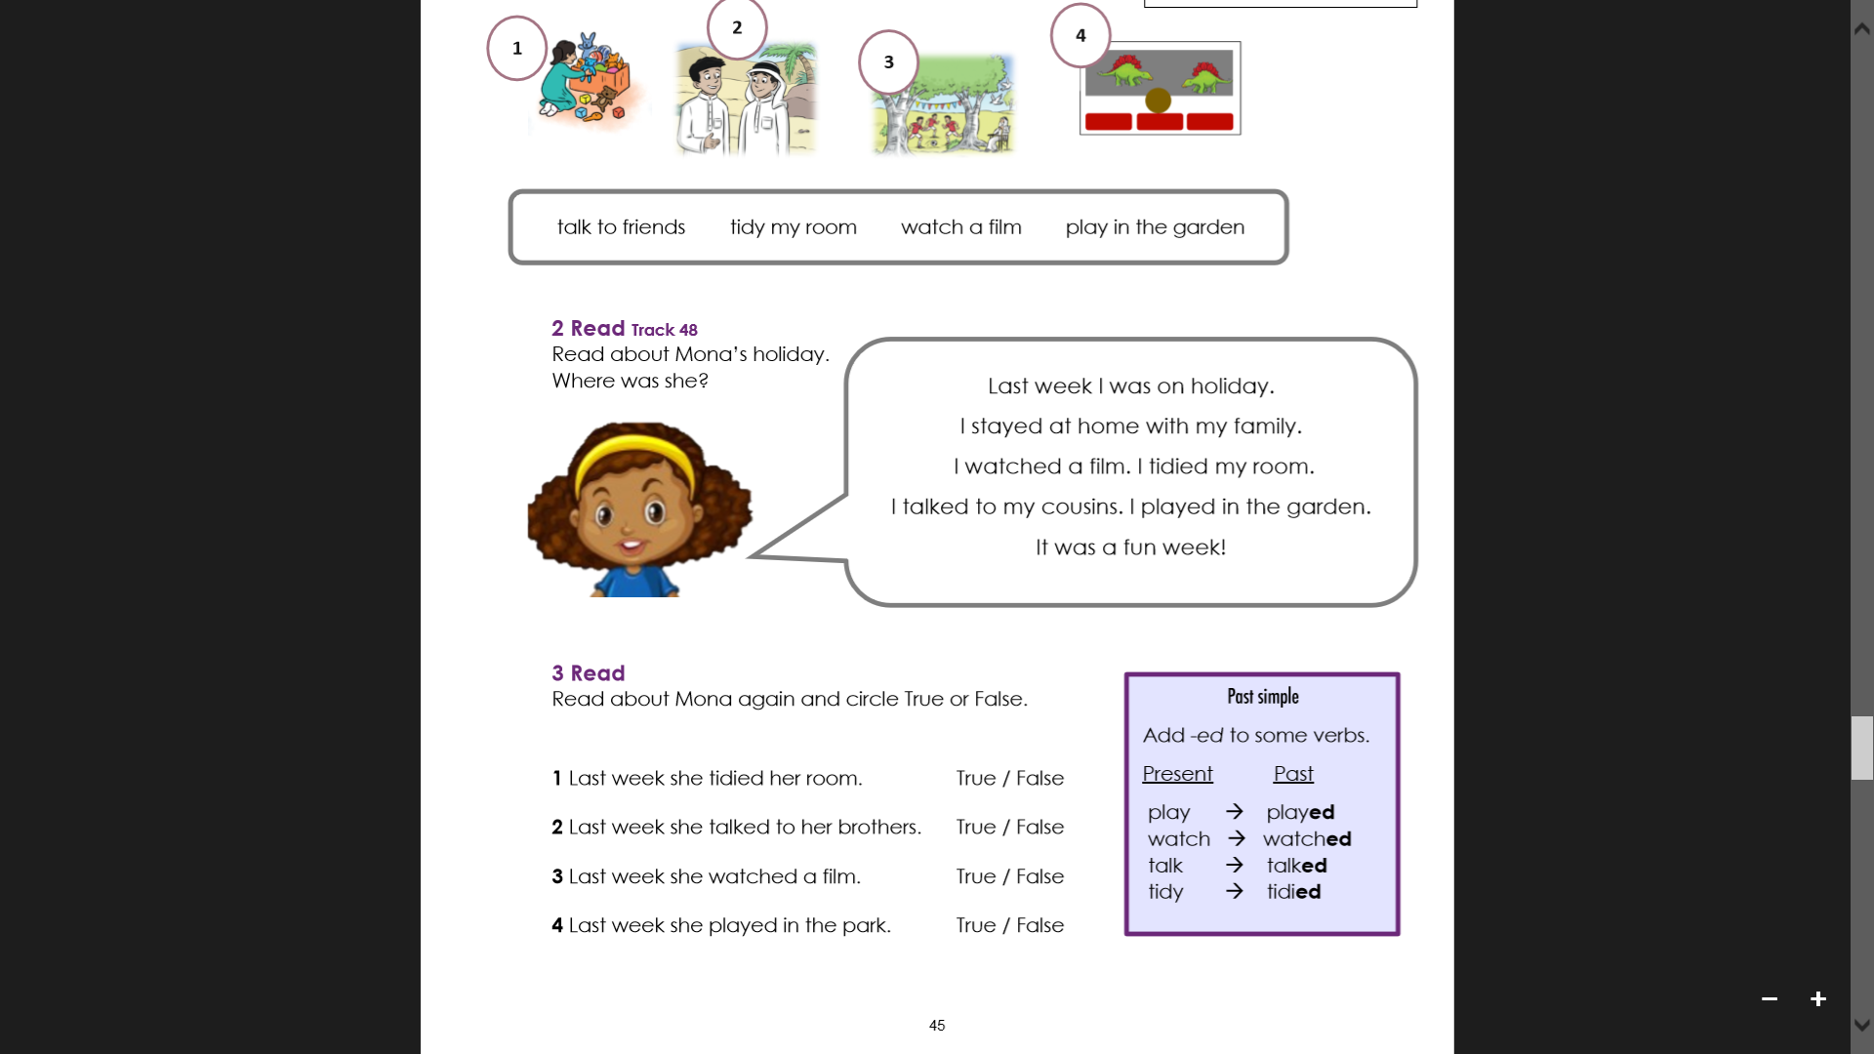
PURPLE
RED
SPIN
ORANGE
BLUE
GREEN
YELLOW

Slide 13
PURPLE
RED
SPIN
ORANGE
BLUE
GREEN
YELLOW

Slide 15
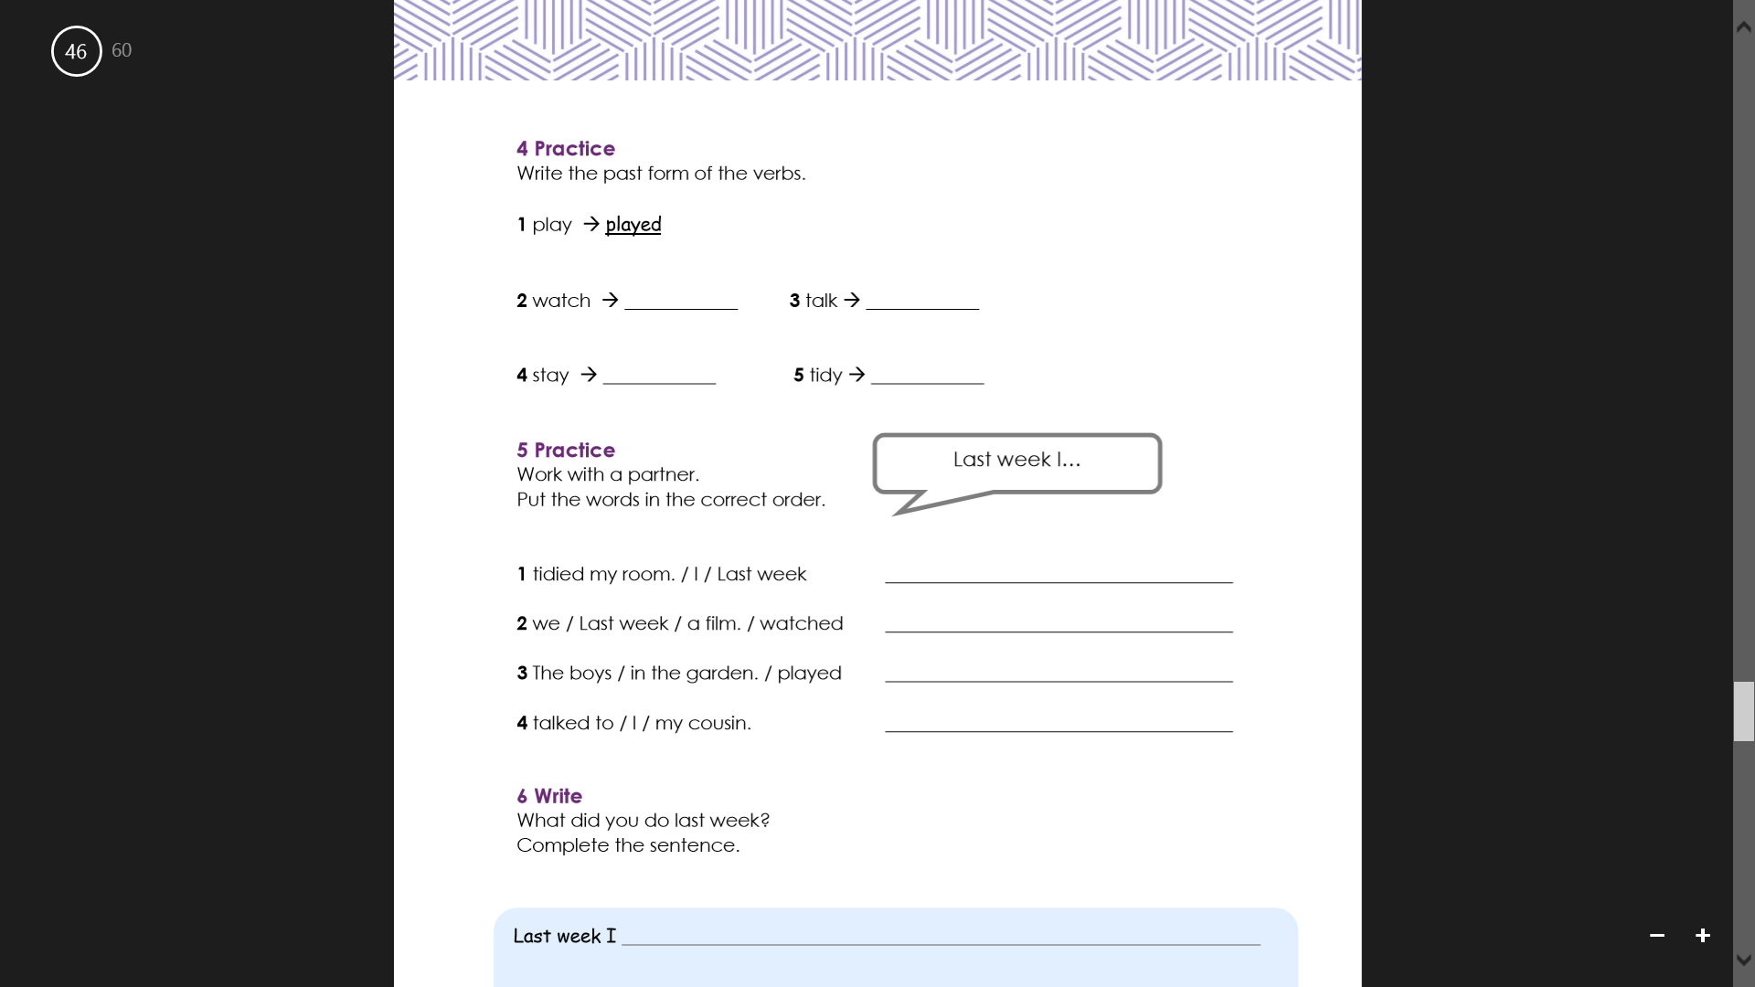
PURPLE
RED
SPIN
ORANGE
BLUE
GREEN
YELLOW
watched
talked
stayed
tidied

Slide 16
PURPLE
RED
SPIN
ORANGE
BLUE
GREEN
YELLOW
I
tidied my room.
Last week
watched
we
a film.
Last week
played
The boys
in the garden.
talked
I
to my cousin.

Slide 17
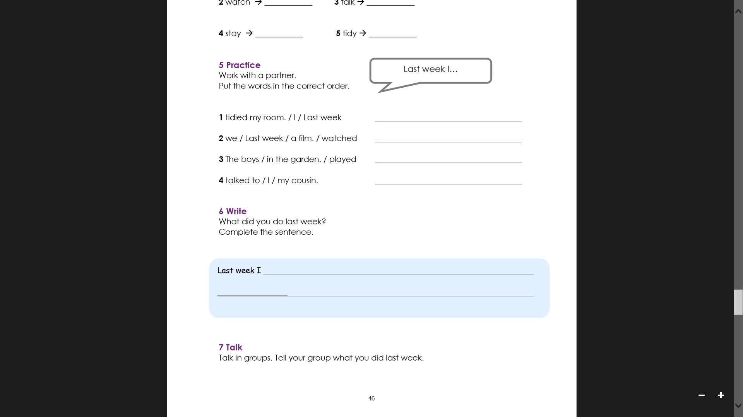
class.
class
PURPLE
RED
SPIN
BLUE
ORANGE
GREEN
YELLOW

Slide 18
PURPLE
RED
SPIN
BLUE
ORANGE
GREEN
YELLOW

Slide 19
attendance

Slide 20
ALEF

Slide 21


8
6
8
6
Red
0
easy
Yellow
0
EASY https://www.liveworksheets.com/yb692981kt
MEDIUM https://www.liveworksheets.com/fv1415177et
https://www.liveworksheets.com/as1224654mc
HARD https://www.liveworksheets.com/zl1256748pt
Green
0
everyone
Blue
0
Purple
0
hard
Orange
0
Post in the TEAMS chat board

Slide 22

https://quizizz.com/admin/quiz/start_new/6006dcd71aed1a001dd65862
or
https://quizizz.com/admin/quiz/6006dcd71aed1a001dd65862

Slide 23
homework
finish p45/46

Slide 24
homework
ALEF

Slide 25




Evaluate your learning for today in the chat:
Self Evaluation
Type a if you are confused.
Type a if you are getting there.
Type a if you got it!

Slide 26
Plenary: Exit Slip
Please write your answers in the chat.
What did you do last holiday?

