Slide 1
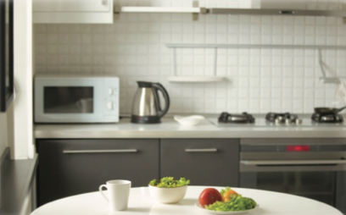
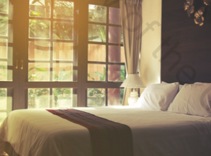
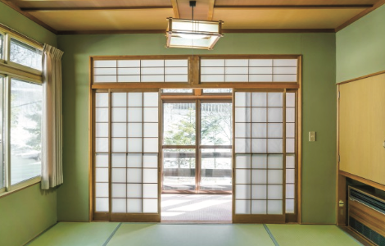
Unit 5
Around the house

Slide 2
Unit 5: Lessons 1-2
Around the house
1 In the kitchen
2 In my room

Slide 3

Unit 5: Lessons 1-4
Around the house
Listen for specific information.
Read for specific information.
Speak using familiar words and sentences.
Use basic language structures in writing.
To use the possessive (’s).
To use present simple vs. present continuous verbs.

Slide 4
Unit 5: Lesson 1
In the kitchen

Slide 5
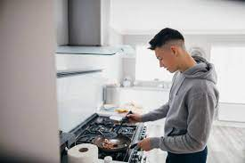
Can you cook? What is your favorite food to cook?

Slide 6
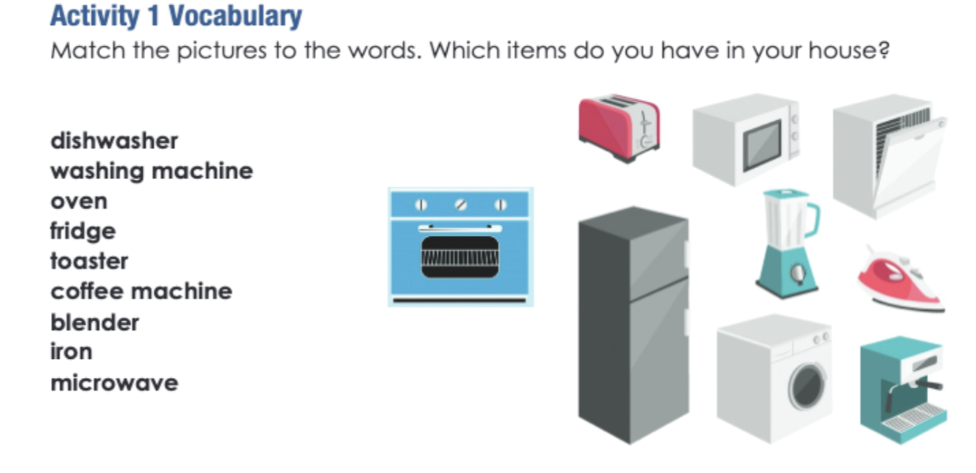
Grade 8 Access
Unit 5: Lesson 1
Keywords
Pages 90-91
C
D
B
A
G
F
E
H
I

Slide 7

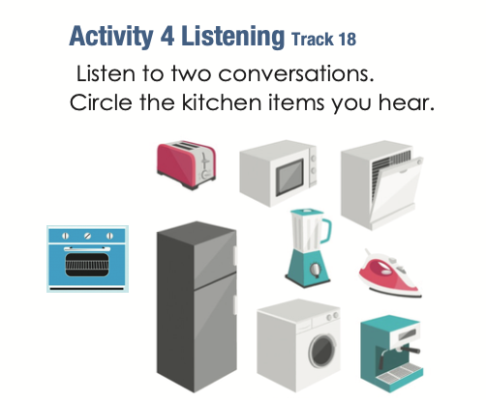
Grade 8 Access
Unit 5: Lesson 1
Keywords
Pages 90-91
Activity: Choose one item and write three sentences about it.
____________________________
____________________________
____________________________
____________________________
____________________________
____________________________
____________________________
____________________________
____________________________
____________________________
____________________________
____________________________
We use dishwashers to clean our dishes.
The dishwasher needs special soap.
You can buy dishwashers from stores like Carrefour.

Slide 8
Unit 5: Lesson 2
In my room

Slide 9
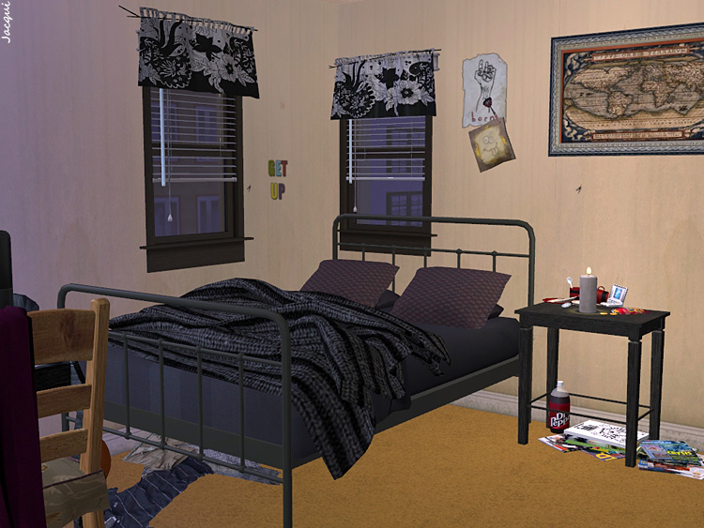
What does your room look like? Describe it to me.

Slide 10
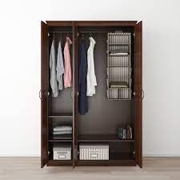
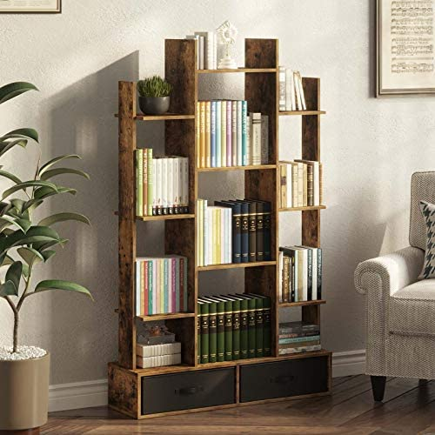
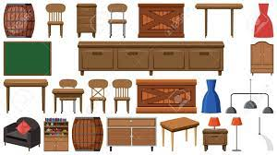
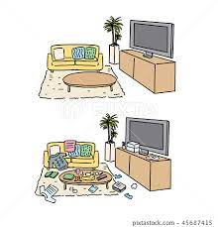

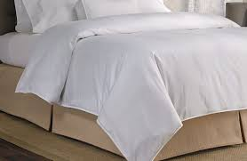
Grade 8 Access
Unit 5: Lesson 2
Keywords
Pages 92-93
furniture
wardrobe
book shelf
tidy
pillow
duvet
messy

Slide 11
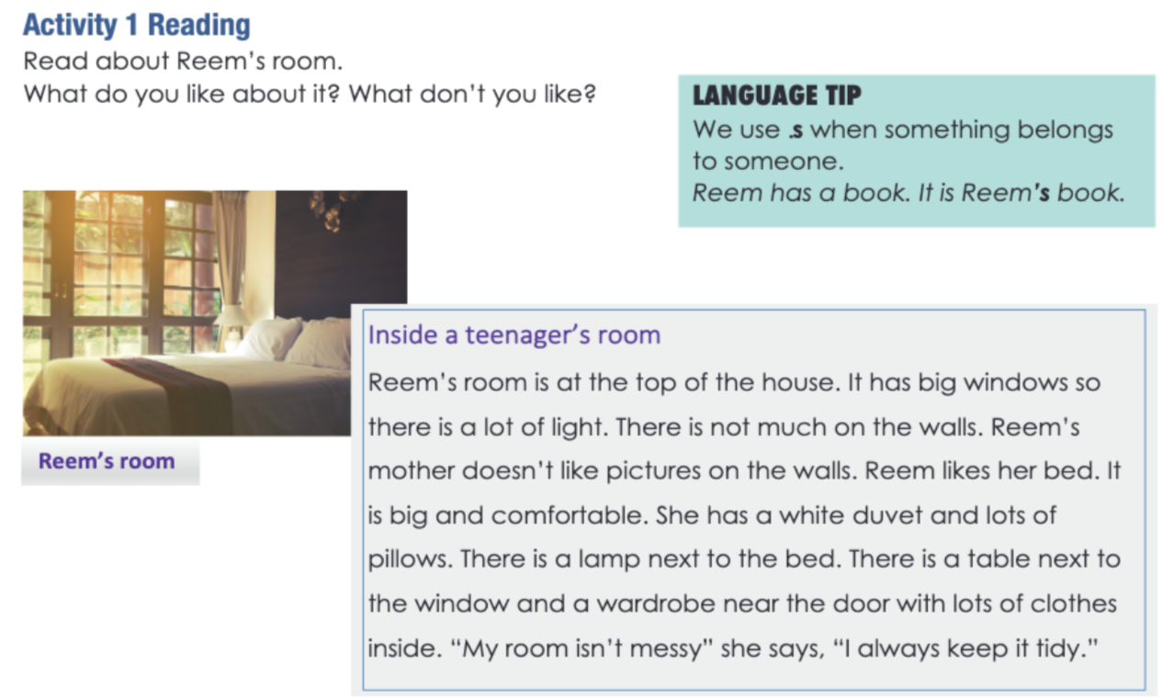
Grade 8 Access
Unit 5: Lesson 2
Activity 1
Pages 92-93
Reem’s Room
Sarah’s book
Hamad’s car
hospital’s ambulance
School’s bus
’s = possessive s (possess = own)
Your laptop is the school’s laptop.
Saeed’s room is always tidy.

Slide 12
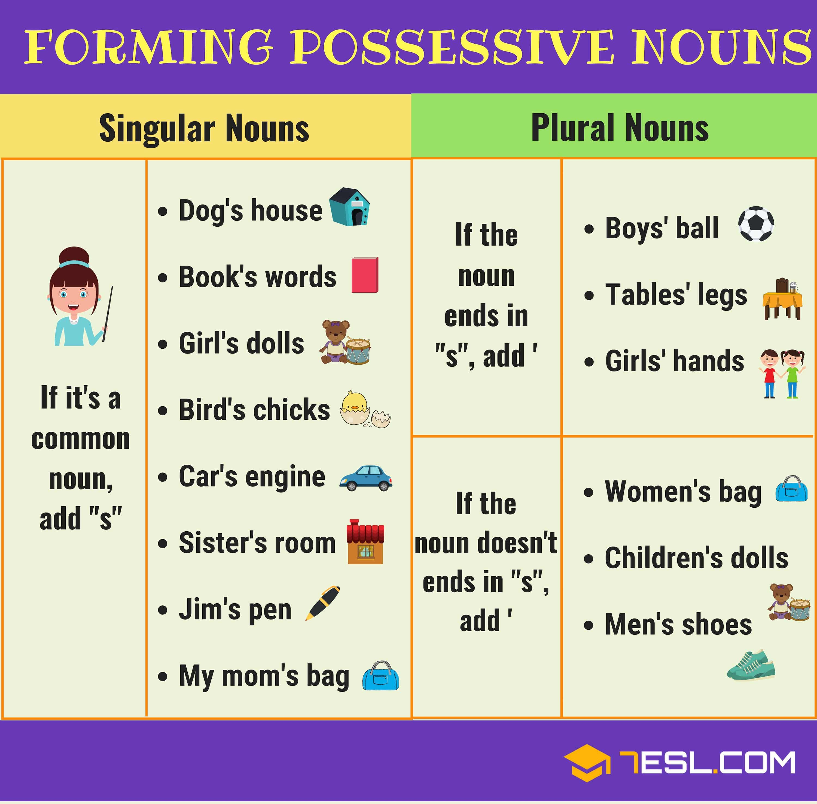
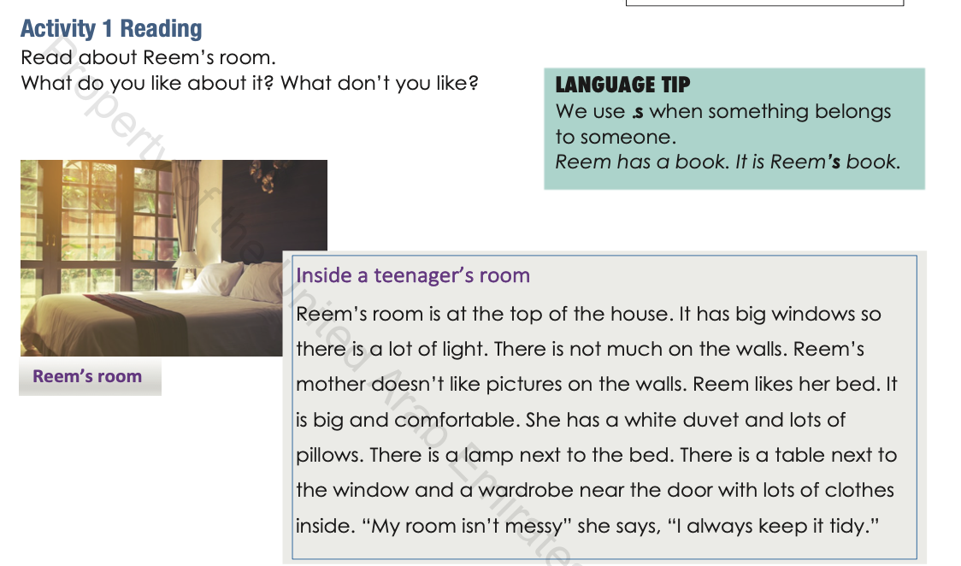
Grade 8 Access
Unit 5: Lesson 2
Activity 1
Pages 92-93
’s = possessive s
(possess = own)
Reem’s Room
Sarah’s book
Hamad’s car
hospital’s ambulance
School’s bus
When we use (’s) we are saying that something belongs to that person or place.
Your laptop is the school’s laptop.
Saeed’s room is always tidy.
Boys’ table = if the word ends in “s” we just put an apostrophe after the “s” (boys’)
Alef Lesson 40!

Slide 13
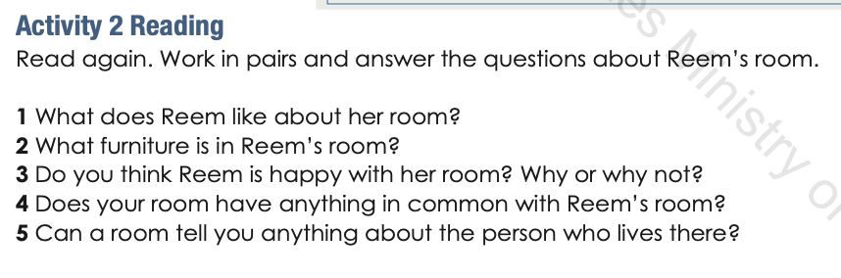
Grade 8 Access
Unit 5: Lesson 2
Activity 2
Pages 92-93
furniture
Reem likes her bed.
Reem has a bed, wardrobe, table, lamp.
Reem I happy with her room because her room is not messy.
Yes, my room also has a big window. I also have a lamp on my table too.
Rooms can tell you many things about a person, such as their likes and dislikes.

Slide 14
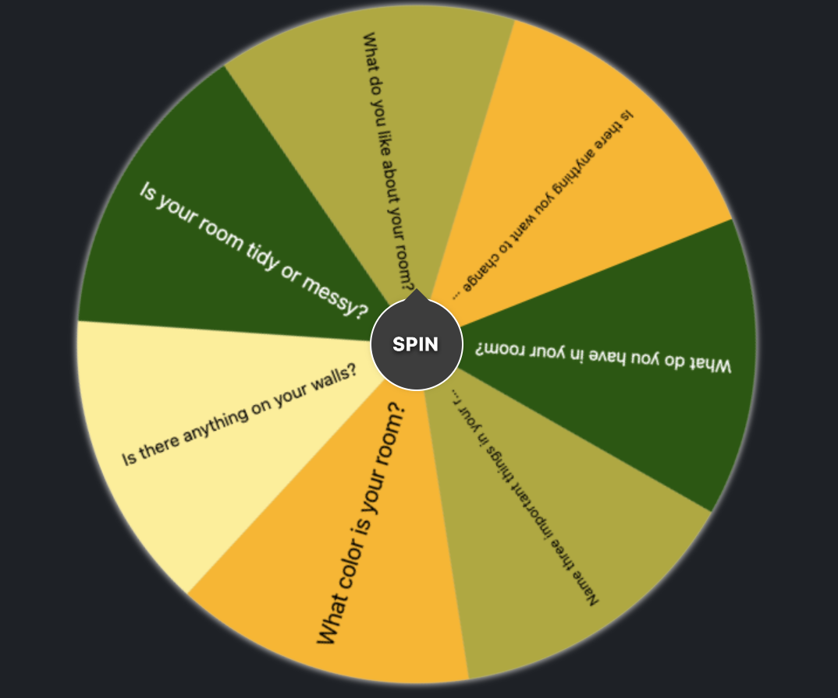
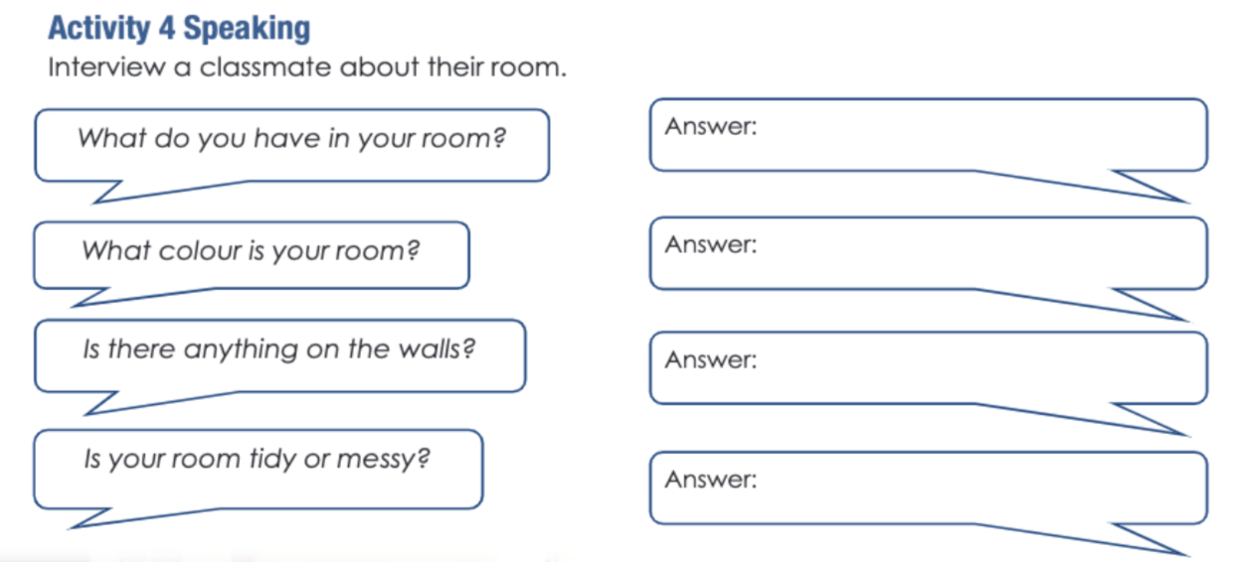
Grade 8 Access
Unit 5: Lesson 2
Activity 4
Pages 92-93
I have a bed.
My room has white walls.
There is a TV on the wall.
Sometimes it’s messy, sometimes it’s tidy.

Slide 15
Unit 5: Lesson 3
Rooms at home

Slide 16
How many rooms do you have in your house?

Slide 17
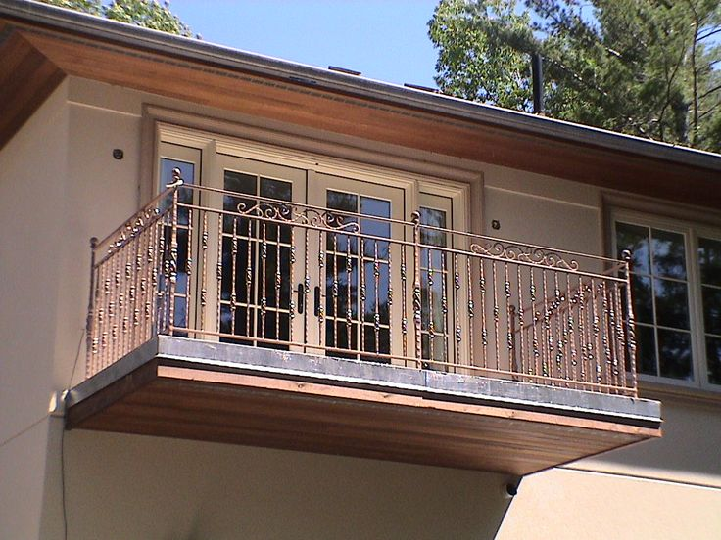

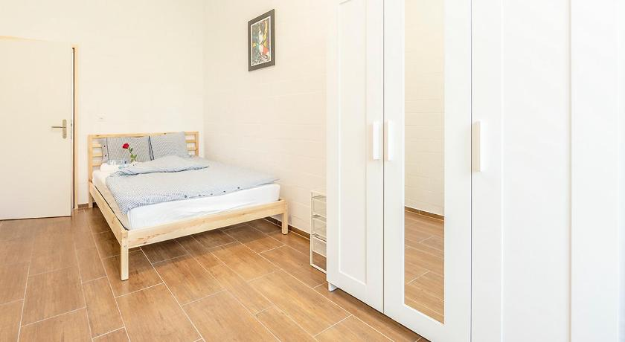
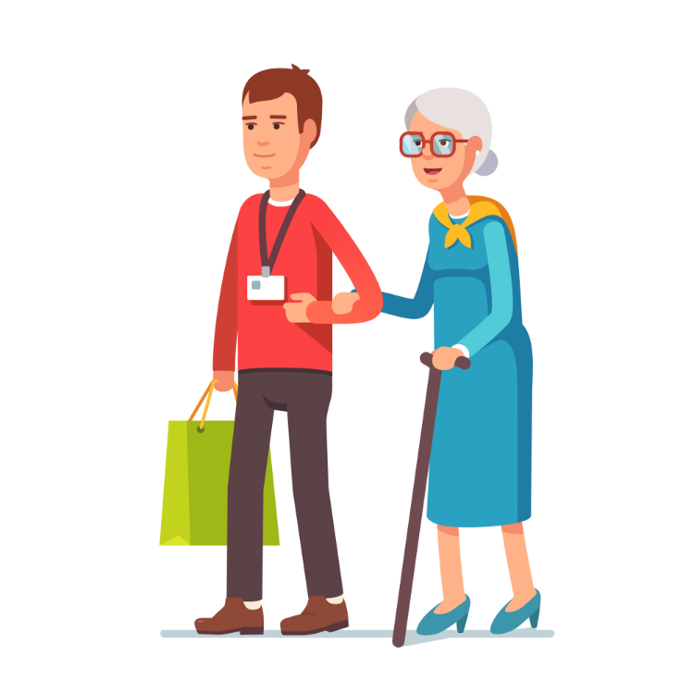
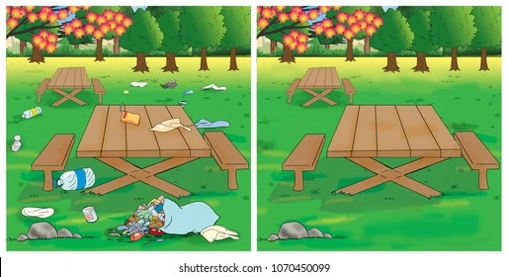
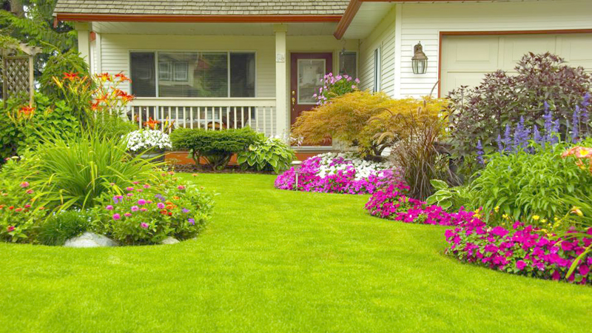
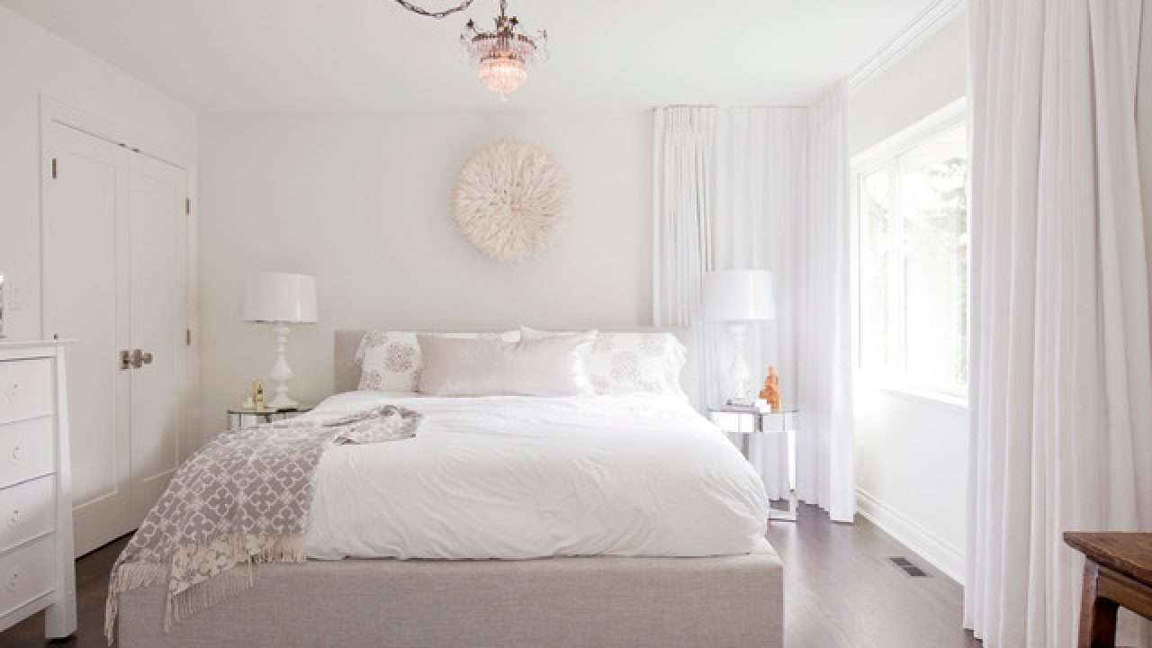
Grade 8 Access
Unit 5: Lesson 2
Keywords, Activity 2
Page 94
balcony
colorful
simple
helpful
clean
garden
bright

Slide 18
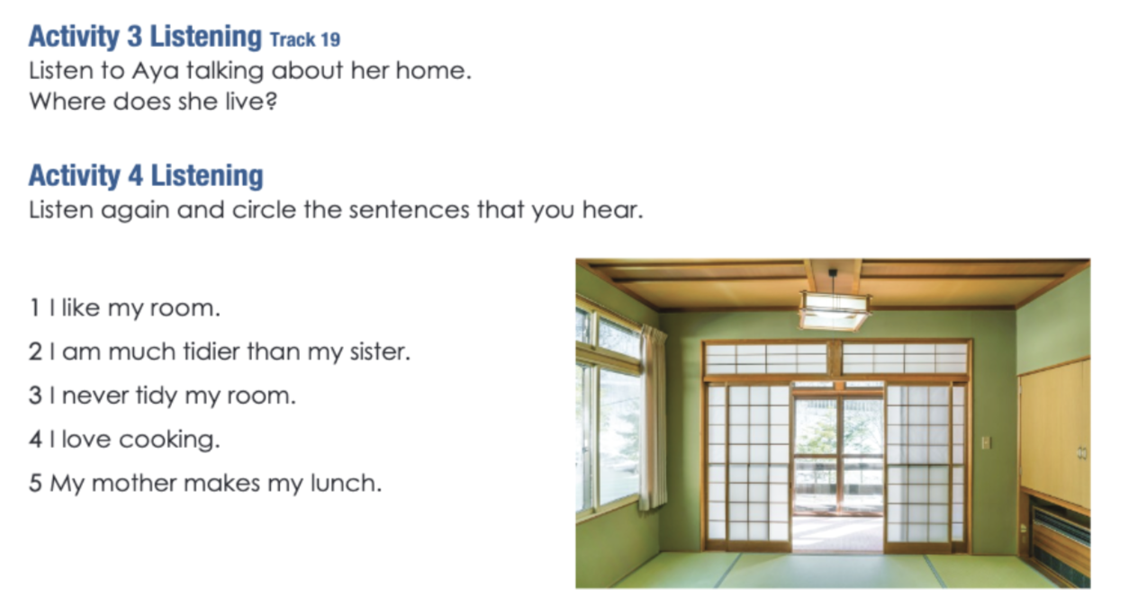
Grade 8 Access
Unit 5: Lesson 2
Activity 1
Pages 94-95
Aya lives in a small house in Tokyo, Japan.

Slide 19
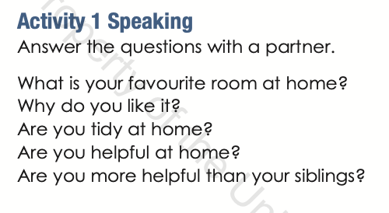
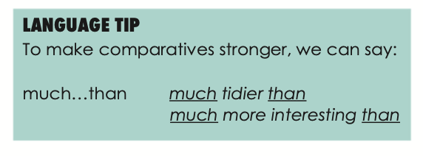
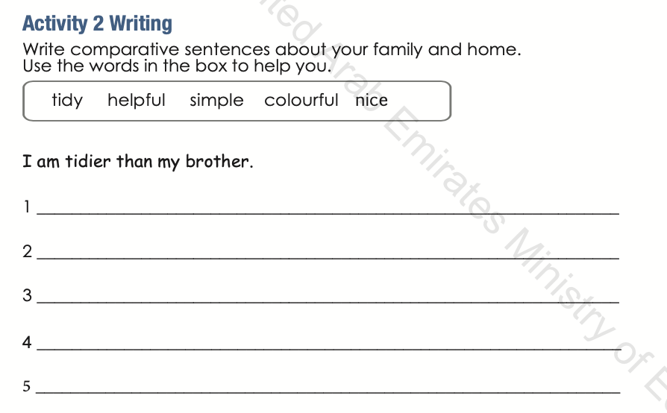
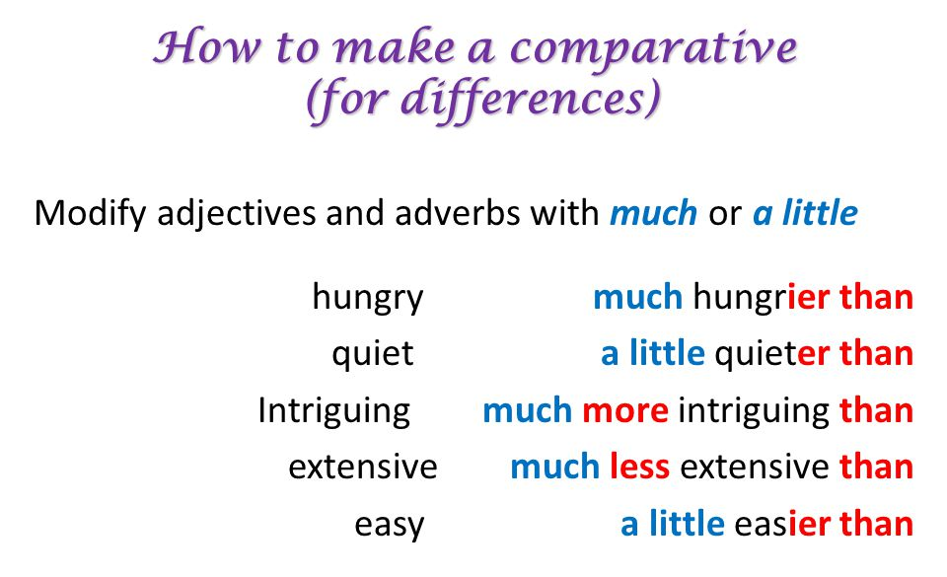
Grade 8 Access
Unit 5: Lesson 3
Activities 1 & 2
Pages 94-95
People are more helpful than robots.
It is simpler to type than write.
My room is more colorful than yours.
The book is much nicer than the movie.

Slide 20
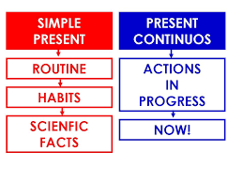
Unit 5: Lesson 4
Language focus: present simple vs. present continuous

Slide 21
What do you do at school?
I learn at school.
We read at school.
He talks at school.
What are you doing now?
I am learning a lesson.
We are reading at school. They are talking at school.

Slide 22
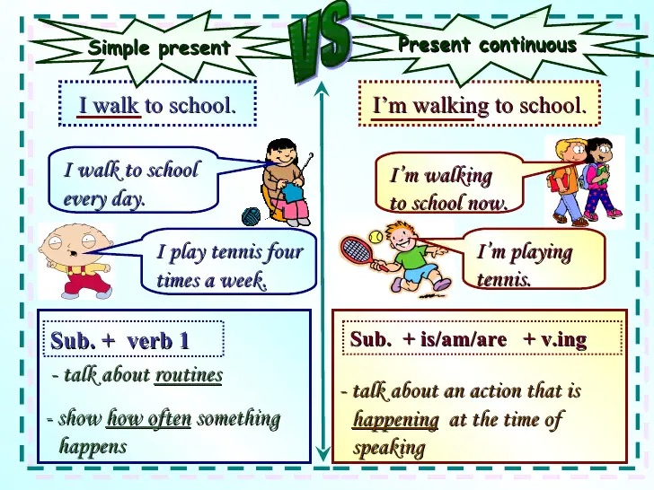
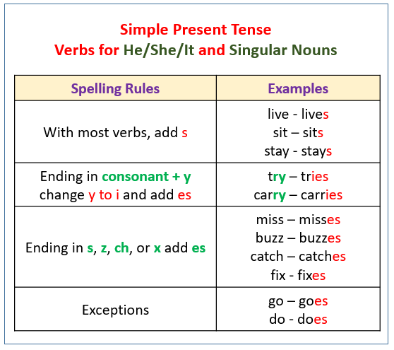
Grade 8 Access
Unit 5: Lesson 4
Grammar
Pages 96-97
Alef Lesson 41!
Present simple = verb has to change.
Play = plays
Watch = watches
carry = carries
Present continuous = verb-ing

Slide 23
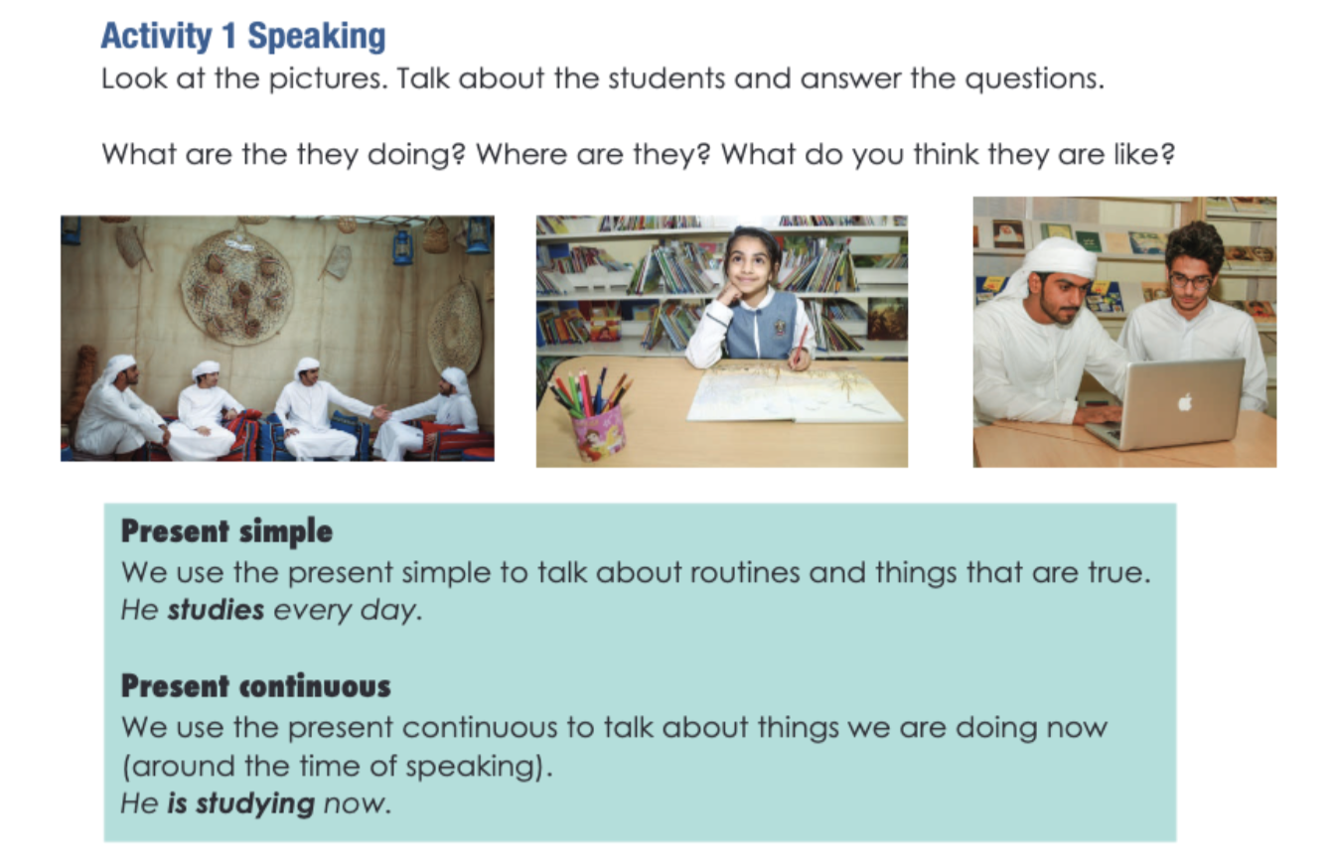
Grade 8 Access
Unit 5: Lesson 4
Activity 1
Pages 94-95

Slide 24
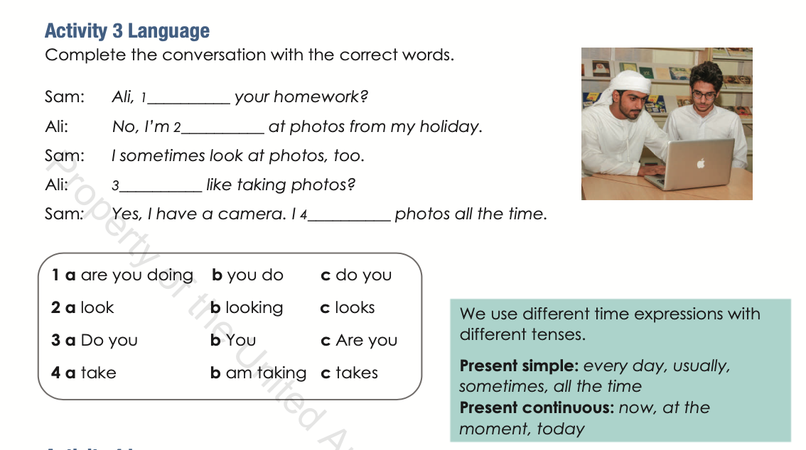
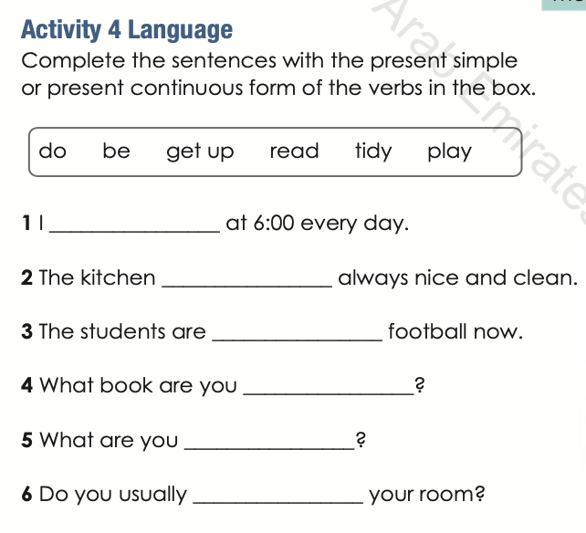
Grade 8 Access
Unit 5: Lesson 4
Activities 3 & 4
Present simple = verb has to change.
Play = plays
Watch = watches
carry = carries
Present continuous = verb-ing
get up
is
playing
reading
doing
tidy
Alef Lesson 37!
Pages 96-97
Verb To be
I am
He/she is
It is
We/They are
Mohamad / Lulu is
Boys are
are you doing
looking
Do you
take

