Slide 1


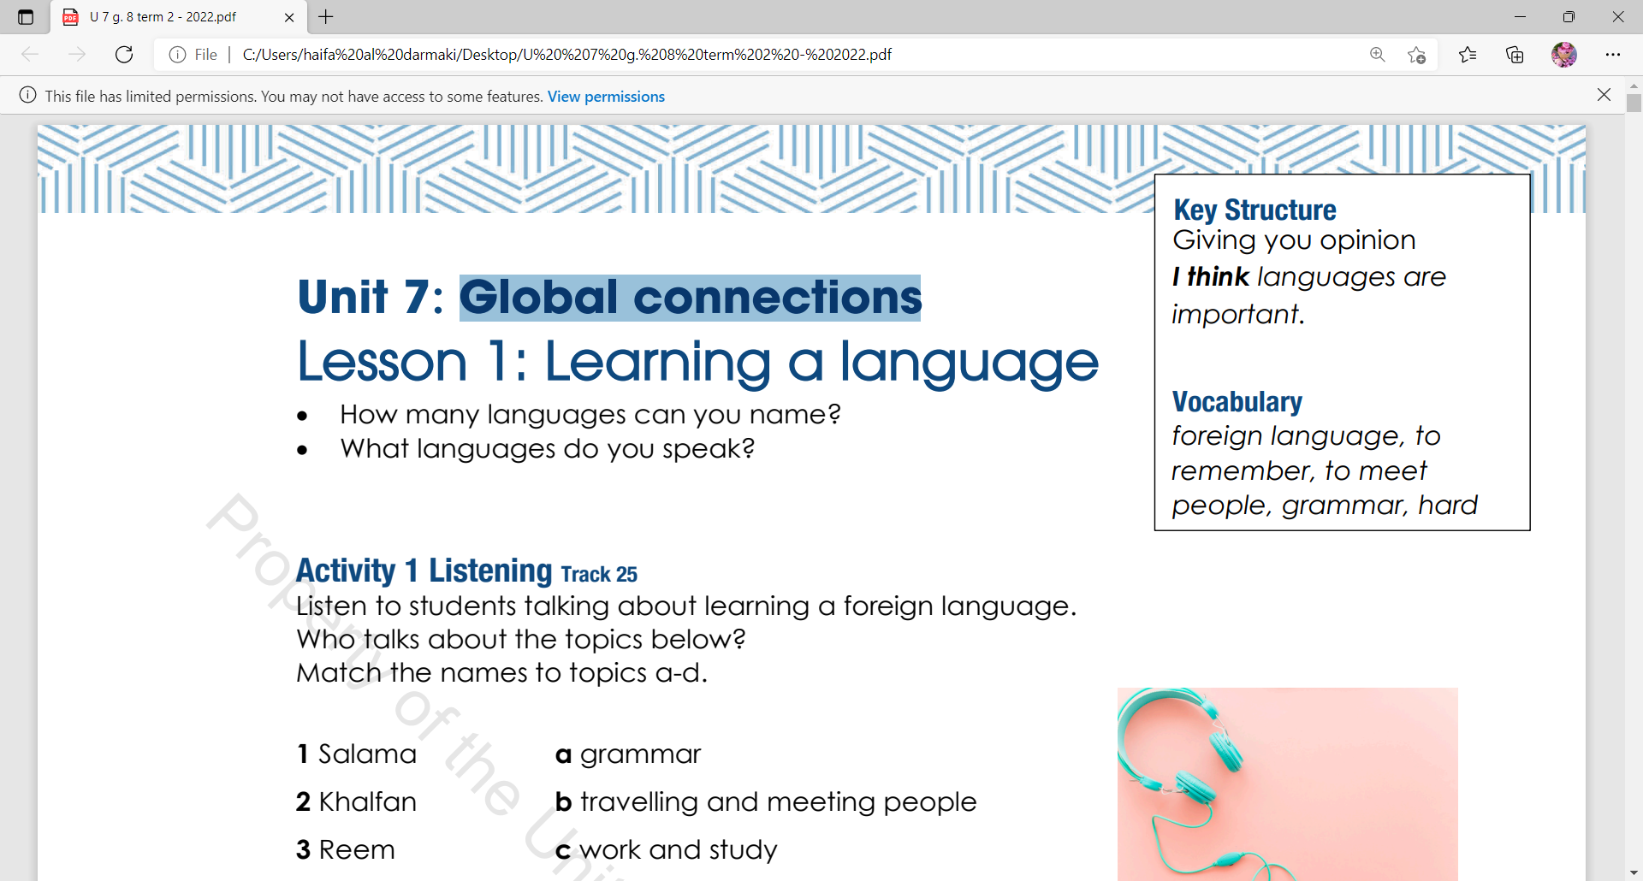
UNIT:7
LESSON :1
Learning languages

Slide 2
Objectives Learning
To discuss languages around the world.
To identify the new words.
To listen for details.
To give their opinions using agree and disagree.

Slide 3


How many languages can you name?
Do you speak another language?​
What language do you wish to learn?
Do you think learning languages is an important thing?

Slide 4





To remember
Foreign languages
Hard
Grammar
Meeting people

Slide 5

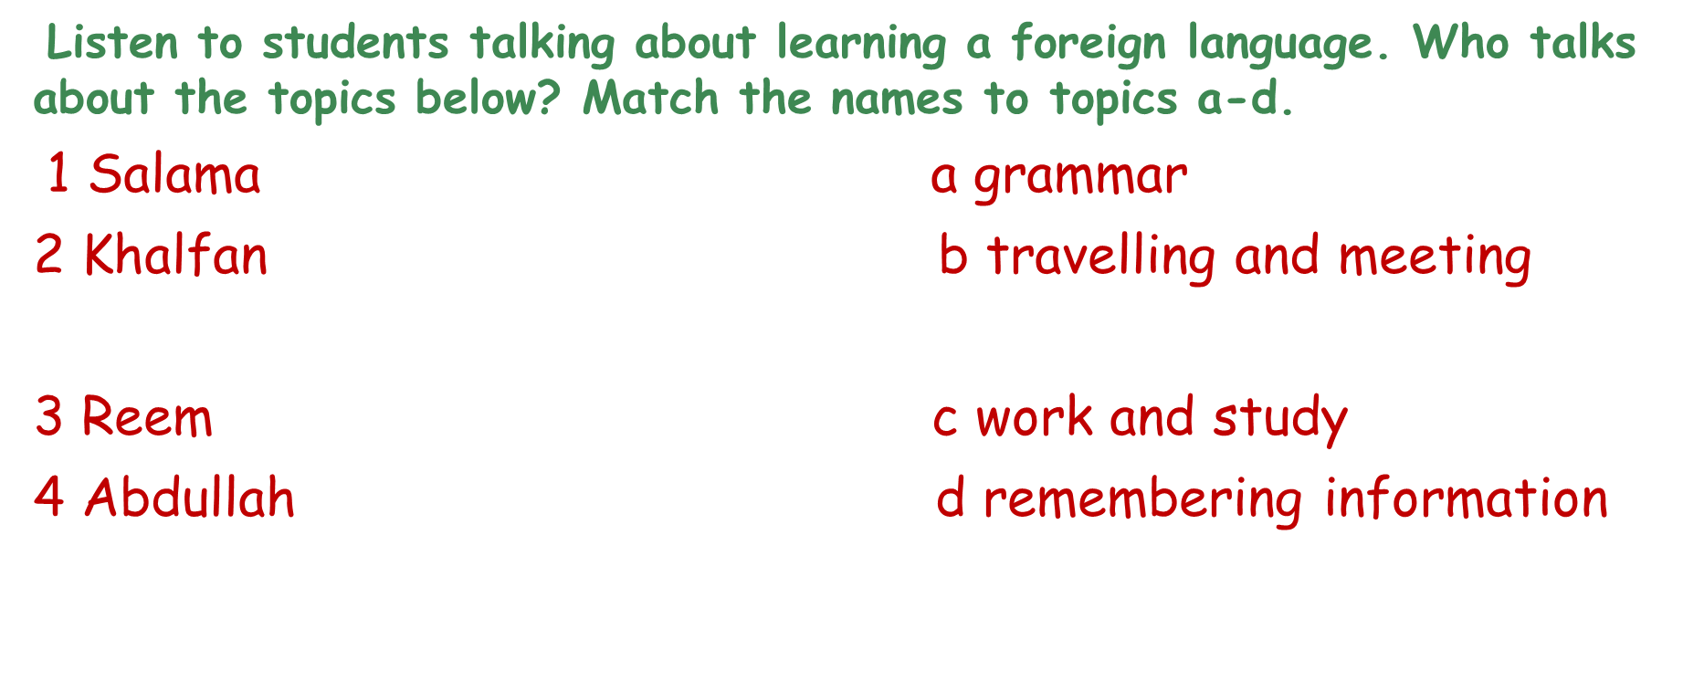

Slide 6

Activity 1 Listening
Listen to students talking about learning a foreign language. Who talks about the topics below? Match the names to topics a-d.
1 Salama a grammar
2 Khalfan b travelling and meeting
3 Reem c work and study
4 Abdullah d remembering information

Slide 7

Do you agree or disagree with the sentences below?
Writing in a foreign language is hard !
Speaking a foreign language helps you to get a good job.
English is a good language to learn.
Studying science or math is more important than studying foreign languages.
Notes:
5 minutes for reading the sentences .

Slide 8
Do you think it is a good idea to learn a foreign language?
I think it’s good to learn a foreign language because:
1. ____________________________________________________
2. ____________________________________________________
I don’t think it’s good to learn a foreign language because:
1. Sometimes it's difficult
2. ____________________________________________________

Slide 9
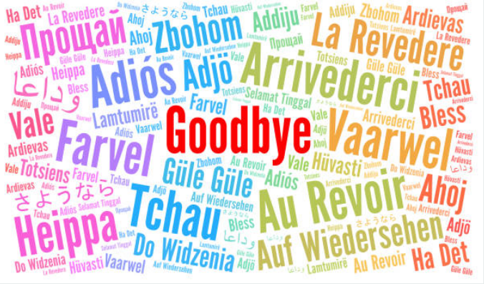

Exit….
I hope all of you
Understood the Lesson .

