Slide 1

Term 2 Revision
-Grammar
G 7 General
ALAIN Model School
Mahra Lafi ALMuhairi

Slide 2

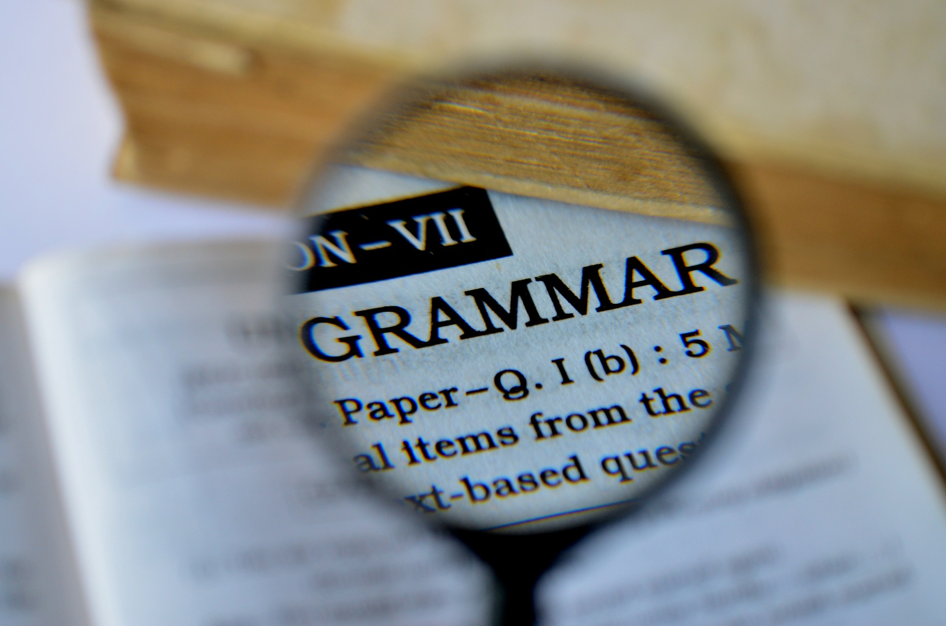
Grammar

Slide 3
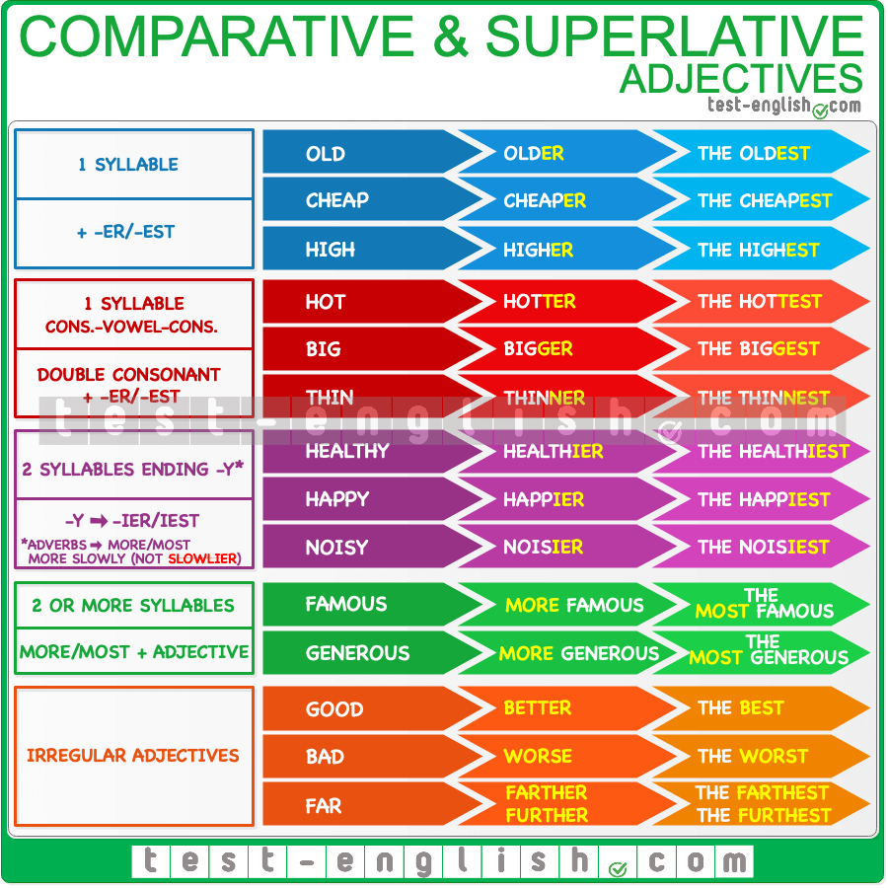
Adjectives
Comparative and superlative

Slide 4
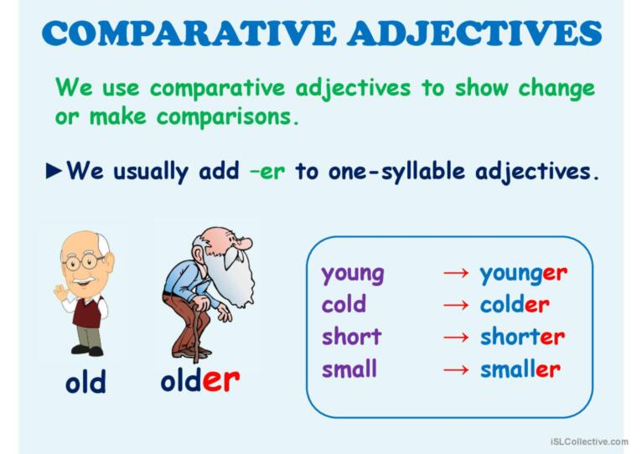

Slide 5
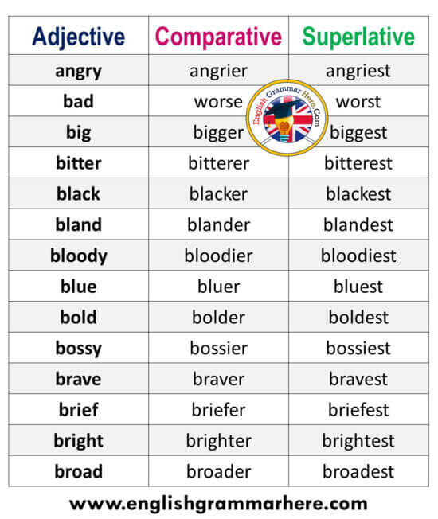

Slide 6
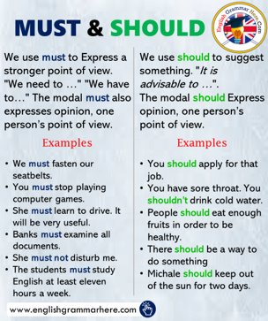
Adverbs: frequency and manner

Slide 7
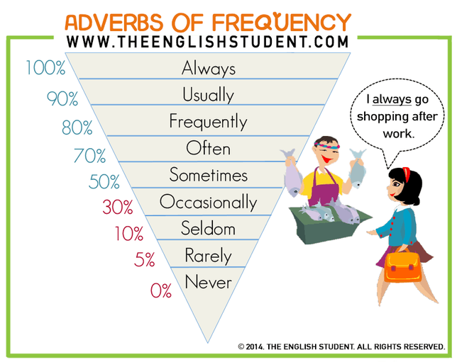

Slide 8
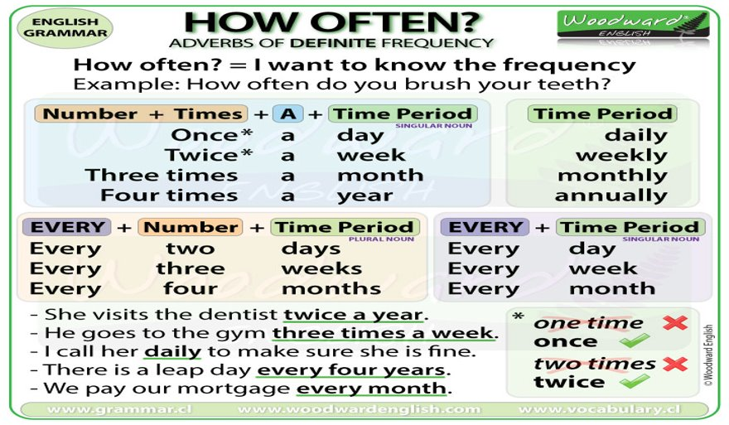

Slide 9
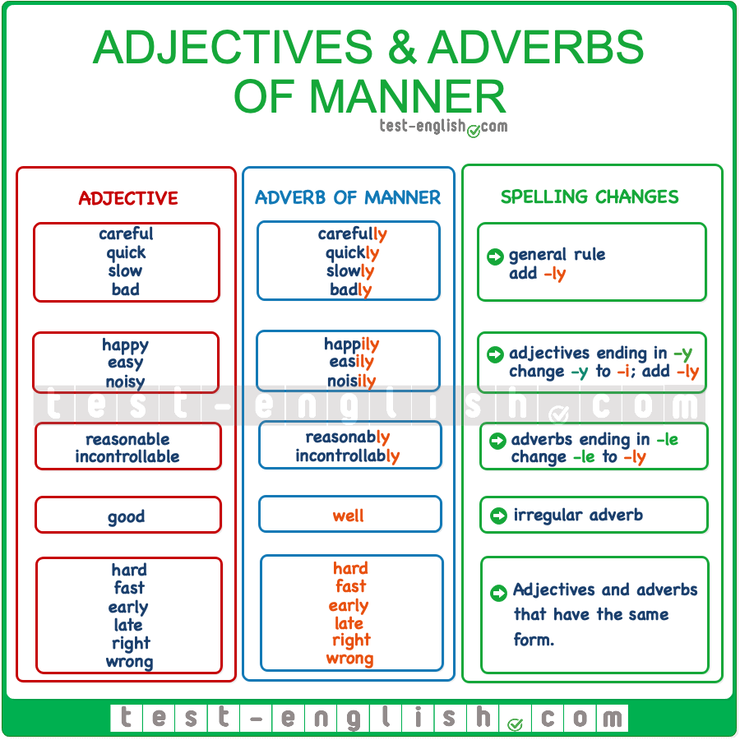
Adverb of manner

Slide 10
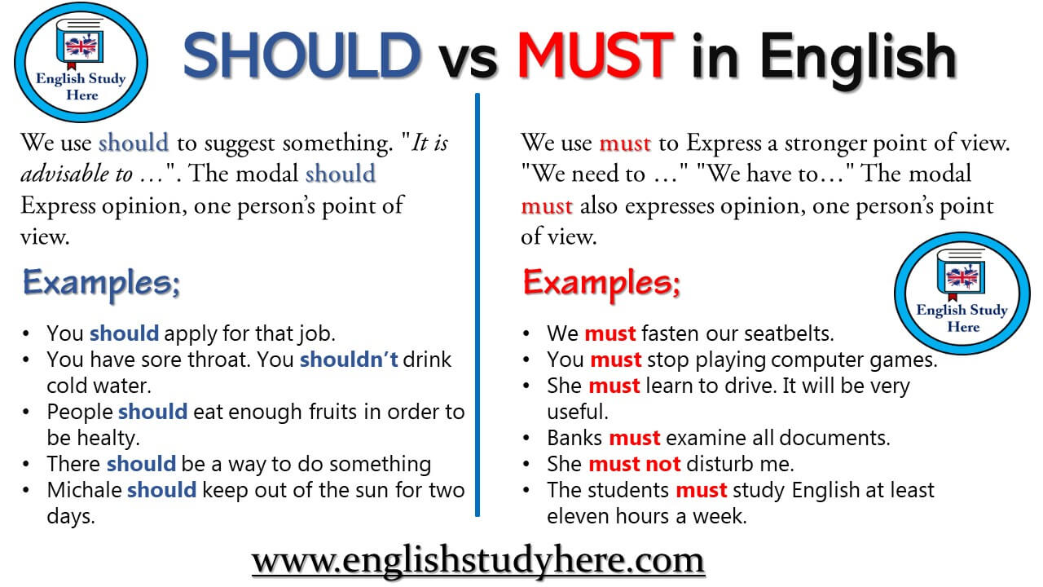

Slide 11

I wish you all the best

