Slide 1
EOT3-Review
12 Adv

Slide 2
Maze
1- https://www.liveworksheets.com/oe3072319so
2- https://www.liveworksheets.com/nc1496074se
3- https://www.liveworksheets.com/ij1252296zf
4- https://www.liveworksheets.com/om1257537vx
5- https://www.liveworksheets.com/oe3072319so
6- https://www.liveworksheets.com/kf3089856uo

Slide 3
Reading Comprehensions
1- https://www.liveworksheets.com/ya1723355mf
2- https://www.liveworksheets.com/ci899721gd
3- https://www.liveworksheets.com/qm3072295kr
4- https://app.wizer.me/learn/J3380W
5- https://forms.office.com/r/M4FhWPdUyw

Slide 4
Vocabulary
1- https://wordwall.net/resource/32680827
Lesson 1 : Fun? It’ll Coast Ya
2- https://wordwall.net/resource/32328496
Lesson 2 : Delicious food, deadly stove.
3- https://quizlet.com/_bnypgb?x=1qqt&i=32neaa
Lesson 2 : Delicious food, deadly stove.

Slide 5
Grammar
https://www.liveworksheets.com/kb1116207bp
Mixed Conditionals
https://www.liveworksheets.com/oe1111885bp
Mixed Conditionals
https://www.liveworksheets.com/fb2390757ui
Cleft sentences
https://www.liveworksheets.com/db2453335nn
Cleft sentences
https://www.liveworksheets.com/ta2375149vg
Subordinating
https://quizizz.com/admin/quiz/62a59afd1d0f17001e8d75e2?source=quiz_page
Click on Preview and start answering the given questions.

Slide 6
Functional Language
Functional language is language that you need in different day-to-day situations.

Slide 7
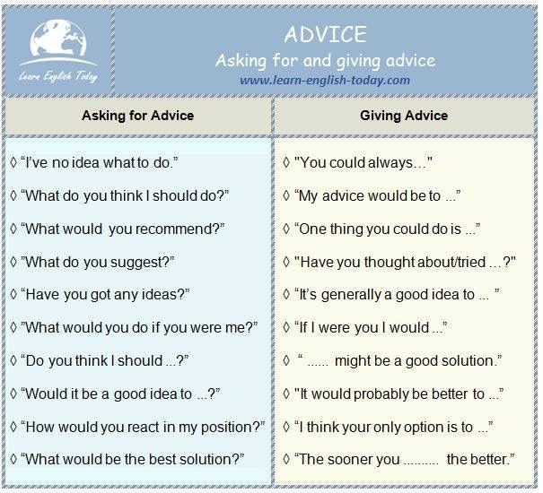
Functional Language
Asking OR Giving Advice

Slide 8
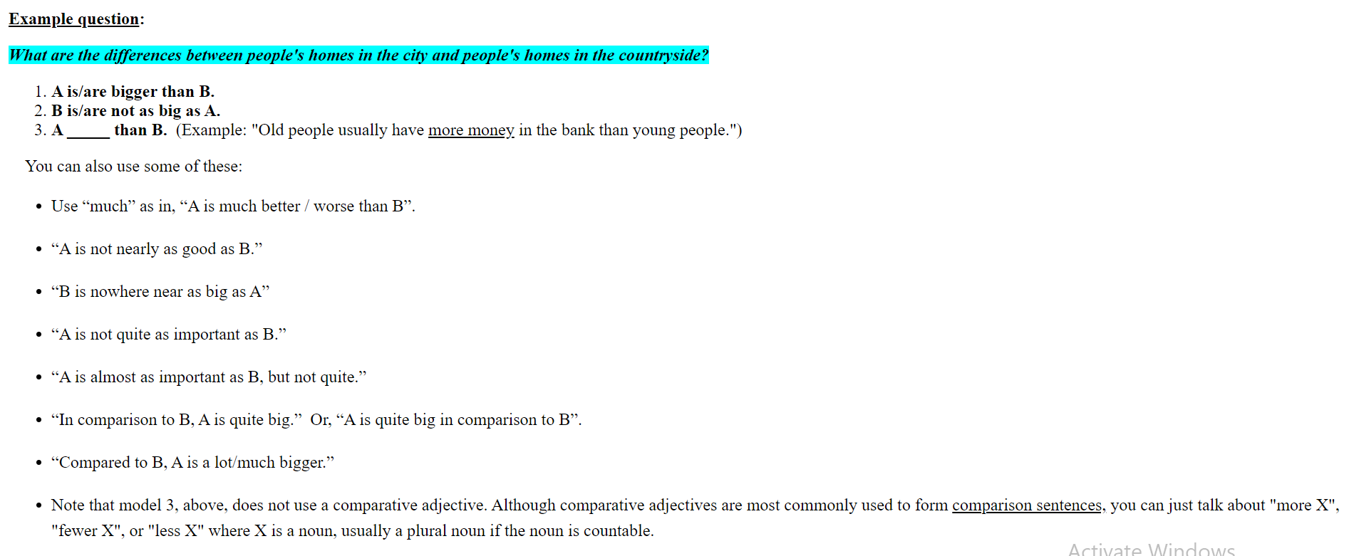
Functional Language
Comparing & Contrasting

Slide 9
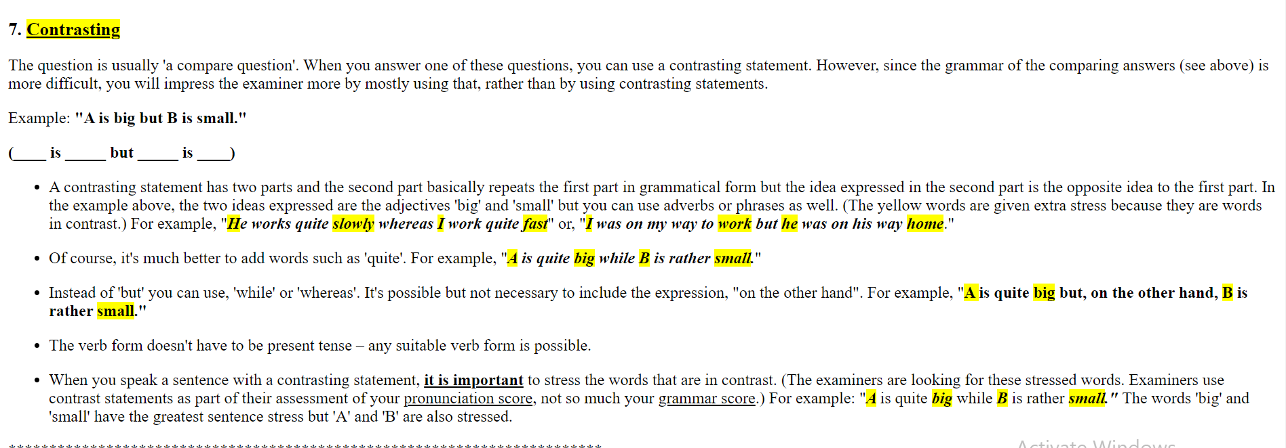
Functional Language
Comparing & Contrasting

Slide 10
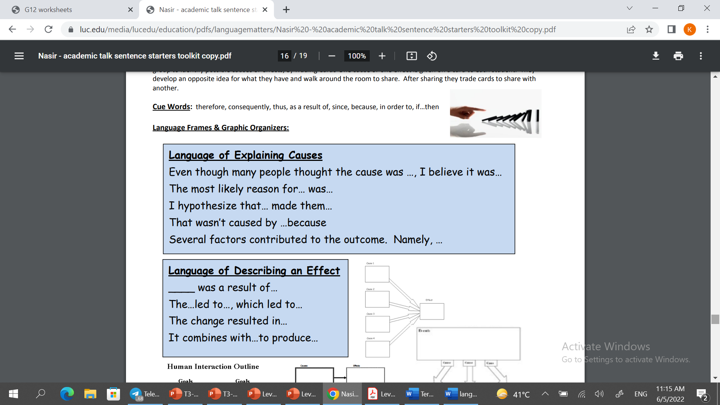
Functional Language
Cause & Sequence

Slide 11
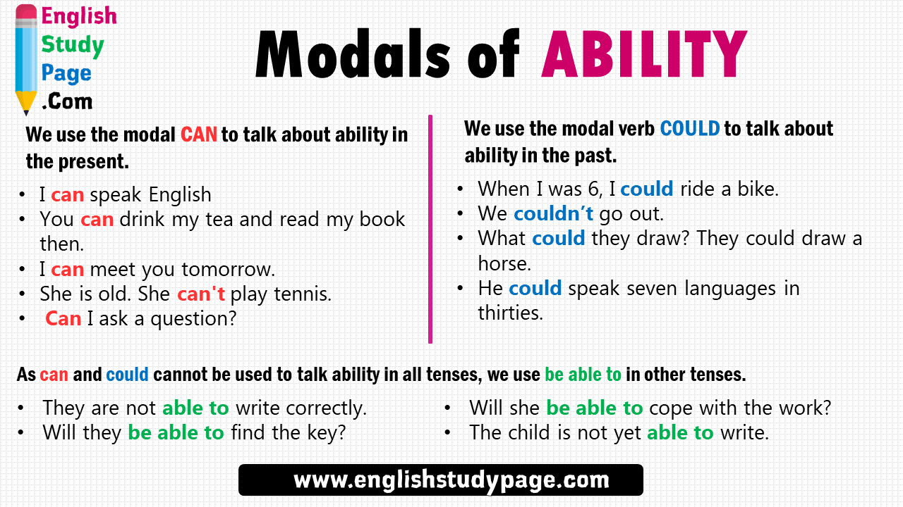
Functional Language
Talking about ability

Slide 12
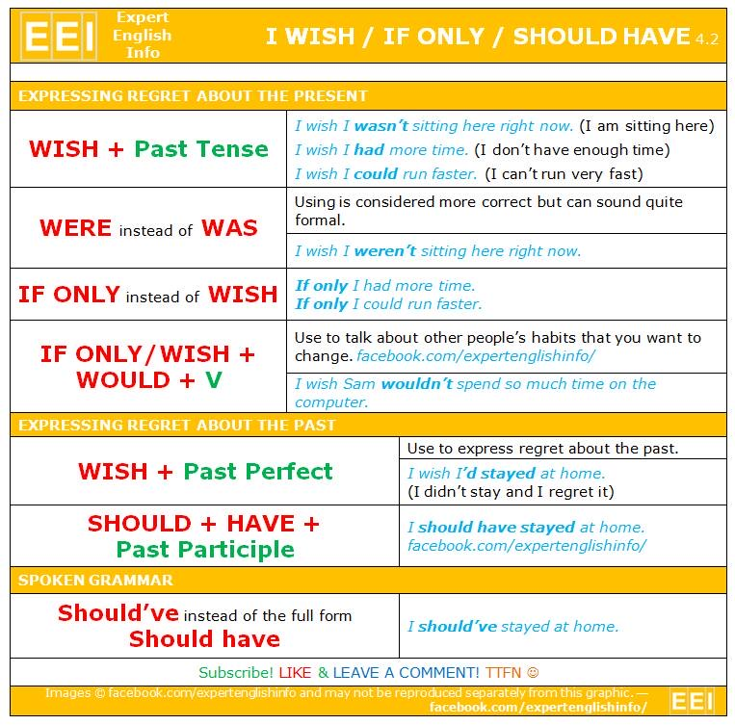
Functional Language
Expressing regret

Slide 13
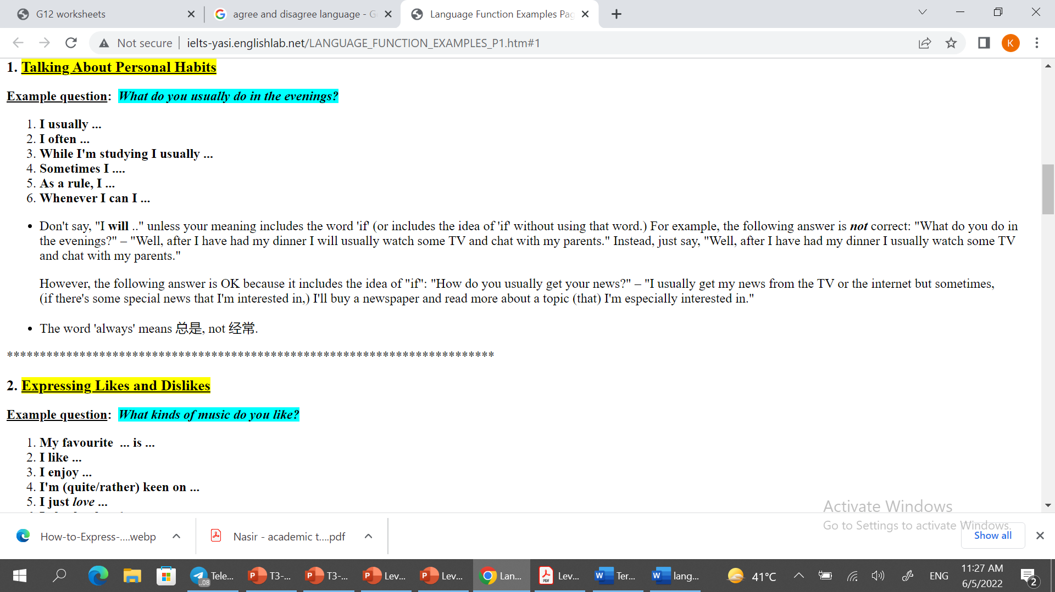
Functional Language
Describing habits, routines, tasks & jobs.

