Slide 1
Summary of rules for Term 3 Final Assessment (Grade 5)
Unit 9, 10, 11
Done By:
Ms. Mariem Souissi

Slide 2
Instructions
This file is an attempt to help you study and revise for the final exam but it is not everything. It is like a summary of the rules and vocabulary we studied.
You have to study the course books Learners and Activity ( Units 9, 10, 11 )
I believe in you. You can do it easily.
All the best

Slide 3
Unit 9
Where We Live
Vocabulary
Road-office-building-office-pavement-path-lake-forest-mountain-field
Beautiful-clean-dry-crowded-peaceful-dirty-colorful-pretty-ancient-noisy-popular-amazing-modern
Check vocabulary list for Unit 9

Slide 4
Vocabulary
Energy-produce-carbon footprint-poles-melting-cause-reduce-flood-rise-sea level-recycle-materials-absorb-release-poles-melt
Tropical forest-plant-environment-campaign-muddy-amount-skyscrapers-dish washer-huge-strange-exciting
Castle-lush-surrounded-scenery-keen on-chirp-whispered-reward-date-cricket-

Slide 5
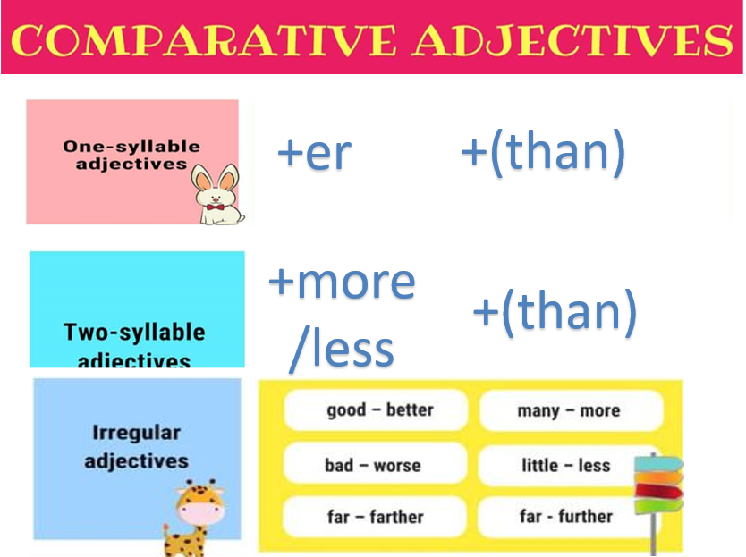
Grammar Rules

Slide 6
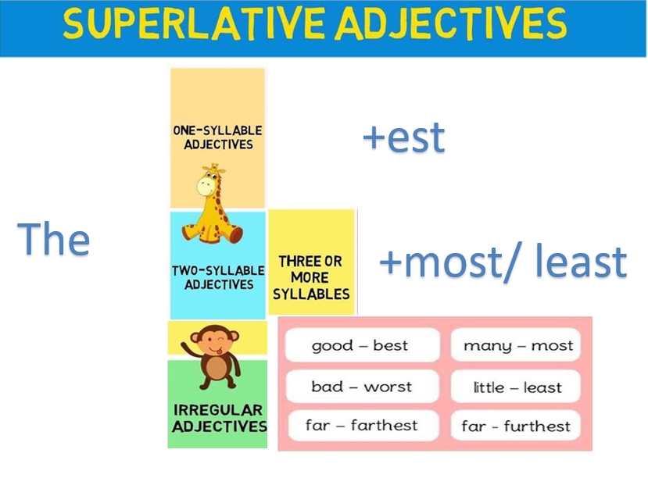
Grammar Rules

Slide 7
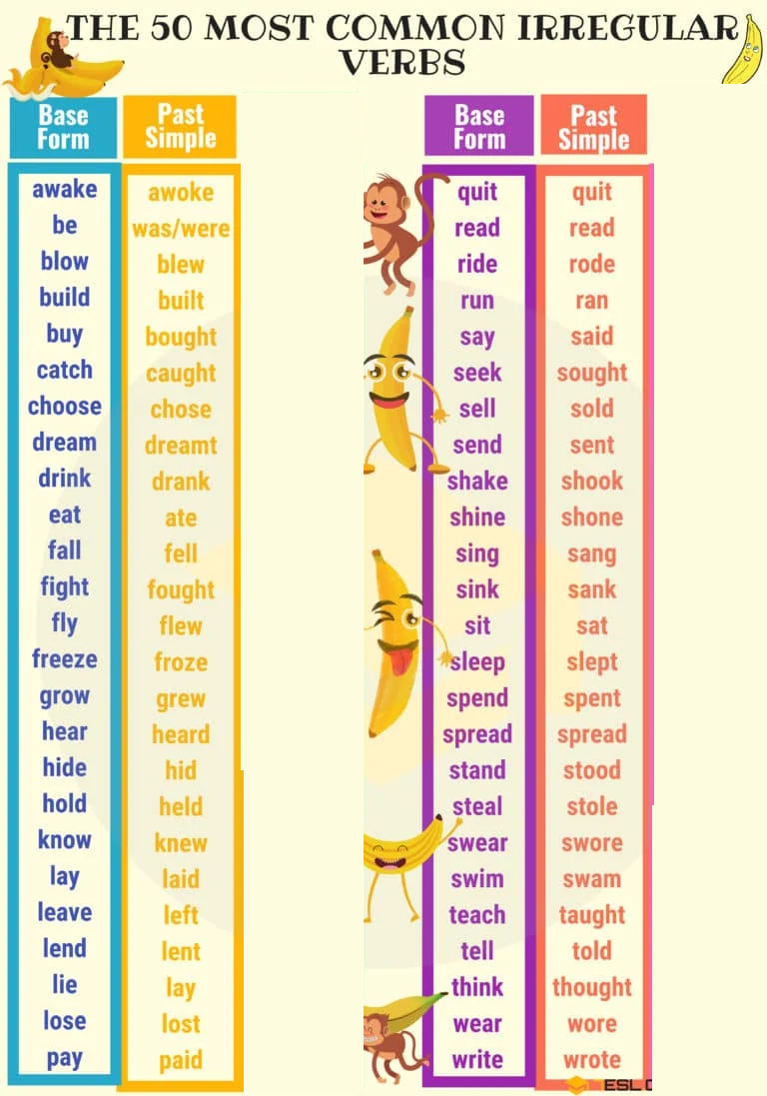
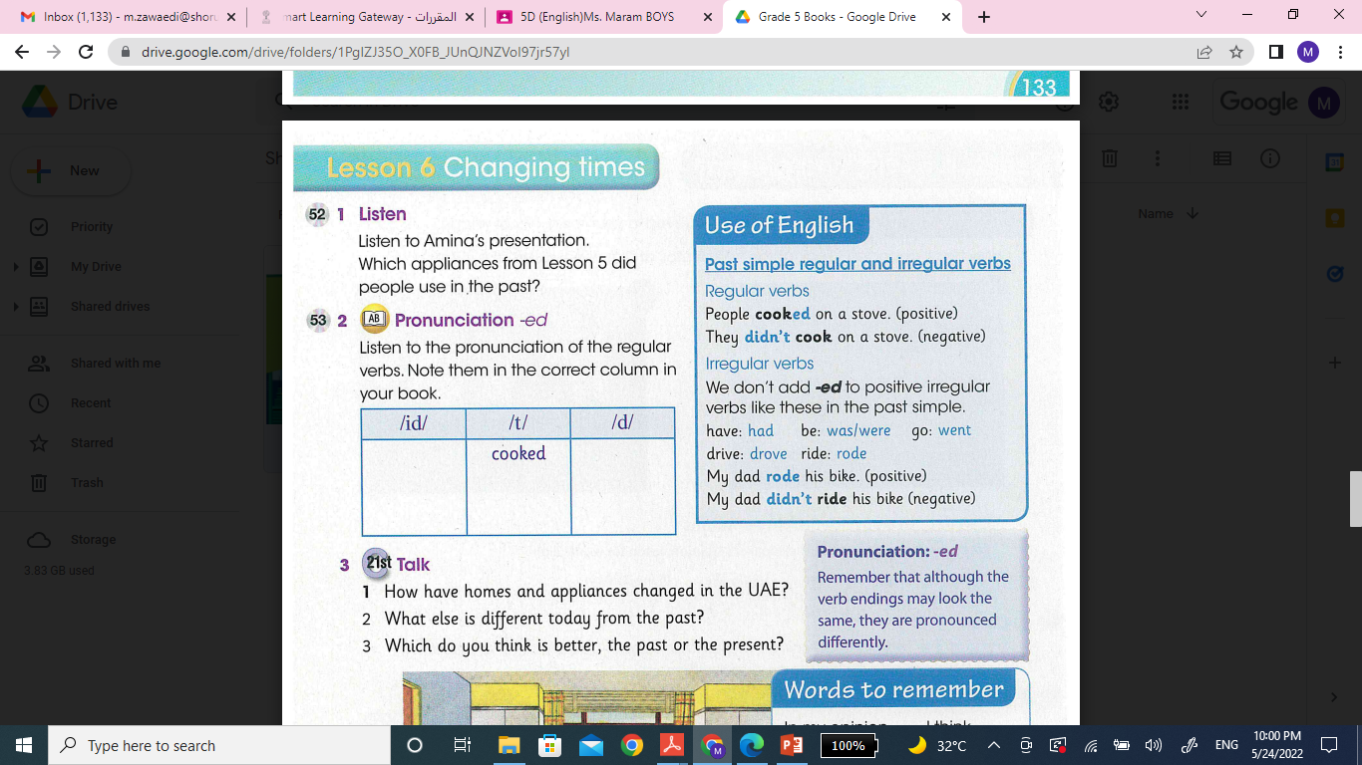
Past verbs
In the negative form ( a regular or irregular verb ) We need to use ‘did not/ didn’t + inf verb’

Slide 8
Practice for regular and irregular verbs :
https://www.liveworksheets.com/tl407370lq
https://www.liveworksheets.com/ts35901ms
Practice for superlative and comparative :
https://www.liveworksheets.com/do923hl
https://www.liveworksheets.com/tv1325tf

Slide 9
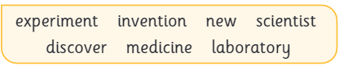
Unit 10
All About Science
Vocabulary
Check vocabulary list for Unit 10

Slide 10
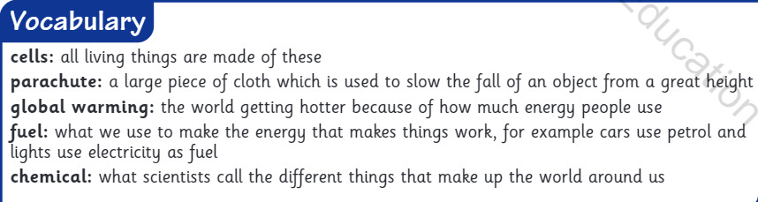
Vocabulary
Storm-collect-string-happen-dangerous-lightning-find out-instructions-straw-scissors-prediction-discover-pump blood-lungs-breath-

Slide 11
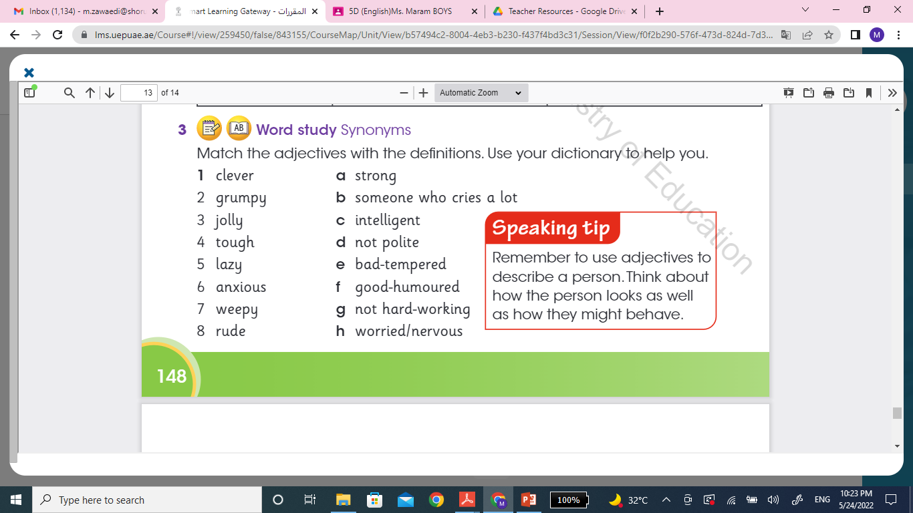
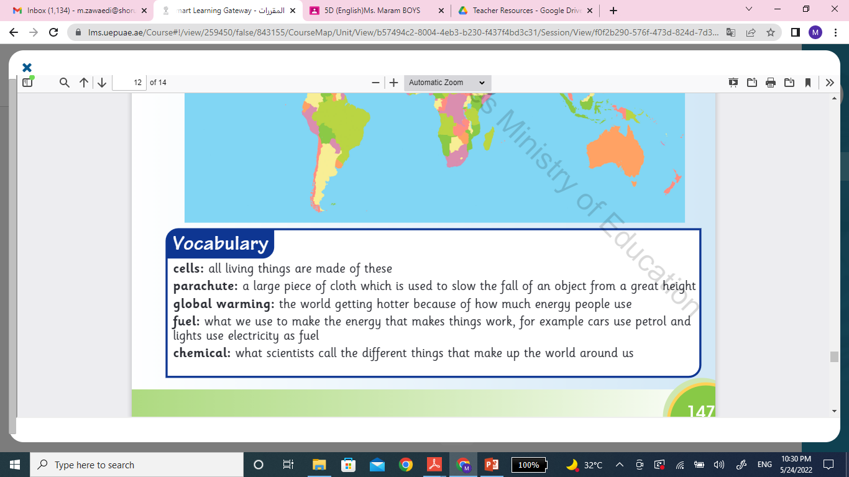
Vocabulary

Slide 12
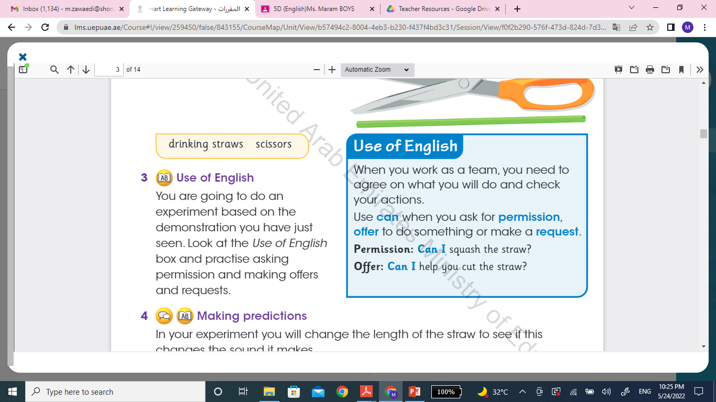
Can to ask for permission / to offer / to make a request

Slide 13
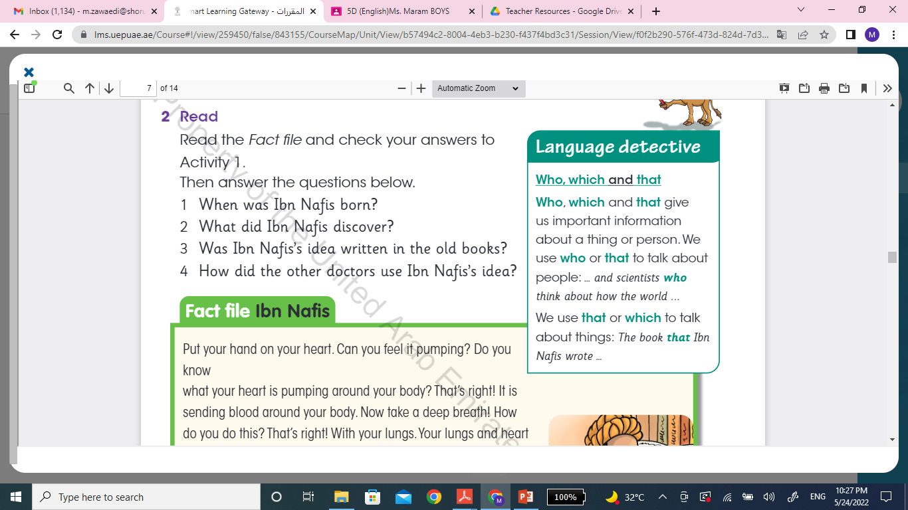
Relative pronouns
Practice link:
https://www.liveworksheets.com/ah176091hd

Slide 14
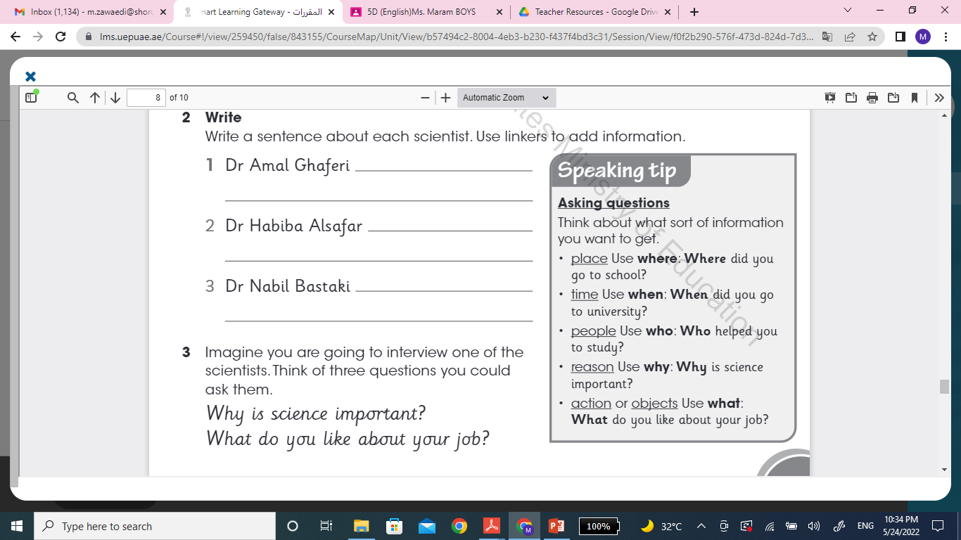
Grammar

Slide 15
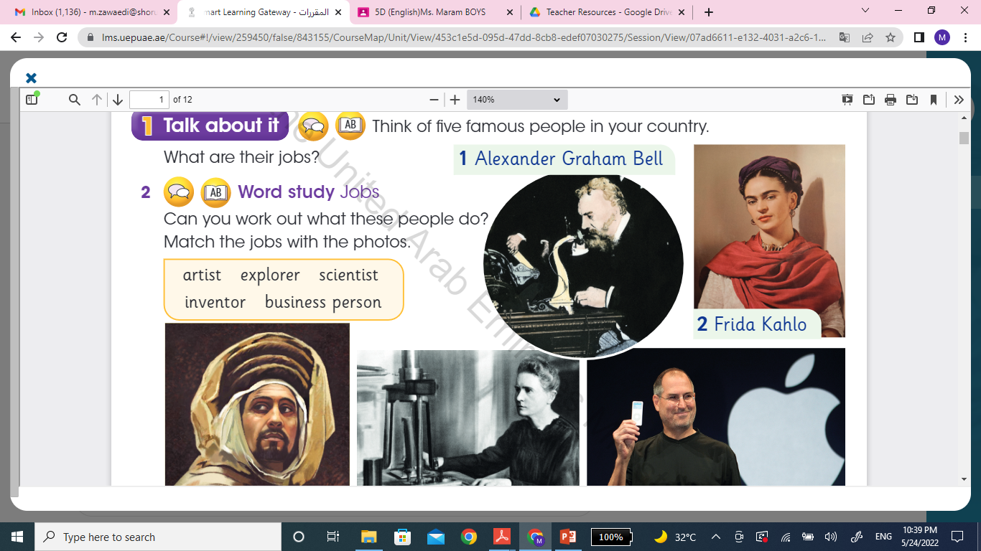
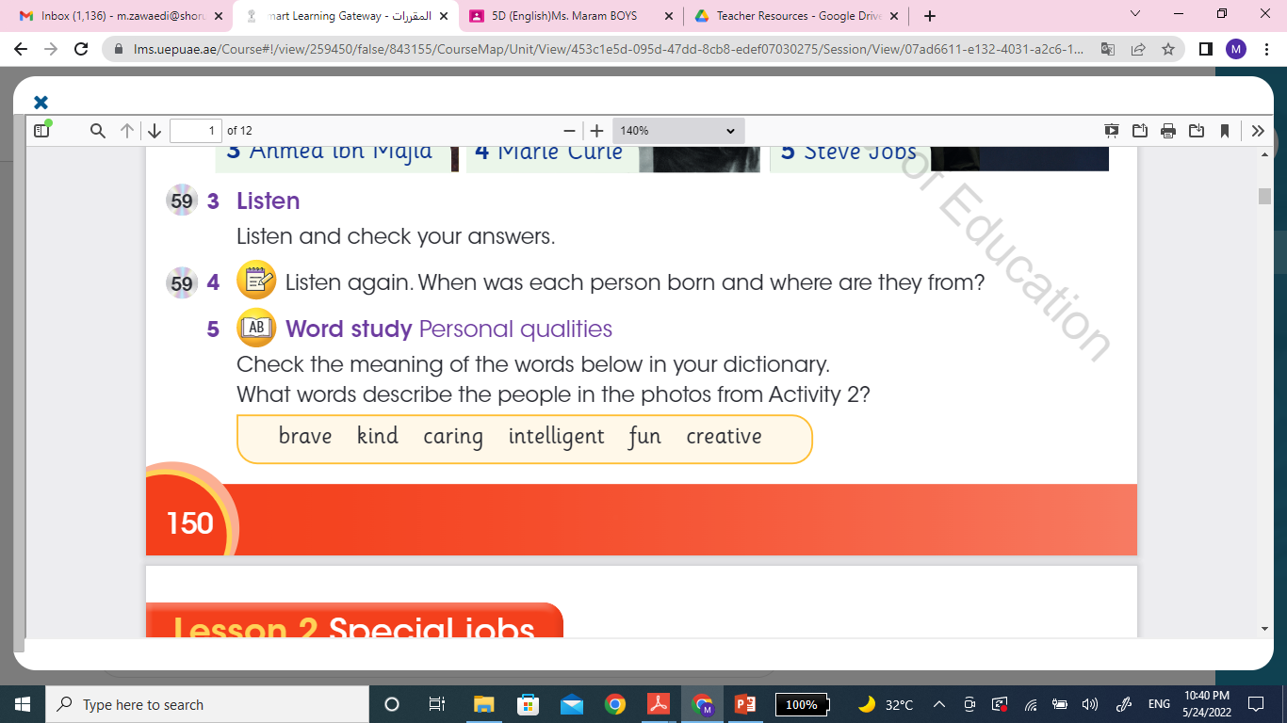
Unit 11
Famous People
Vocabulary
Check vocabulary list for Unit 11

Slide 16
Vocabluary
Flag-president-poetry-poems-caring-exciting-generous-rocket-skydiver-spin-fall-spent-train-presentation-fearless-brave-fear-wild-desert-merchant-eagle-claws-gardener-palace-
Borrow-reward-debt-gardener-return-honesty-protect-ankle-astronauts-determined-float-include-created-invented

Slide 17
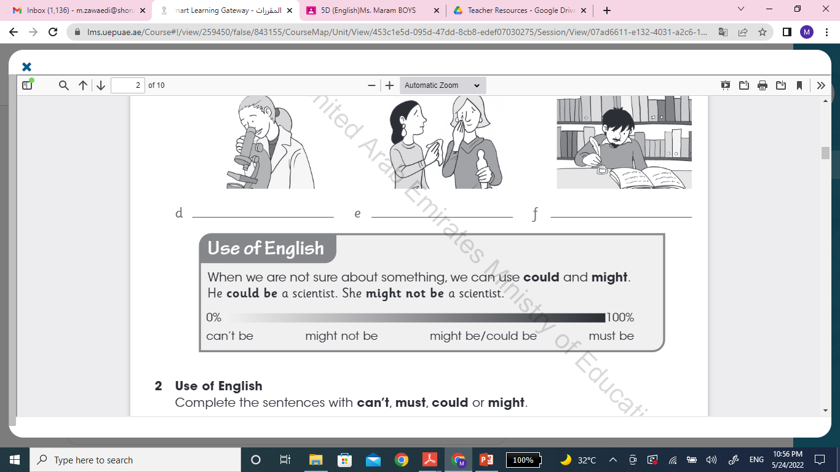
Modals
Can’t….sure it is not
Must….sure it is
Might or could….not sure
They are followed by infinitives.
Example: He can’t be a piano teacher. He can only play one song.

Slide 18
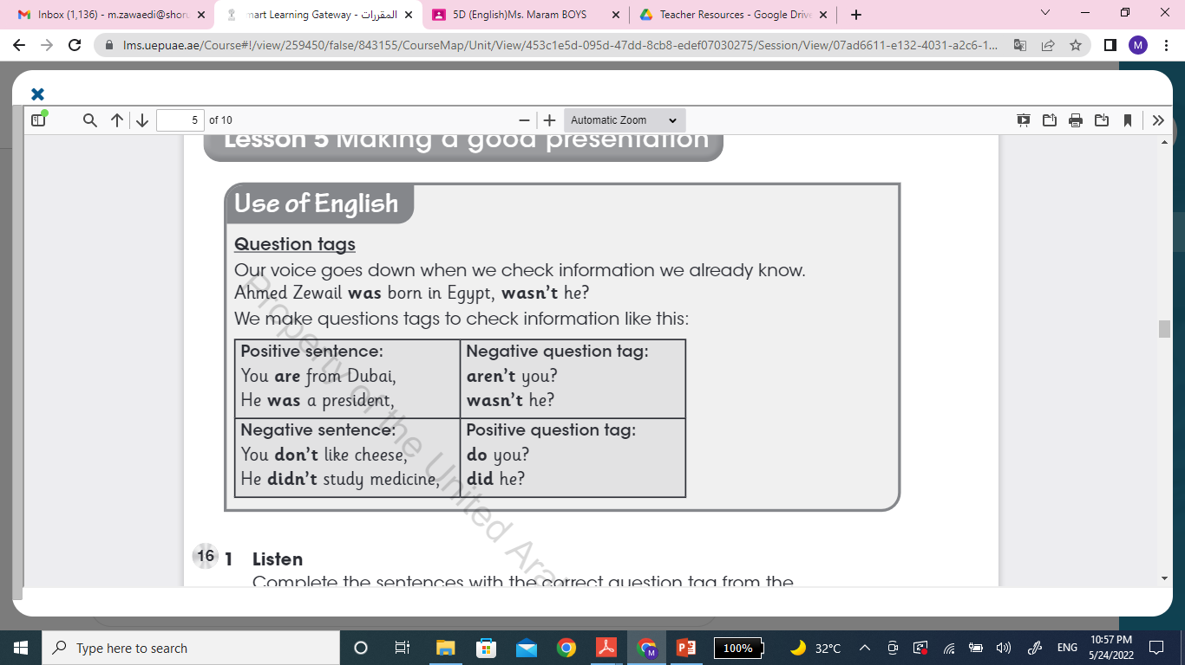
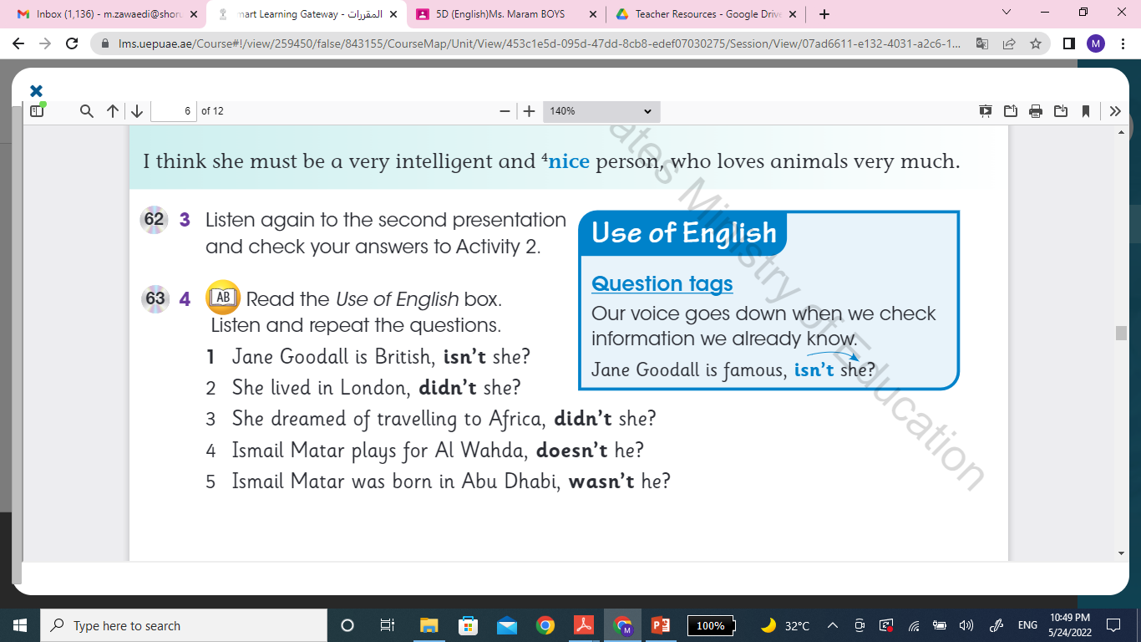
Grammar
Question Tags
Practice :
https://www.liveworksheets.com/nu681763jt

Slide 19
Wish you all the best

