Slide 1
Lesson 8: Language focus
Present simple questions

Slide 2
Distance Learning Guidelines
1) Please mute your microphones and cameras
2) Do not touch the screen or click on anything when the PowerPoint is showing
3) If you are joining us on a phone, please keep phones on silent
4) Do not record this session
5) If you have any questions you can write them on the chat or request to speak
6) Please write your name for me when you first enter the chat so I can monitor attendance
7) Please join the meeting at the assigned time

Slide 3
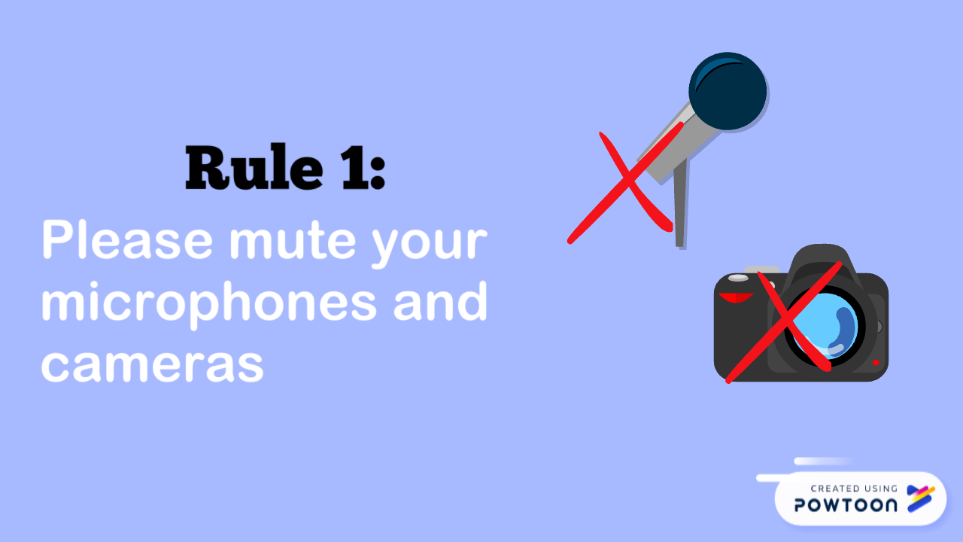
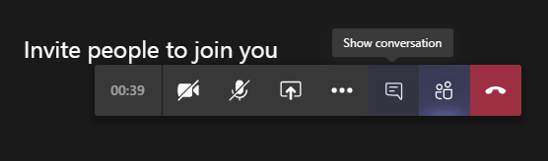

Slide 4
Learning Objective
To understand and use present simple questions

Slide 5


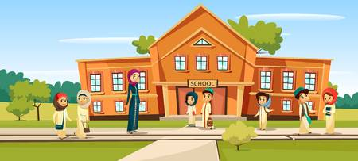

Starter

Slide 6
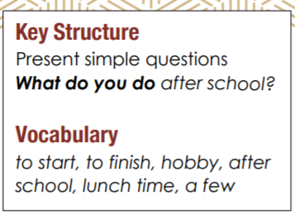

Slide 7
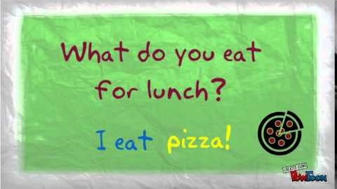
Let us watch a video

Slide 8
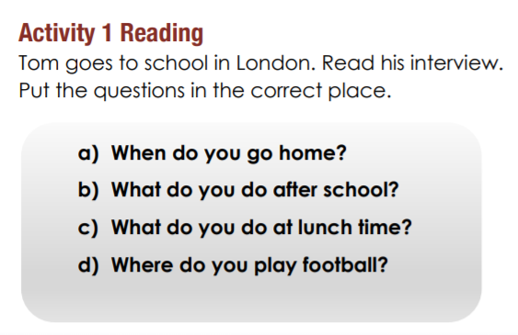
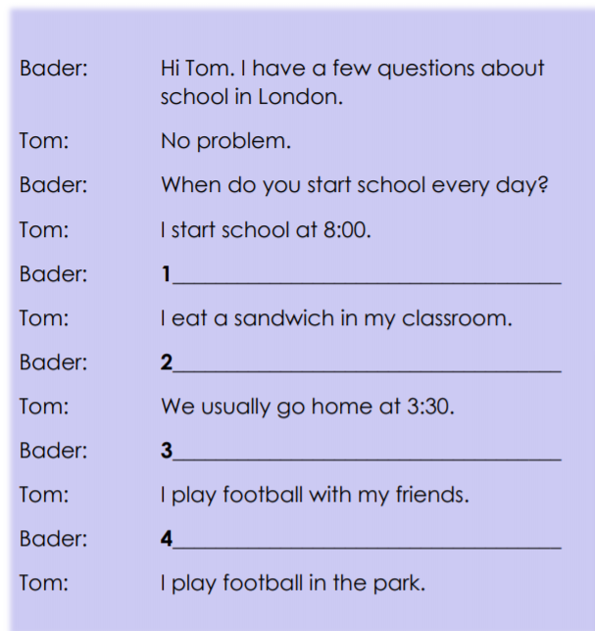

What do you do at lunch time?
When do you go home?
What do you do after school?
What do you do after school?

Slide 9
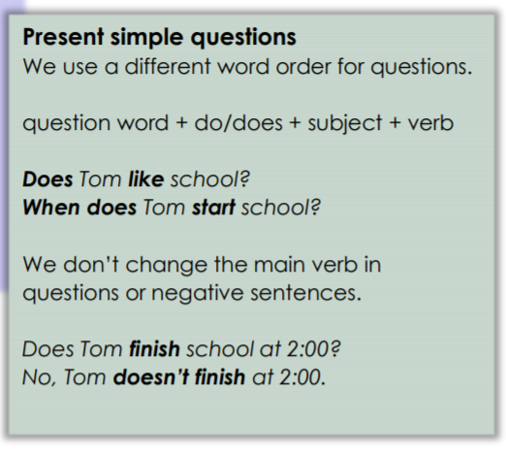

Slide 10
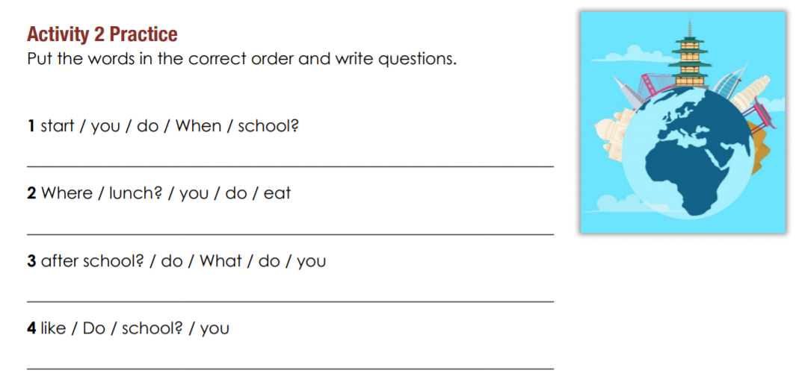
When do you start school?
When do you start school?
What do you do after school?
Do you like school?

Slide 11
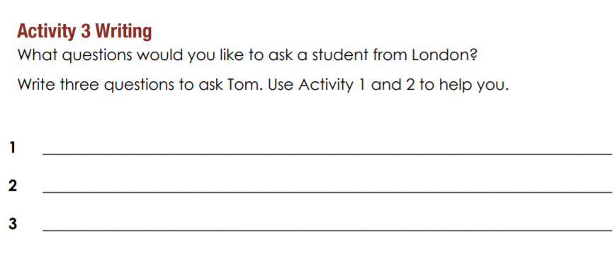
Write your answer to our chat board.

Slide 12
What did you learn today?

