Slide 1
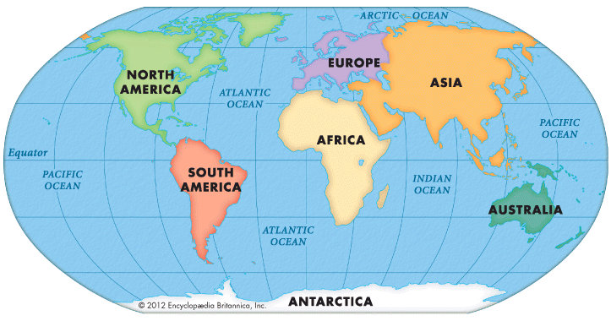
Do you know your geography?
Unit 4,Lessons 5–6

Slide 2
Learn the continents and Oceans
How many continents and Oceans are there?

Slide 3
How well do you know your geography?
Quiz
https://quizizz.com/admin/quiz/5faf507d8a09d5001ca56627

Slide 4
Read Part 1 of the story and underline the verbs in the past simple.
Circle the words in the past continuous.

Slide 5
Read Part 2 of the story and put the verbs in simple past or past continuous tense.

Slide 6
Read Part 2 of the story and put the verbs in simple past or past continuous tense.
continued
decided
was moving
arrived
climbed
walked
arrived
laughed
criticised

Slide 7
What is the moral of this story.

Slide 8
https://quizizz.com/join?gc=5296974&from=challengeFriends

Slide 9
Workbook Activity 5 : Complete the text with the correct form of the verb. Use the past simple or past continuous.
A Journey
King Akbar was travelling (travel) to a city a long way from his home. It was hot and he………………… (begin) to feel tired and bored.
‘Can anybody shorten this road for me?’ he …..……… (ask). The men ………………(look) at one another anxiously. They ……………. (say) there was no shorter road through the mountains to their destination.
‘I can,’ said Birbal.
‘You can shorten the road?’ said the king.

Slide 10
‘I can,’ said Birbal.
‘But first, listen to this story.’
Birbal ……………………(ride) beside the king and ……………… (begin) to tell a story.
It ………….(be) a very exciting tale, full of adventure and mystery. All the listeners …..………(be) fascinated. Before they knew it, they had reached the end of their journey.
‘We’ve arrived!’ ……………..(shout) Akbar. ‘So soon!’
‘Well,’ smiled Birbal, ‘you did say you wanted the road to be shortened.’
The emperor thanked Birbal for his clever ways.

Slide 11
Workbook Activity 5 : Complete the text with the correct form of the verb. Use the past simple or past continuous.
A Journey
King Akbar was travelling (travel) to a city a long way from his home. It was hot and he………………… (begin) to feel tired and bored.
‘Can anybody shorten this road for me?’ he …..……… (ask). The men ………………(look) at one another anxiously. They ……………. (say) there was no shorter road through the mountains to their destination.
‘I can,’ said Birbal.
‘You can shorten the road?’ said the king.
began
asked
looked
said

Slide 12
‘I can,’ said Birbal.
‘But first, listen to this story.’
Birbal ……………………(ride) beside the king and ……………… (begin) to tell a story.
It ………….(be) a very exciting tale, full of adventure and mystery. All the listeners …..………(be) fascinated. Before they knew it, they had reached the end of their journey.
‘We’ve arrived!’ ……………..(shout) Akbar. ‘So soon!’
‘Well,’ smiled Birbal, ‘you did say you wanted the road to be shortened.’
The emperor thanked Birbal for his clever ways.
was riding
began
was
were
shouted

Slide 13
Review Alef Lessons 23 & 32
Plenary
Past Simple Tense
And
Past Continuous Tense.

