Slide 1
English
Access Book 6
Unit 2: Sport
Lesson 10: Review

Slide 2

Lesson Outcomes
Students will be able to:
Participate in class discussions.
Complete the sentences with the words in the box.
Complete the sentences with the comparative form of each adjective.
Ask and answer questions.
Read an email and determine who it’s from.
Determine whether the sentences are true or false.
Answer Kareem’s questions and write 3 sentences in the email reply.

Slide 3
hard-working
goalposts
warm up
basketball
match
healthy
week

Slide 4
taller
faster
easier
shorter
more difficult

Slide 6

Starter: Look at the logos. What are they?
What are emails used for?

Slide 9
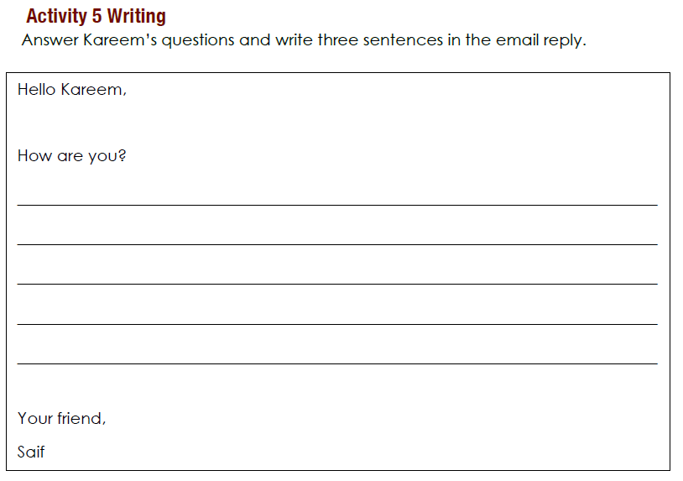
Yes, you can play with me.
I like to swim, play tennis, and play football as well.
You should come to my house this weekend to play football.

