Slide 1
Unit 1
In and Out of School
Lesson : 7
The infinitive
Page : 7

Slide 2
Objectives:
*To use the verb + infinitive with to form correctly in speech.
*To use the verb + infinitive with to form correctly in sentences

Slide 3


Slide 4
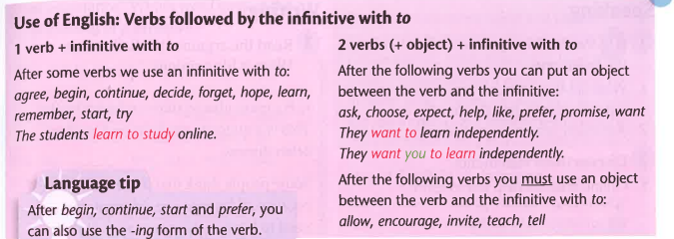

Slide 5
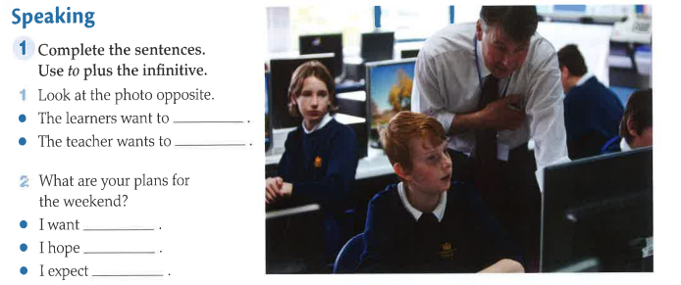

Slide 6
Complete the sentences using the verbs in brackets
Which club do you want?
The cookery club.
I……… (want) join

Slide 7
Complete the sentences using the verbs in brackets
Ali was carrying a heavy bag?
I carried with him.
I……… (help)
………………………………………………………………

Slide 8
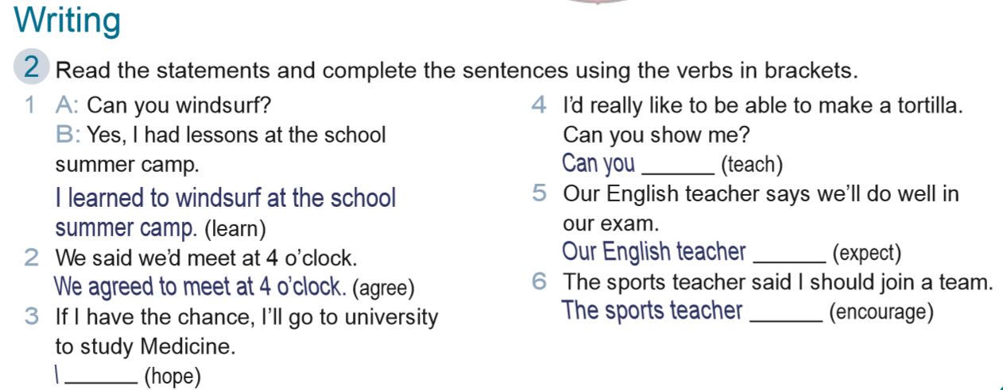

Slide 9
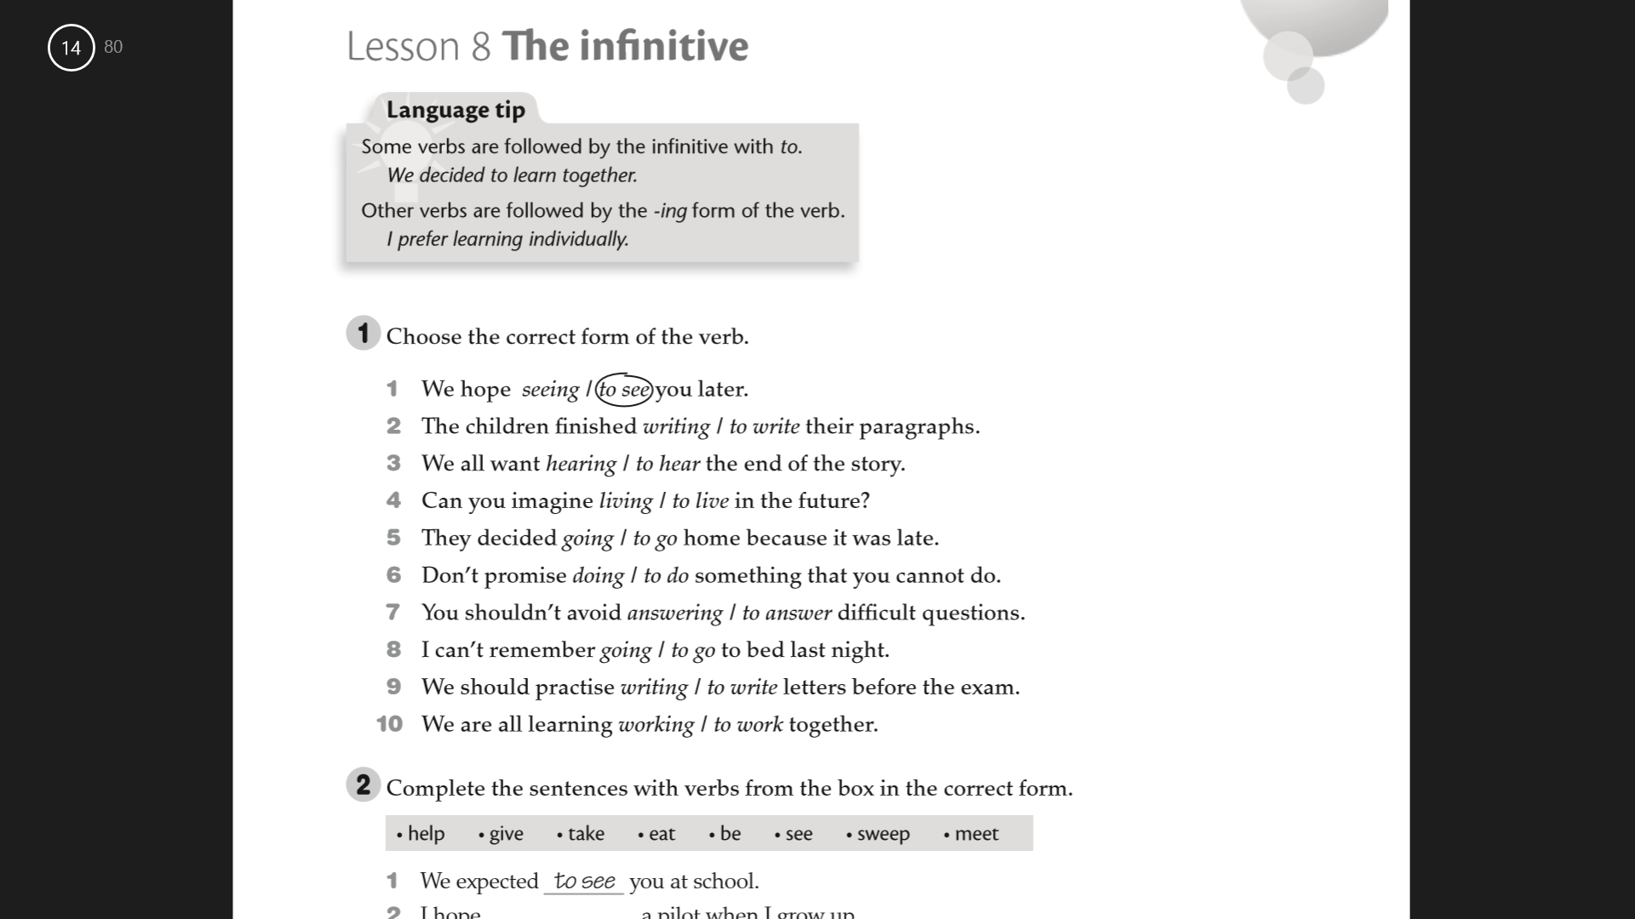

Slide 11
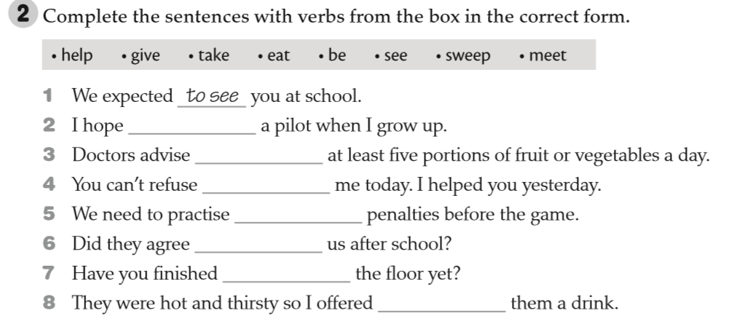
to be
eating
helping
taking
to meet
sweeping
to give

