Slide 1
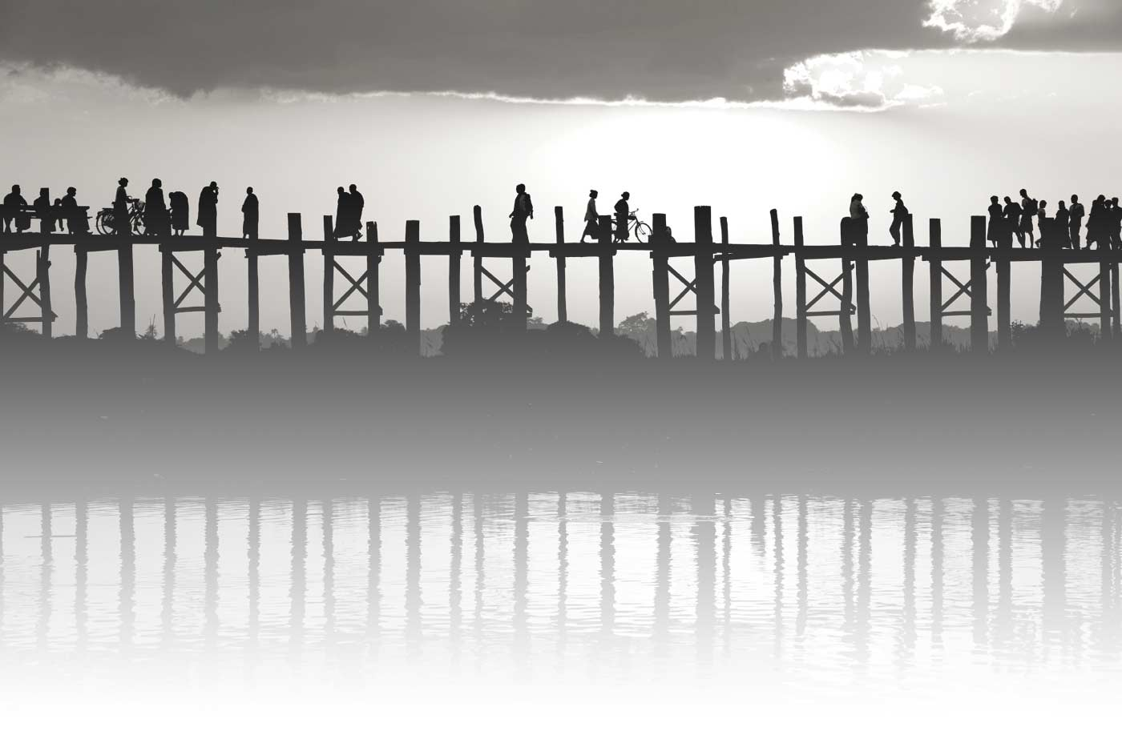
Unit Two
Local Community
Lessons 10-11
You and your city

Slide 2
Lesson 10

Slide 3
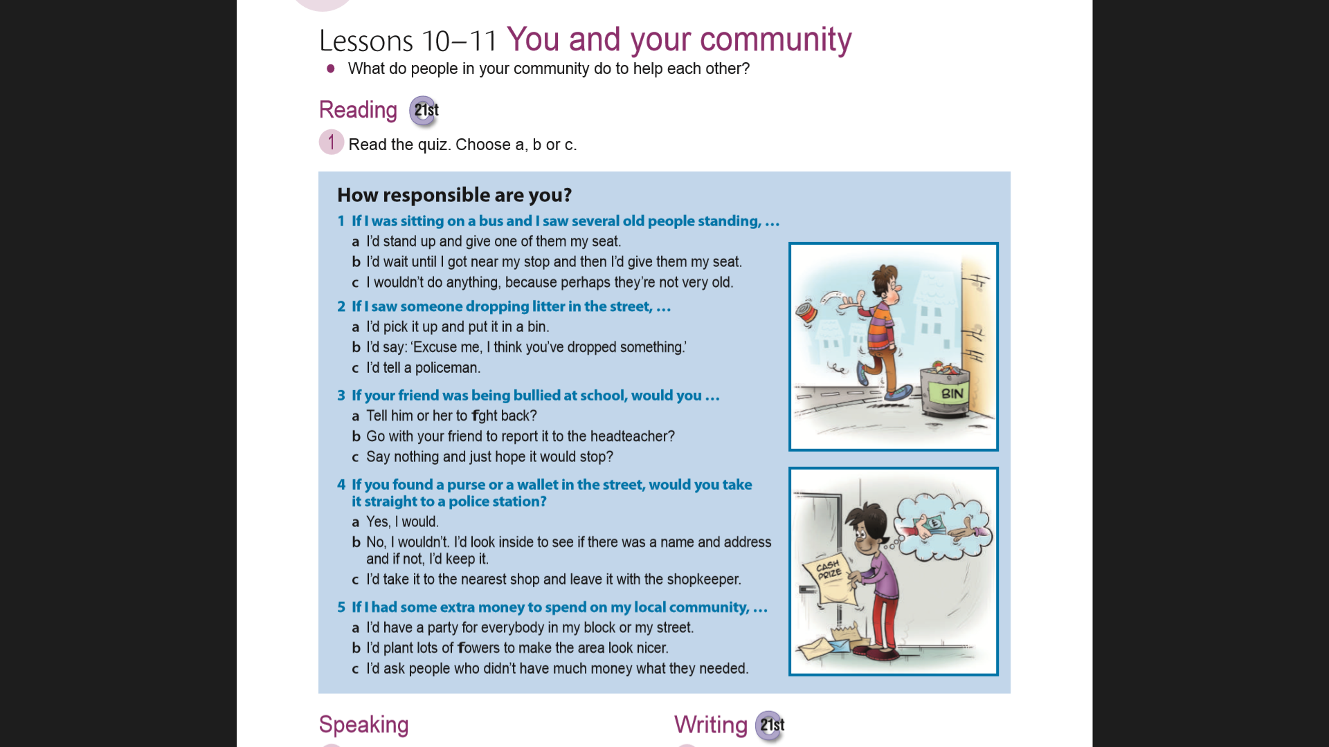

Slide 5
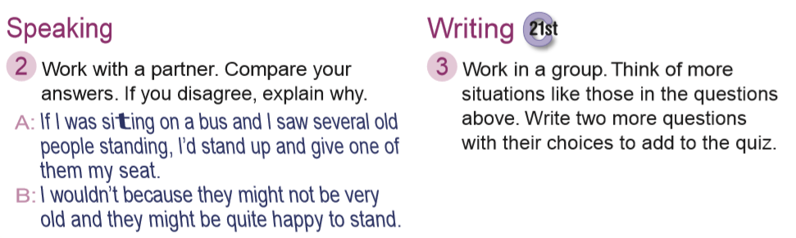
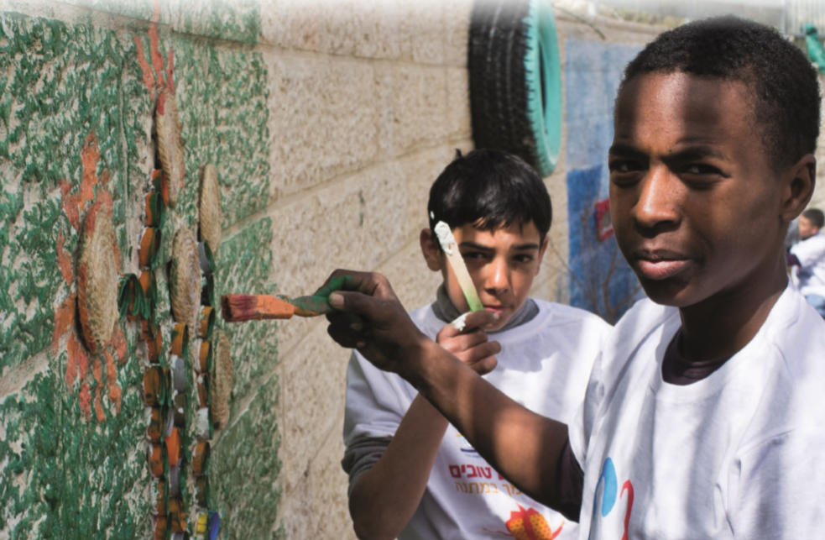

Slide 6
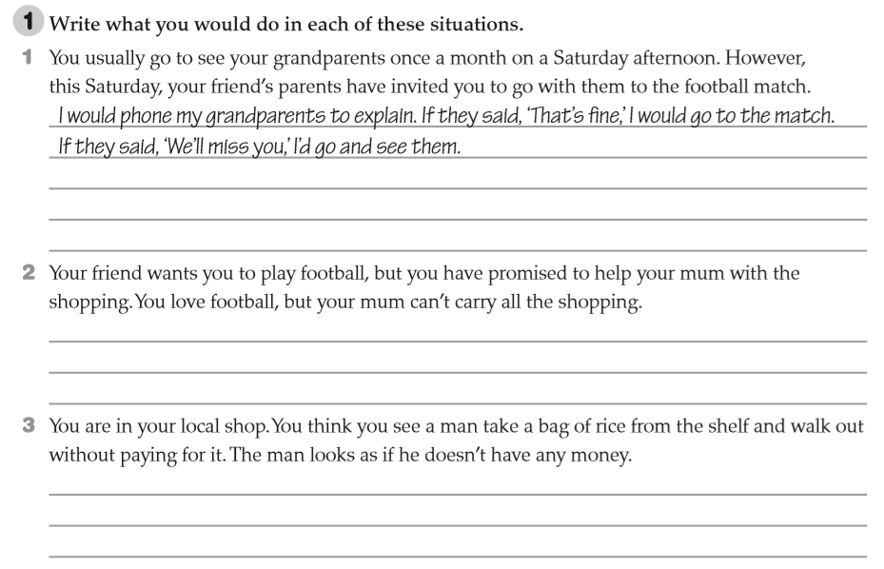

Slide 7
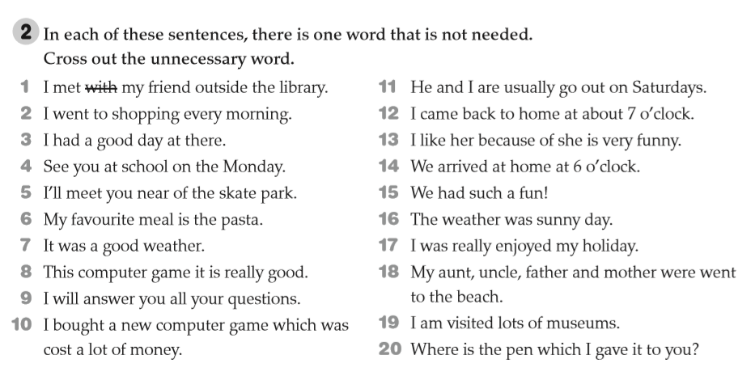

Slide 8
Lesson 11

Slide 9
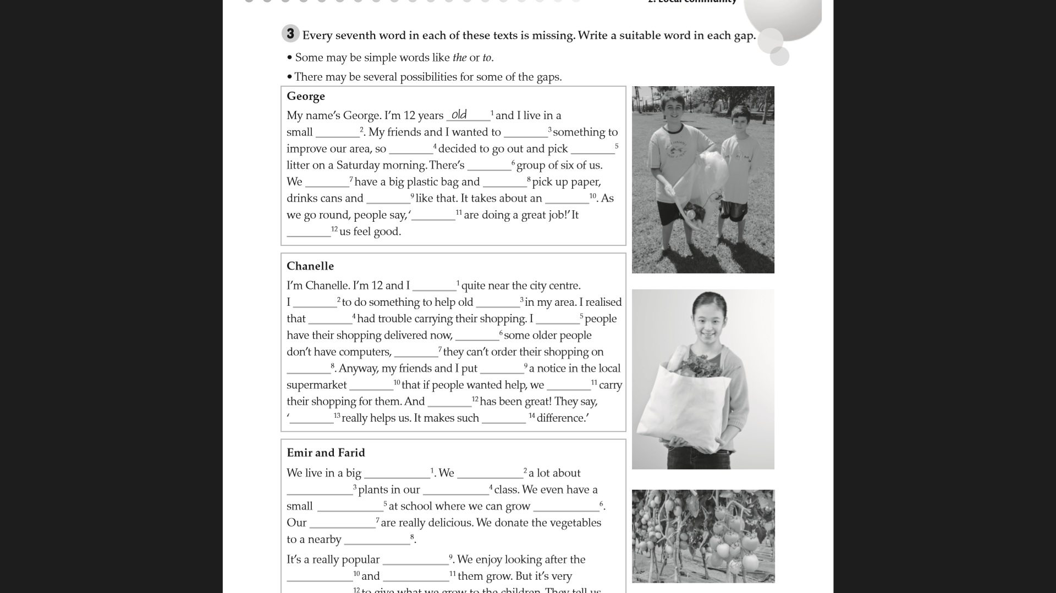
town
do
we
up
a
each
we
things
hour
you
makes

Slide 10
live
wanted
people
they
know
but
so
line
up
saying
would
it
this
a

Slide 11
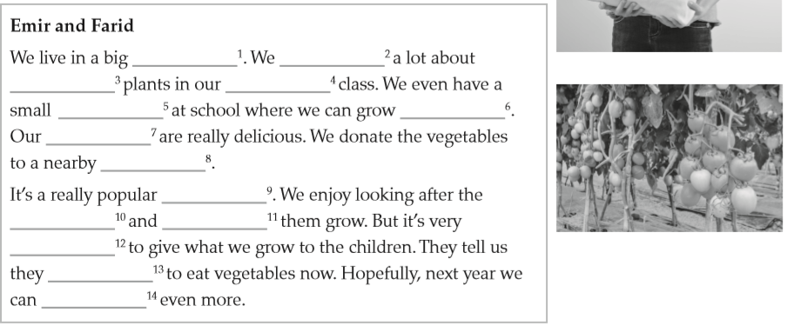
city
learned
growing
Biology
garden
vegetables
tomatoes
orphanage
project
plants
watching
rewarding
love
donate

Slide 12
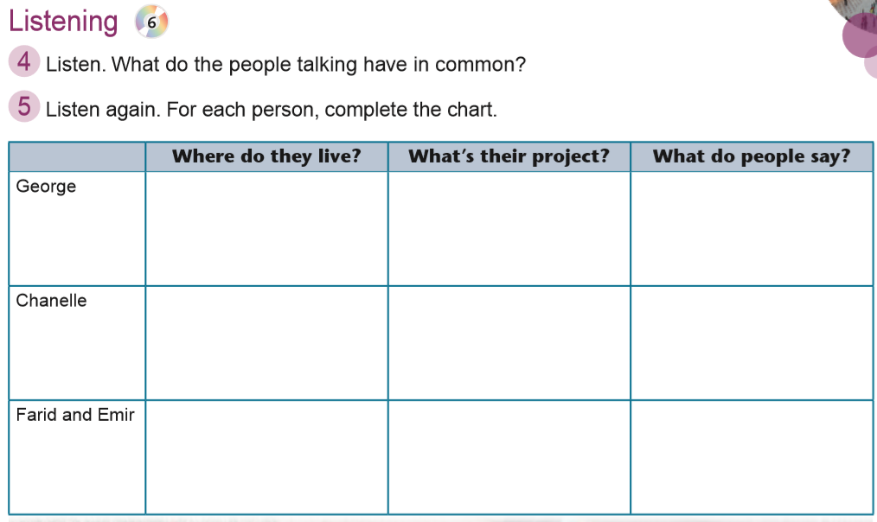
In a small town
Pick up litter
You’re doing a great job!
Near the city centre
Carry shopping home for old people
This really helps us. It makes such a difference!
In a big city
Growing vegetables to donate to the orphanage
They love to eat vegetables

