Slide 1
English Reading Exam
Exam Date:
Exam will be taken on Swift Assess

Slide 2
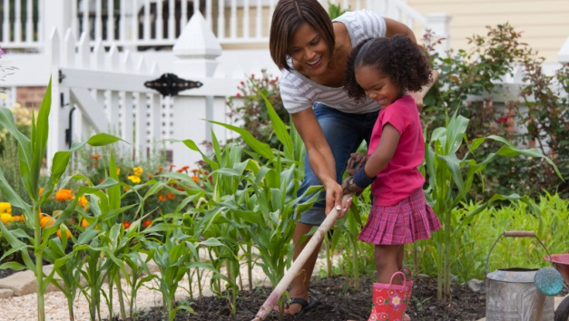
***IMPORTANT***
Important Notes:
1.Each question has a time limit displayed by a timer opposite the question.
2. Students must make sure the question is answered before moving on to the next one and before the question time limit ends.
3. At the end of the question allotted time, a student cannot answer or change the response, and s/he must directly move on to the next question.
4. When a student moves on to the next question, s/he cannot go back to the previous one.
Notes:
NOTE: To change images on this slide, select a picture and delete it. Then click the Insert Picture icon in the placeholder to insert your own image.

Slide 4
Read about how students spend their free time. For questions 1 – 7, choose T
(true) or F (false).
There is one EXAMPLE.
Free Time
Rashid
Saturday is my favourite day, because I can do what I want to do. I spend threequarters of my free time outside. I like to play sports, but I usually don’t have other people to play with. When I am alone, I ride my bike or go running. My friend spends ninety percent of his time inside. He likes to read a lot. When he comes outside, we play tennis or go for a walk, but he doesn’t like to go running. When I must be inside, play computer games, but I prefer being outside.
Shamma
I spend most of my free time writing stories. Ninety percent of my stories are about animals. Before I write, I use the internet to learn about the animal. My last story was about a tiger who played tennis. Right now, I am writing about a lion. In my story, he wants to learn to speak like a mouse. Every day, he goes to Mouse Language School. After school, he spends time in the park so he can practice speaking with mice. I write about animals, but in my stories, they do things that people do.
Eman
I think I spend half of my free time inside and half outside. When I’m inside, I spend three-quarters of my time cooking. I like cooking for my family, and they like it too. The rest of the time, I spend reading and using the internet. When I’m outside, I like to work in the garden. Sometimes, I take a book outside with me, so I can read in the garden. I also enjoy walking with my friends. We read the same books, so we like to walk and talk about what we read.

Slide 5
EXAMPLE: Rashid spends most of his free time outside. T F
1. Rashid goes running with his friend. T F
2. Rashid’s friend spends 90% of his free time playing tennis. T F
3. Most of Shamma’s stories are about animals. T F
4. Shamma goes to a language school. T F
5. Shamma’s story is about a tiger who learns to speak a new language. T F
6. Eman spends three-quarters of her free time cooking. T F
7. Eman and her friends like to talk about books. T F

Slide 6
Read this email from Abdullah to Mostafa. Choose the correct word from the box to complete each sentence for questions 8 – 14. There is one word you do not need. There is one EXAMPLE.
An Email to a Friend
Dear Mostafa,
I am writing to thank you for telling me to write a blog. I am very happy now because many people read my words every day. You told me to write about my favourite free time activity, so I write about sports. You know how much I like basketball, but I also write about football, volleyball, swimming, and cycling. Seventy percent of my blog is about playing sports. Twenty percent is about watching sports. And ten percent is stories I write about sports. My last story was about someone learning how to play basketball. It wasn’t a true story, but my friends liked it a lot. I read that eighty percent of people spend twenty percent of their free time using the internet. And most of those people like to read blogs about free time activities. Reading a blog tells them about the activity and the person who does it. When people read my blog, they learn about me and my life. Anyone who reads my blog knows that I like sports and I like writing, but they don’t know that I also like cooking and painting. I think it would be fun to write about these things too. Maybe I will write three different blogs: one about cooking, one about painting, and one about sports. I know that you don’t like cooking, but you like eating. Will you read my cooking blog?
Your friend,
Abdullah

Slide 7
internet sports painting writing playing story person blog cycling
Example: Mostafa told Abdullah to write a blog.
8. Abdullah’s favourite free time activity is _______________.
9. Abdullah writes about basketball, volleyball, swimming, and ______________.
10. Most of Abdullah’s blog is about _______________ sport.
11. Abdullah’s friends like his last _______________.
12. Most people use the ______________ in their free time.
13. A blog tells people about the activity and the ______________.
14. People don’t know that Abdullah likes cooking and ____________.

Slide 8
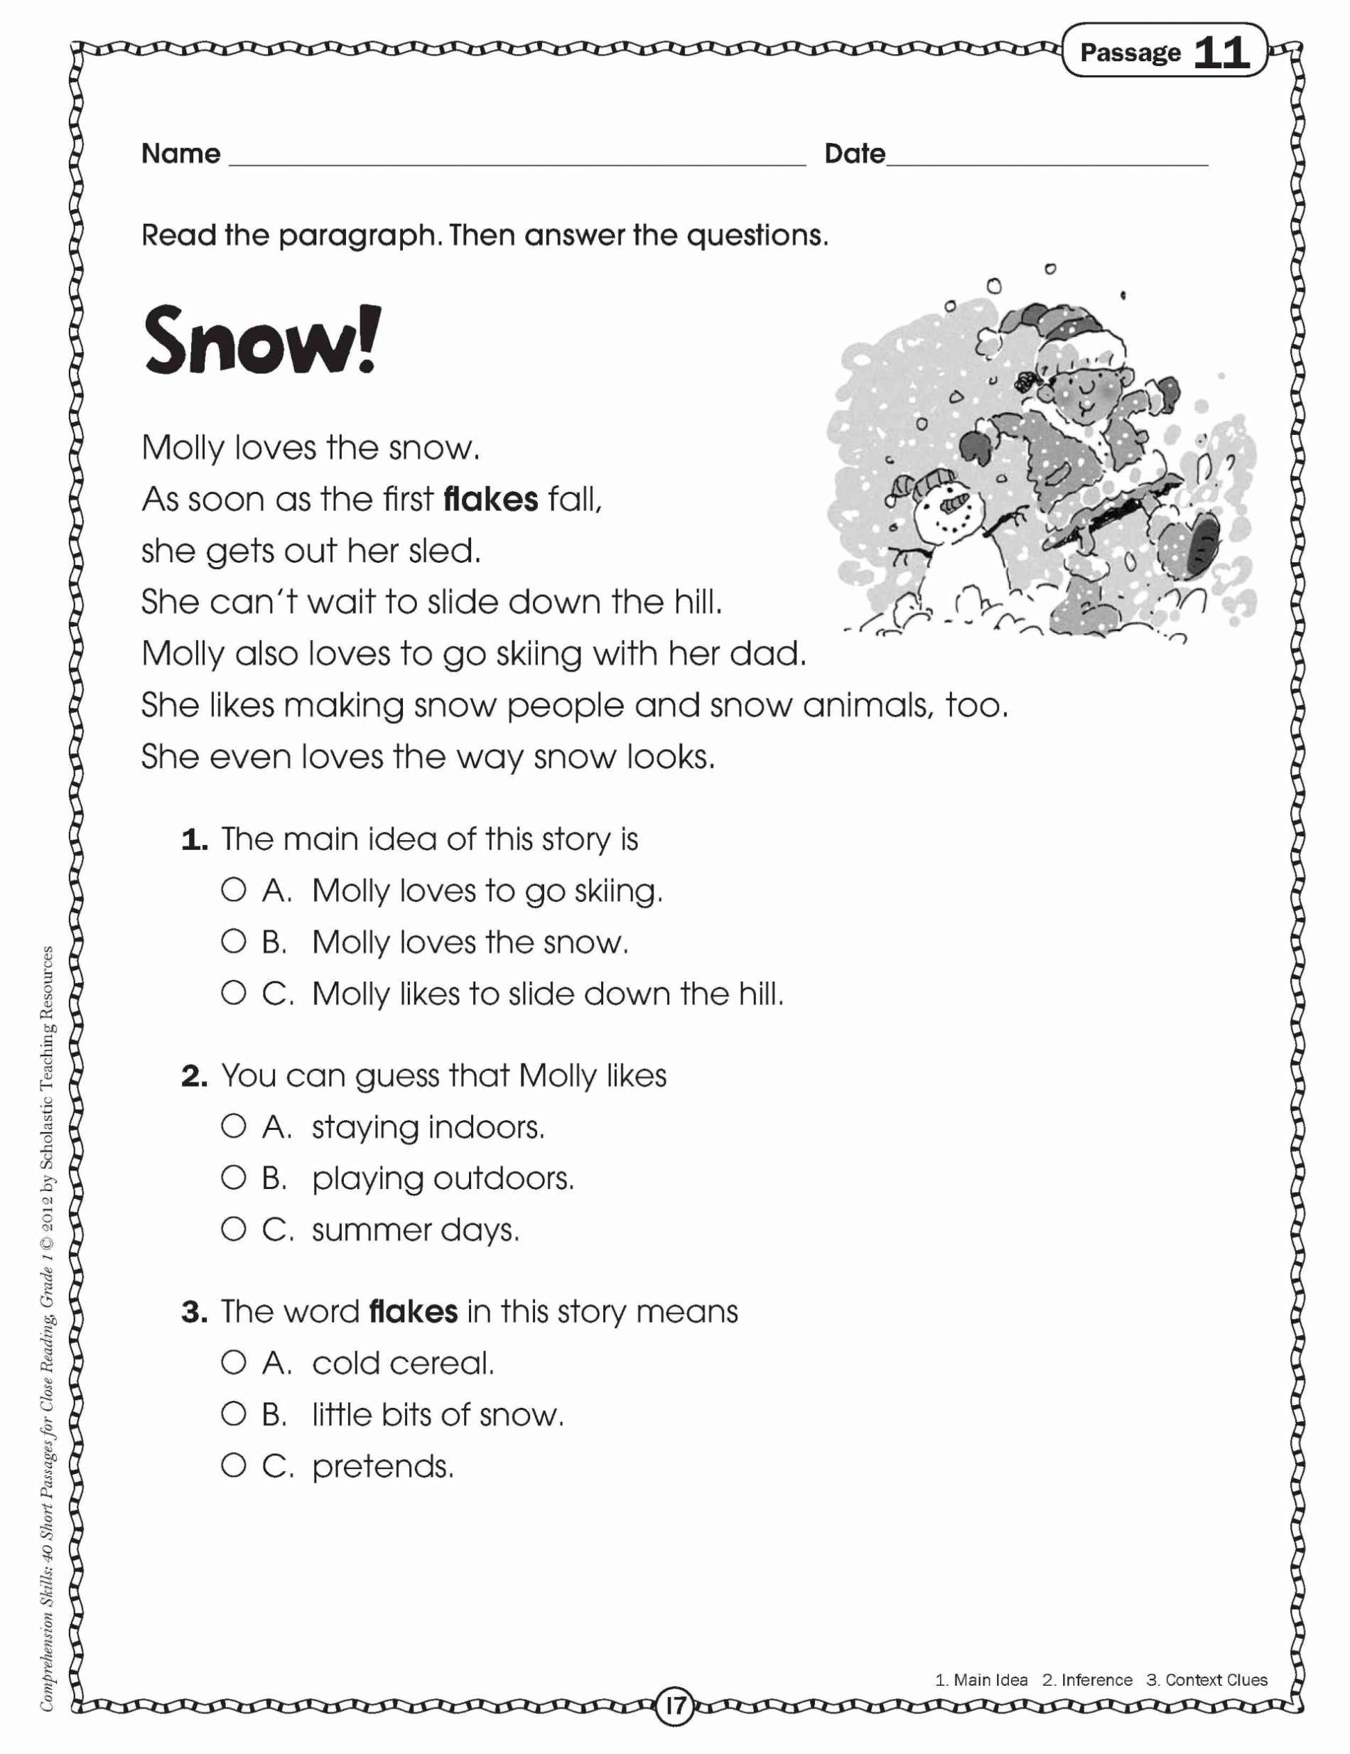

Slide 9
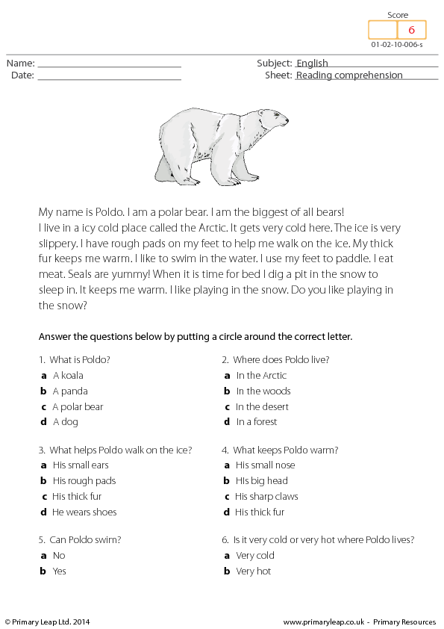

Slide 10
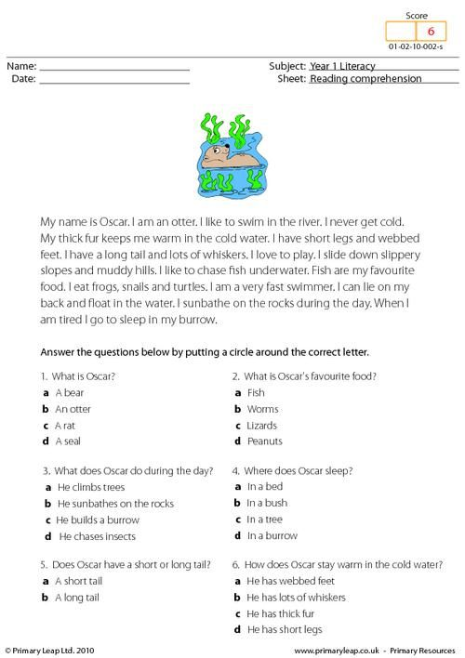

Slide 11
VOCABULARY - UNIT 8 – People and numbers
to share, to spend, to explain, double, feeling, pleased building, museum, famous places, the Pyramids, elephant, lion to steal, palace, prison, gold, poor, rich, farmer free time, subject, volleyball, to prefer, classmates building, continent, country, ocean, mountain fraction, half, quarter, an hour, to read comics, to go running, to rest, garden per cent, quarter, internet, painting, cooking, activity zoo, leopard, caracal, type, woods, lake, cute a quarter of, half of, most of, all of, advice, survey

Slide 12
VOCABULARY - UNIT 9 – Climate and weather extreme weather, weather report, sand, storm, hurricane, aeroplane, thunderstorm, thunder, lightning, sound, to hear, far away, extreme weather, gas, unusual, flood, sandstorm, hurricane, heatwave, umbrella, hat, gloves, scarf, raincoat, boots degrees, wind, windy, light, strong, heavy, temperature, humid, dry, wet, cloudy, high, low, to feel, unhappy, sunny, inside, humid, cool summer, autumn, winter, spring, rainy, cold, snowy, warm

Slide 13




