Slide 1






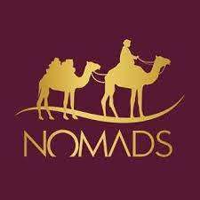
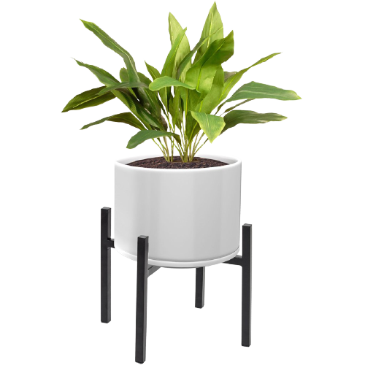
Tuesday
August, 31st 2021
Unit 1: Looking Back
Lesson 1&2: Days gone by
Pages: 1&2
Life is better with education

Slide 2

Objectives:
To identify the meaning of new words.
To listen and identify specific information in simple, extended texts on familiar and some unfamiliar concrete topics.
3. To use the new vocabulary in meaningful sentences.
4. To talk about Union Day in the UAE.

Slide 3
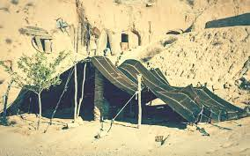
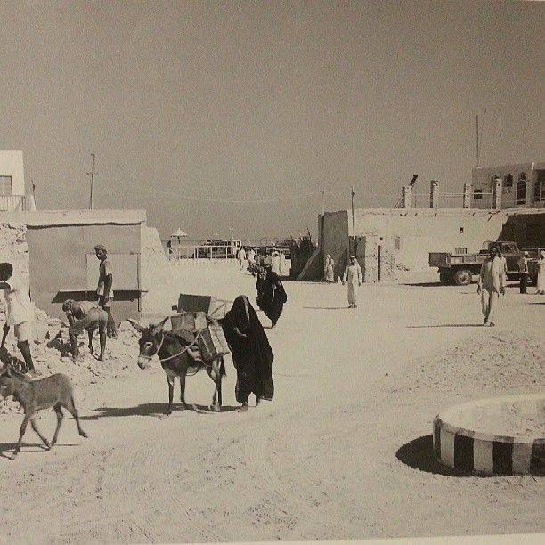
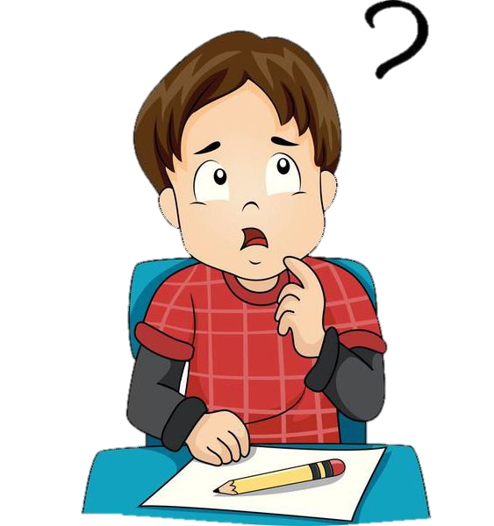
What do you know about the history of the UAE?
What was life like 50 years ago?

Slide 4
Vocabulary Words
Nomads | Bedouin
Ancient | Values
Tribes | Generations
Industry | Population
Export | Import

Slide 5
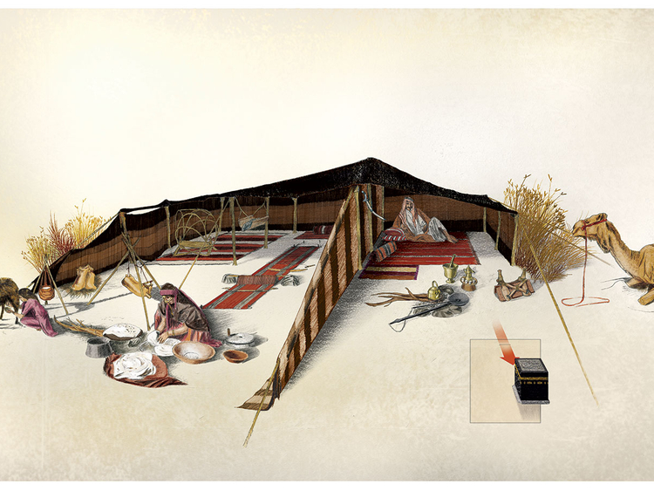
Nomads/ Bedouin
A member of a people having no permanent house, and who travel from place to place to find fresh grasslands for their livestock.

Slide 6
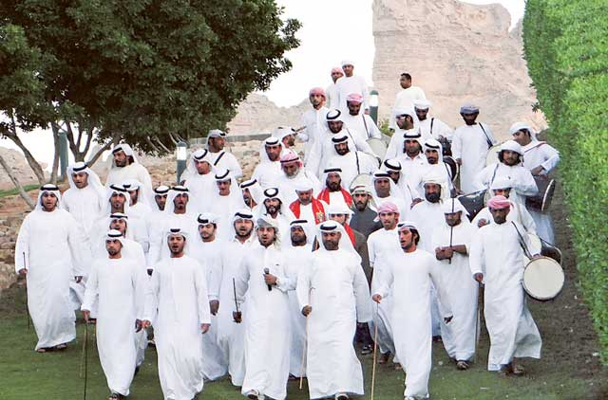
Tribes
A social division in a traditional society consisting of families or communities linked by social, economic, religious, or blood ties, with a common culture and dialect, typically having a recognized leader.
AlShamisi, Al Nuaimi, Al Amri, Al Mansouri

Slide 7
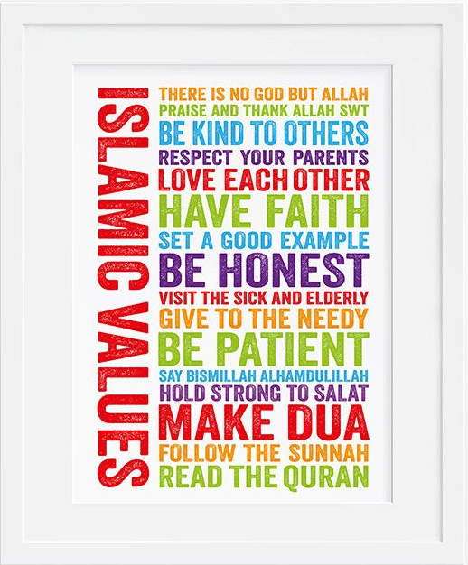
Values
A person's principles or standards of behavior; one's judgment of what is important in life.

Slide 8
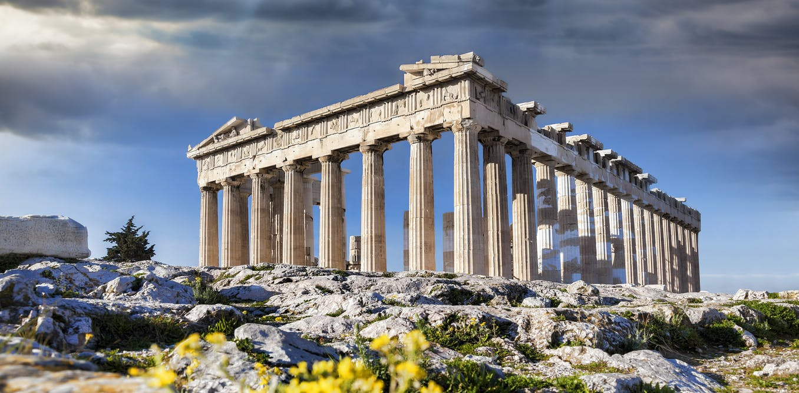
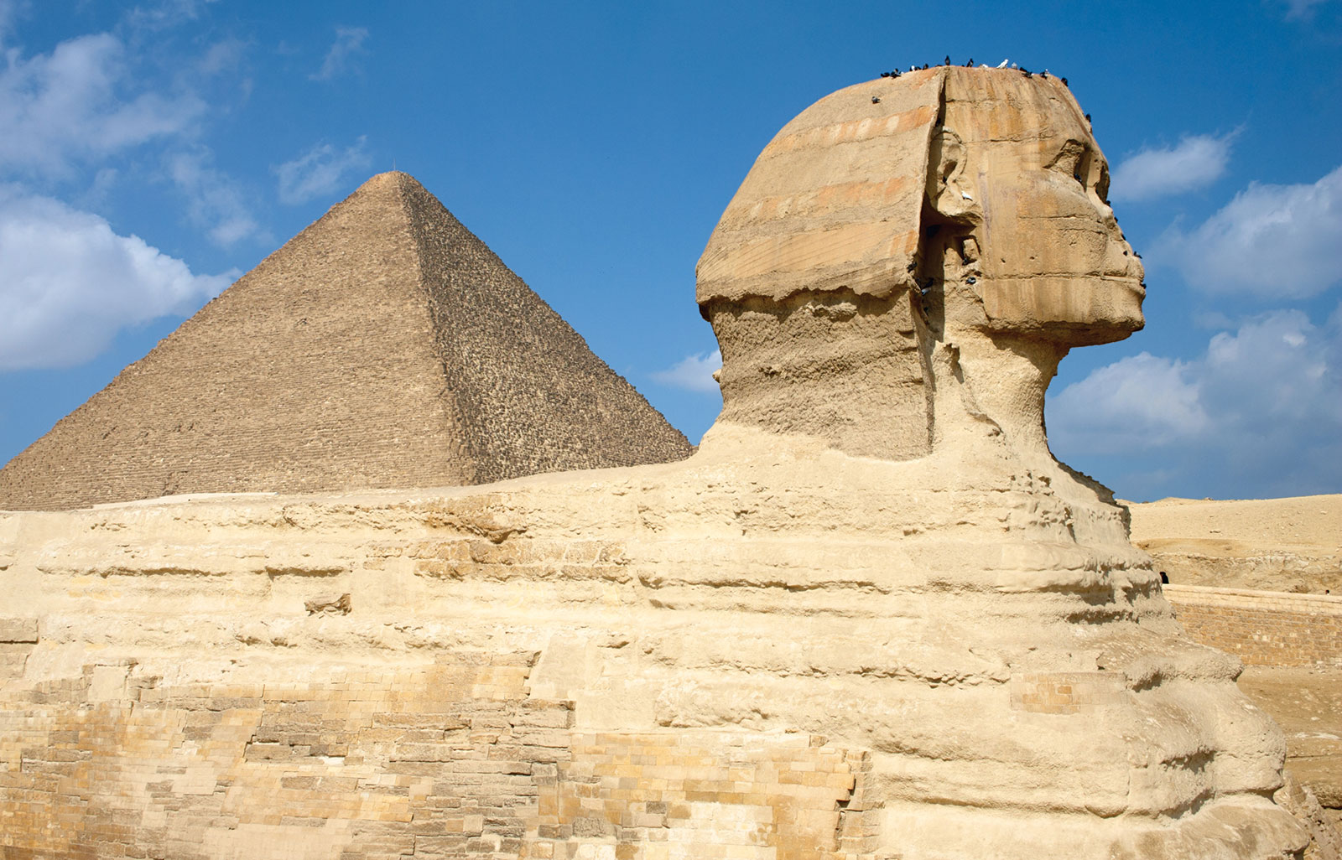
Ancient
belonging to the very distant past and no longer in existence.
old, outdated

Slide 9
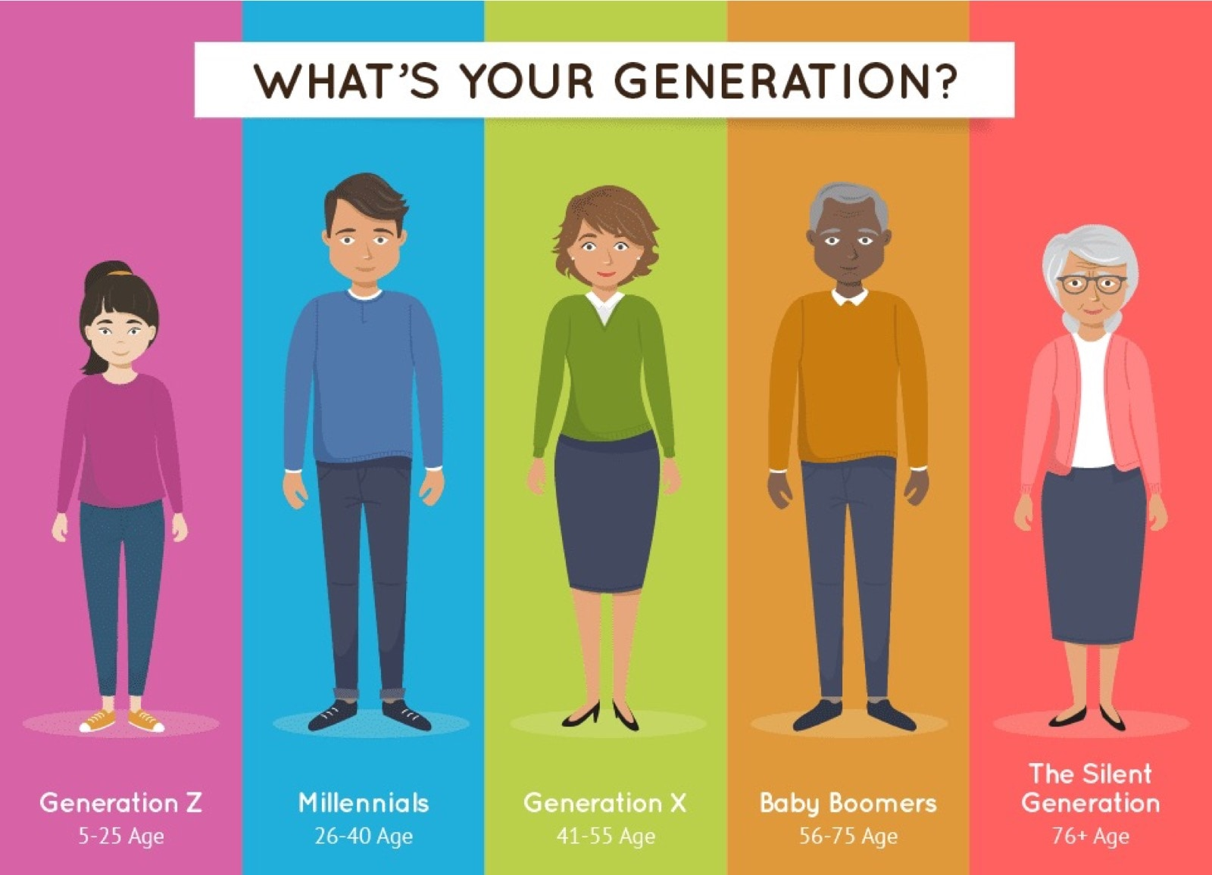
Generations
All of the people born and living at about the same time, regarded collectively.

Slide 10
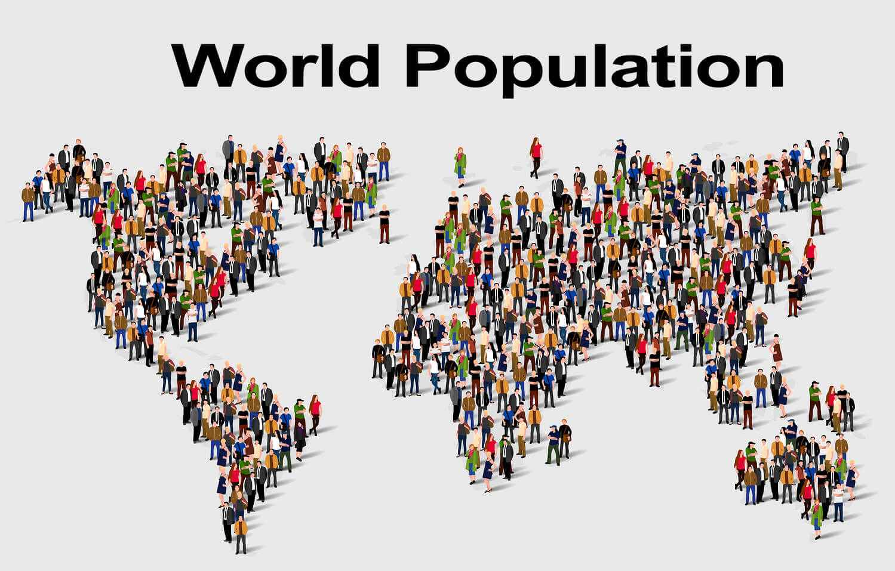
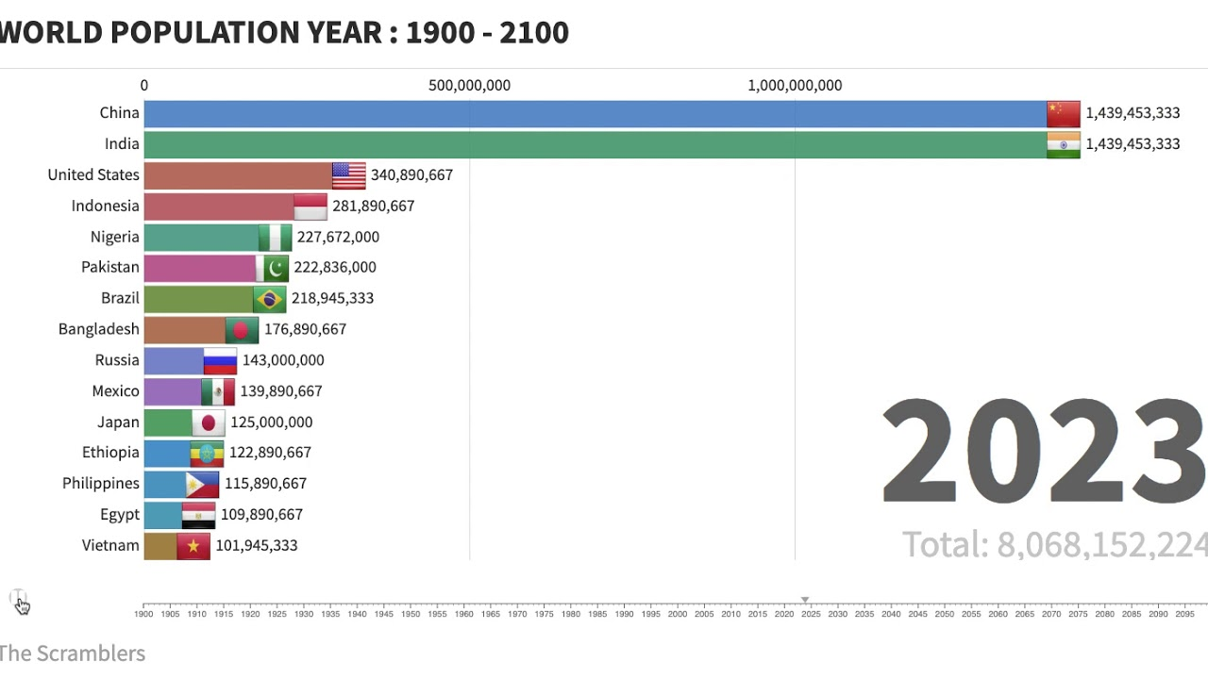
Population
All the inhabitants of a particular town, area, or country.

Slide 11
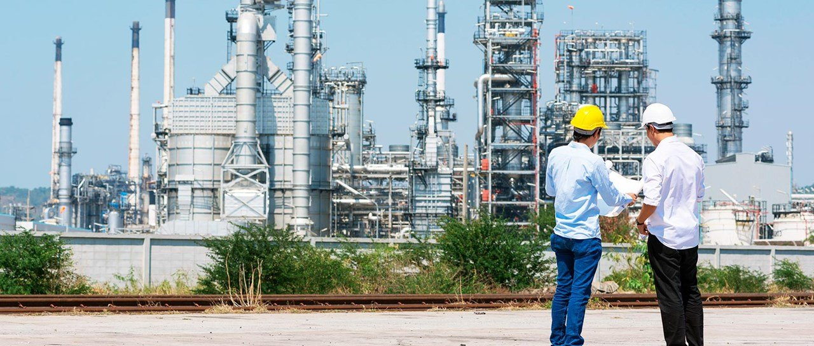
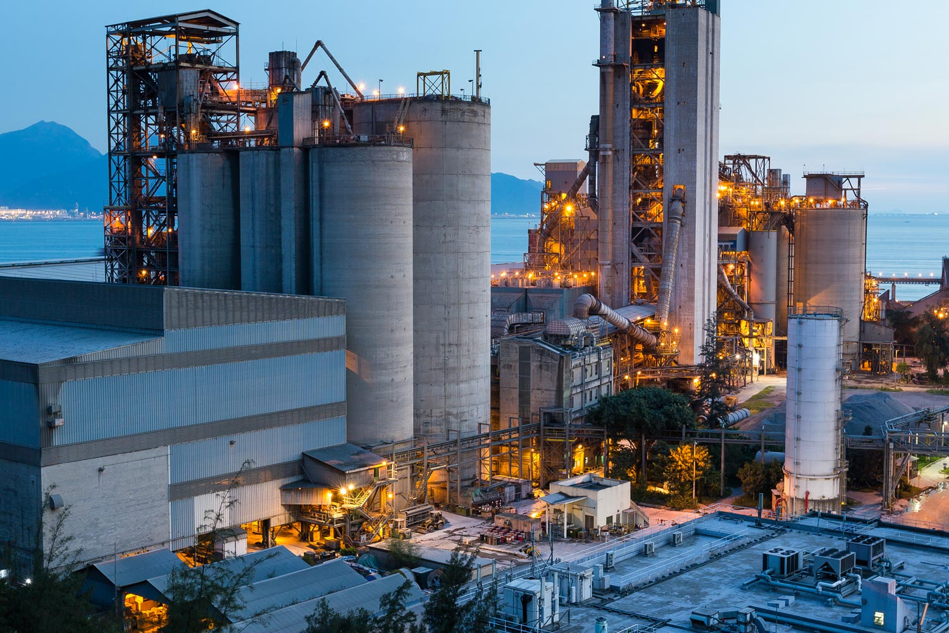
Industry
Economic activity concerned with the processing of raw materials and manufacture of goods in factories.

Slide 12
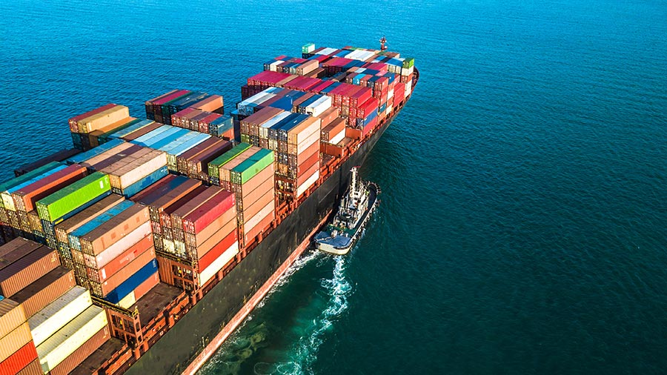
Import # Export
Import:
To bring (goods or services) into a country from abroad for sale.
Export:
To send (goods or services) to another country for sale.

Slide 13
Sunday
August, 29th 2021
Click on the link to complete the vocabulary Activity
https://www.liveworksheets.com/ea2273441mj
Life is better with education

Slide 14
Vocabulary Activity
Complete the sentences with words from the box.
Nomads | Exports | Imports | Values | Industry | Population | Generations | Ancient | Tribes
1. My brother works in ……………………….. He is manager of plastic factory.
2. There are many …………………in the UAE. For example, Al Shamisi and Al Amri.
3. The future …………………….are going to use solar energy and wind energy.
4. The …………………………of the UAE is 9.771 million.
5. All Muslims have the same Islamic …………………………, like respect, patience,…etc
6. The Sphinx is one of the ……………………….wonders of the world.
7. ……………………………are people who live in the desert and travel looking for food and water.
8. The UAE …………………………dates and oil and natural gas to other countries, while it ………………….. machinery and electrical equipment, textiles, metals, plastics and chemical products, and furniture from China and other countries.
industry
tribes
generations
population
values
ancient
Nomads
exports
imports

Slide 15


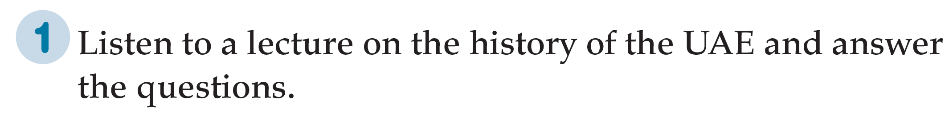
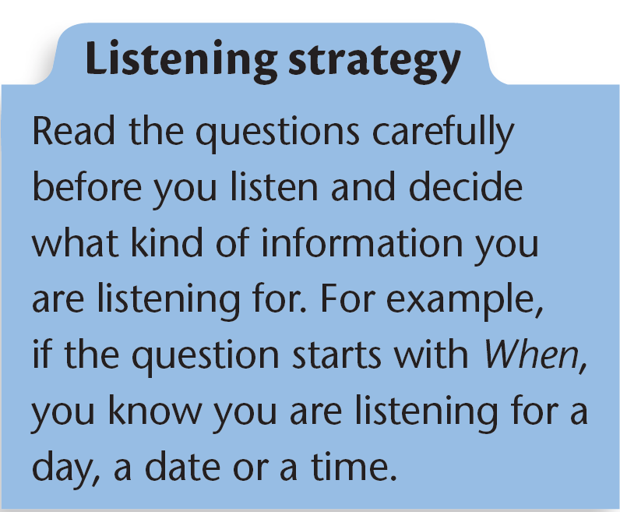
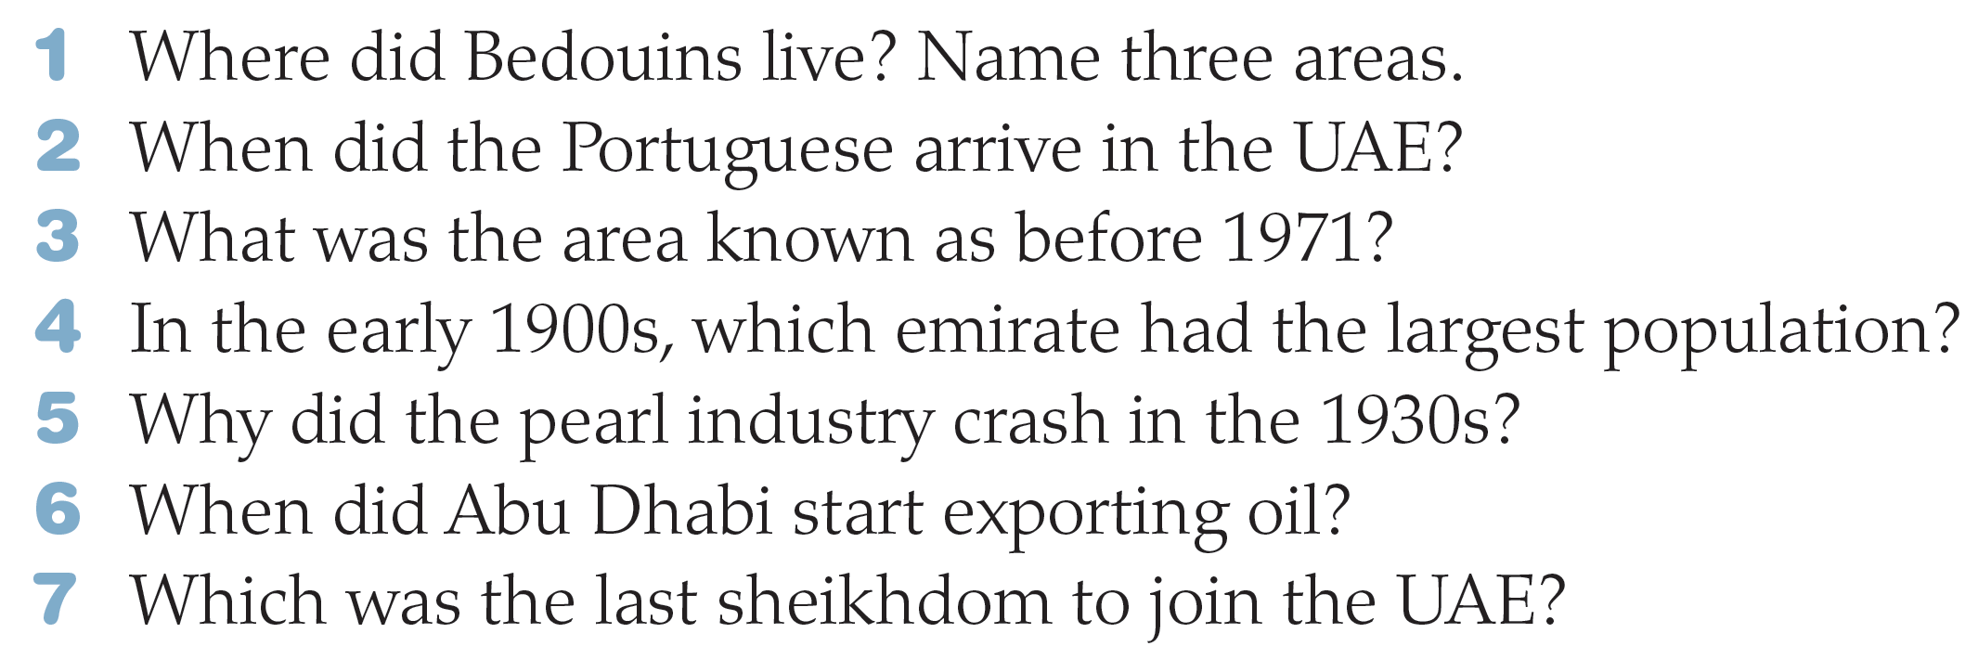

Slide 16
Oceans, oases, and deserts.
In 1498
The Trucial States.

Slide 17
Sharjah
Because of the Japanese invention of the cultured pearls
In 1962.
Ras Al Khaimah in 1972

Slide 18
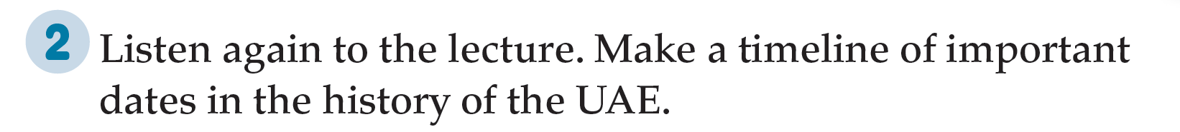
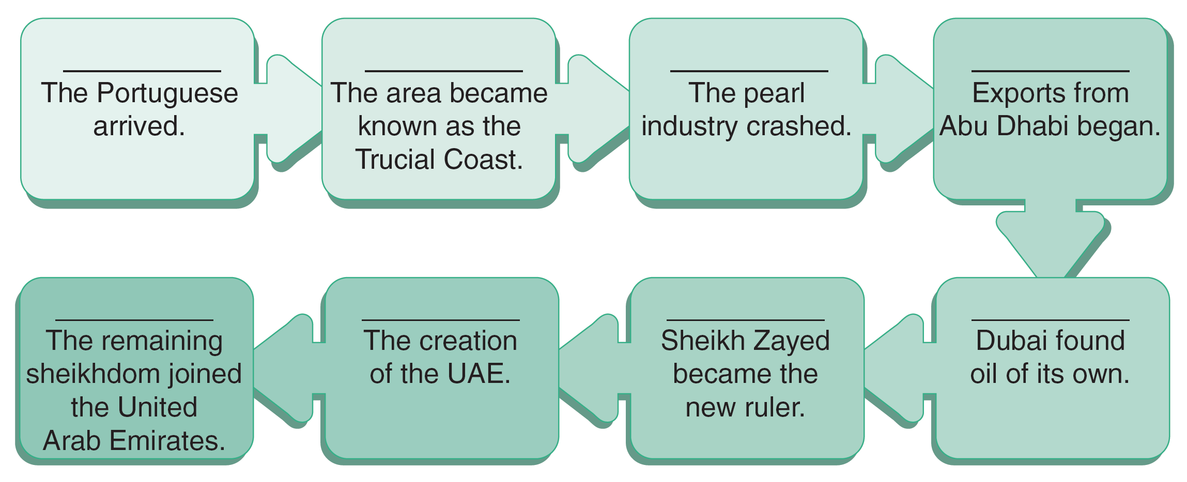
1498
1820s
1930s
1962
1972
1971
6th August 1966
Mid-1960s

Slide 19
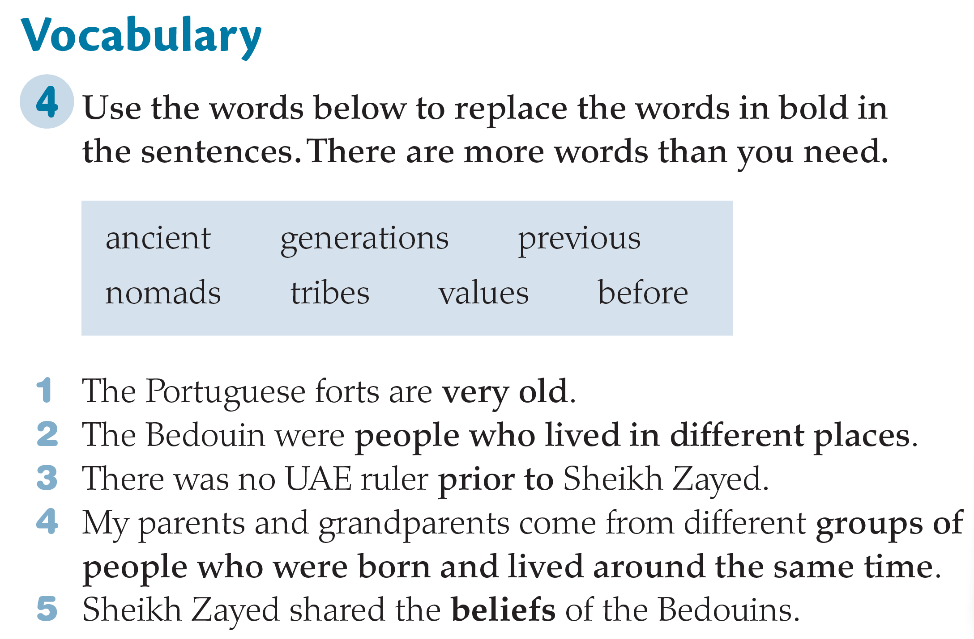
https://www.liveworksheets.com/mi2273489pt

Slide 20


