Slide 1
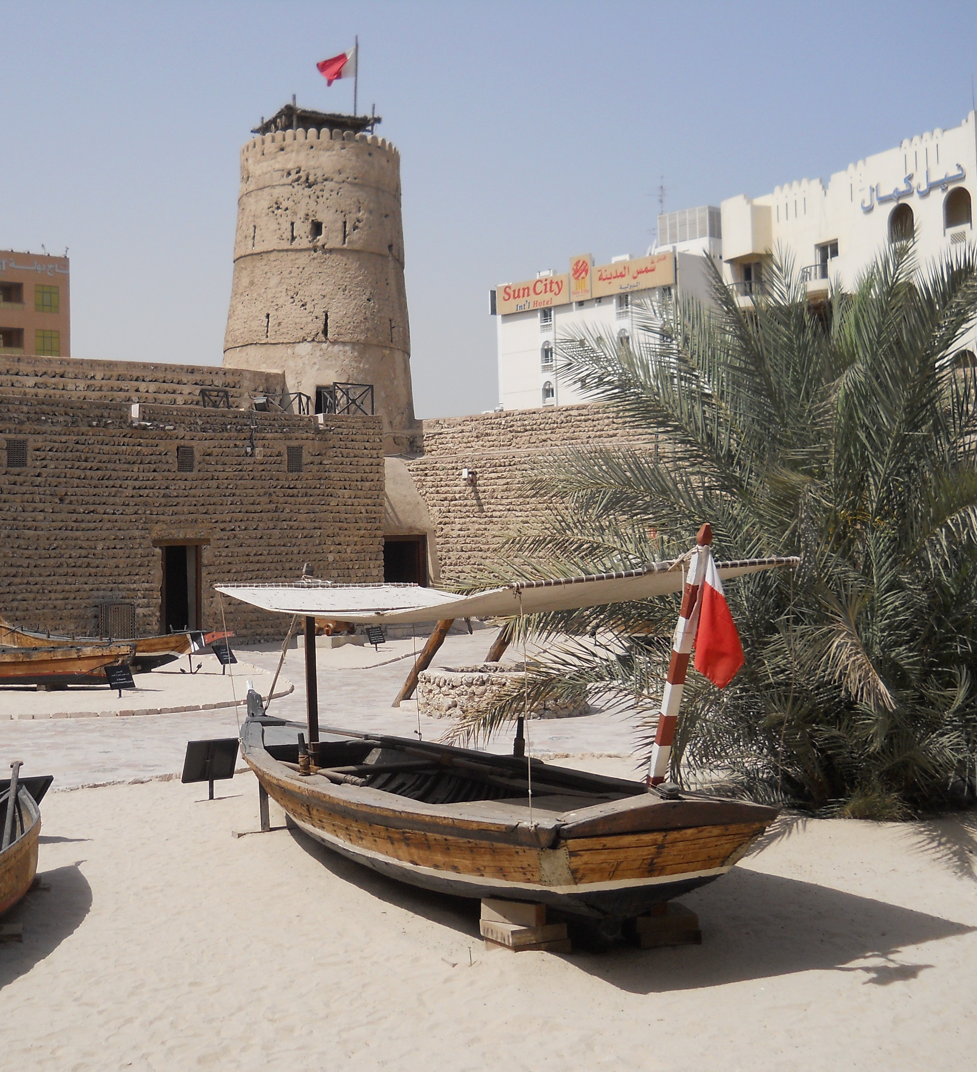
Unit 1 A Changing Landscape
Grade 11
Week 3
14/09/2021
Lessons 13-14

Slide 2

The National Anthem

Slide 3

Learning objectives
1
3
2
Speaking: To develop learners’ ability to
compare past and present.
To develop learners’ ability to skim
and scan a reading text for information.
Link to prior learning:
• Lexis and structures seen earlier in the unit

Slide 4
Introduction

Slide 5
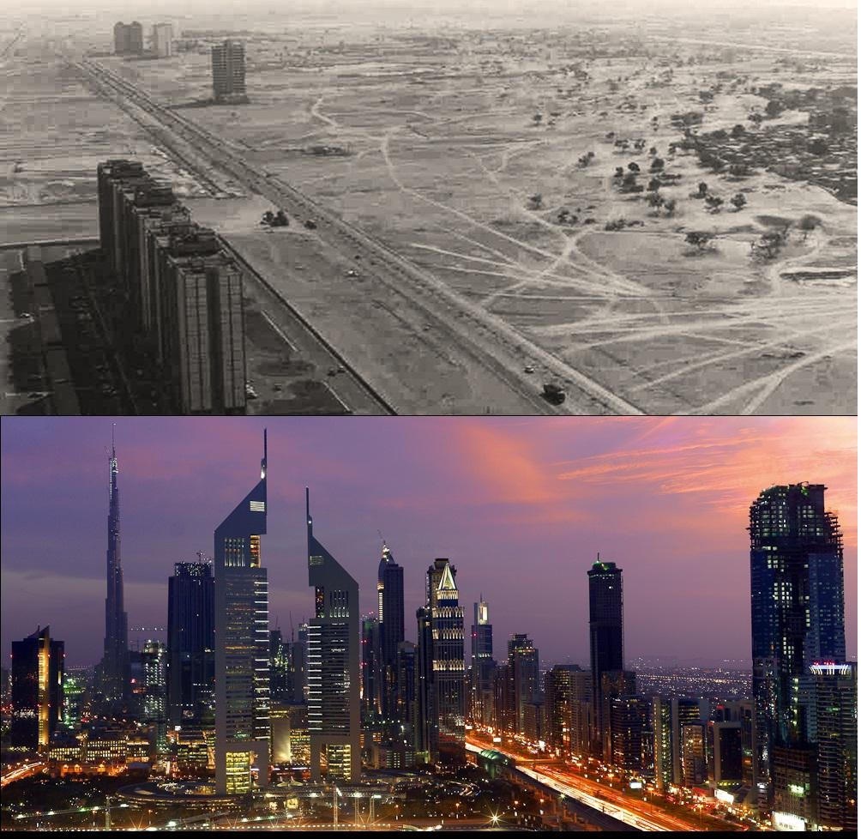

Slide 6
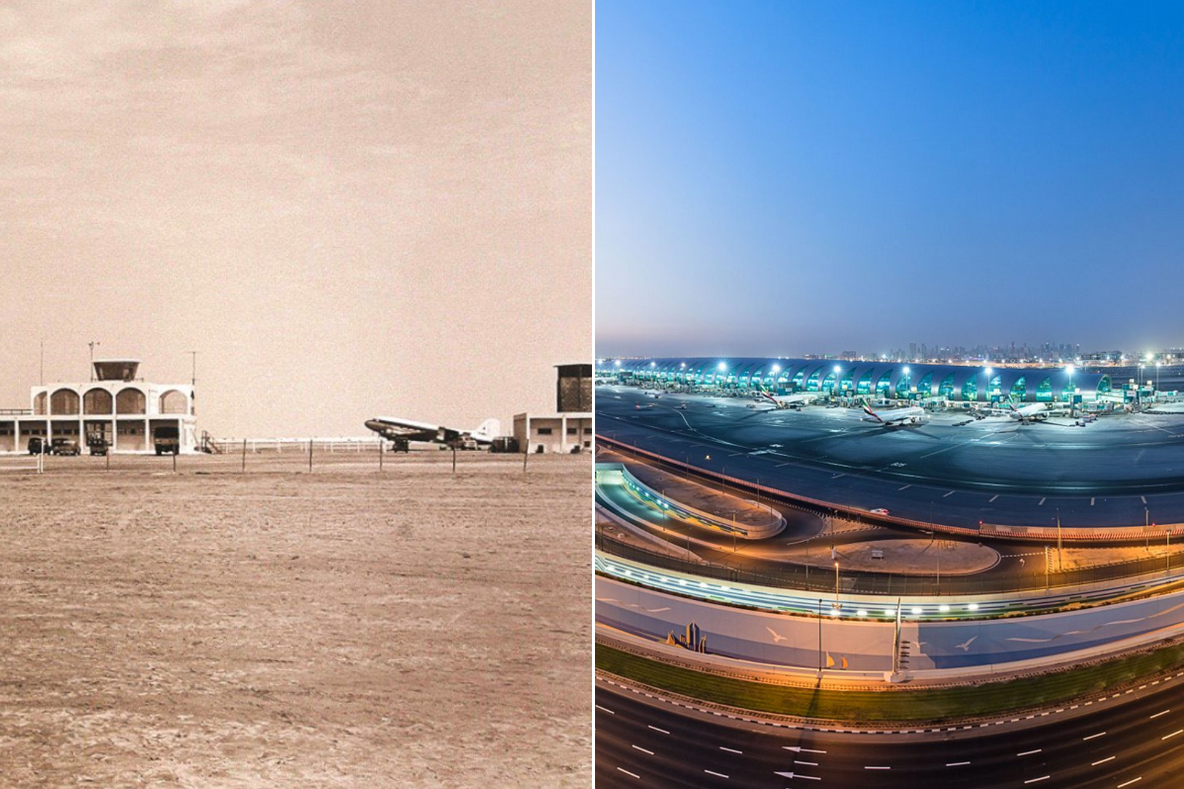

Slide 7
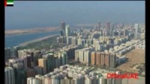

Slide 8
Reading

Slide 9
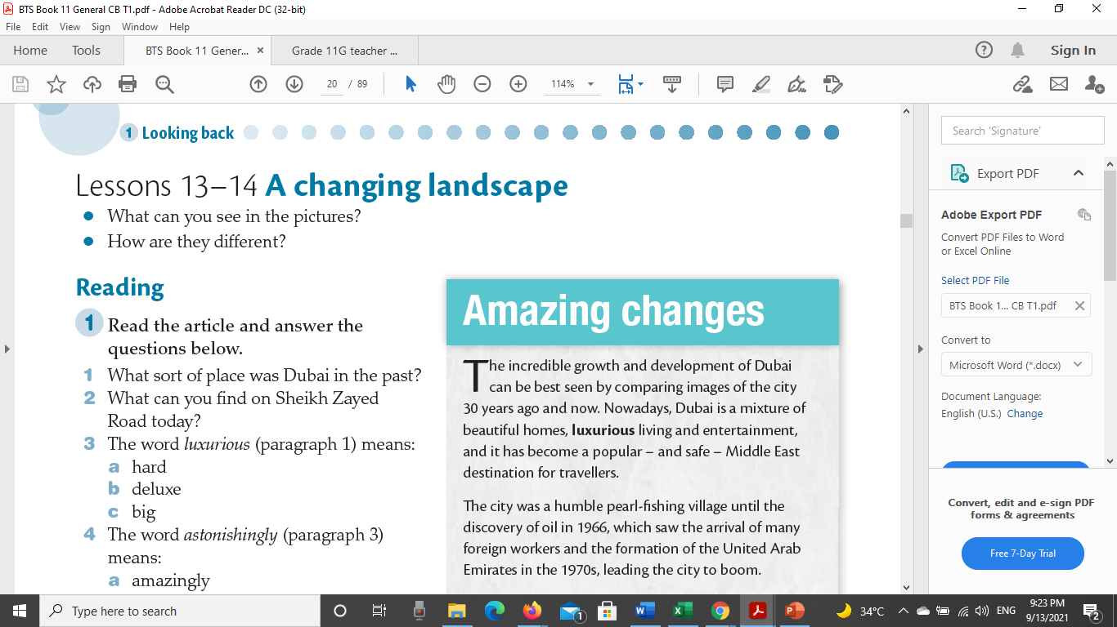


Slide 10
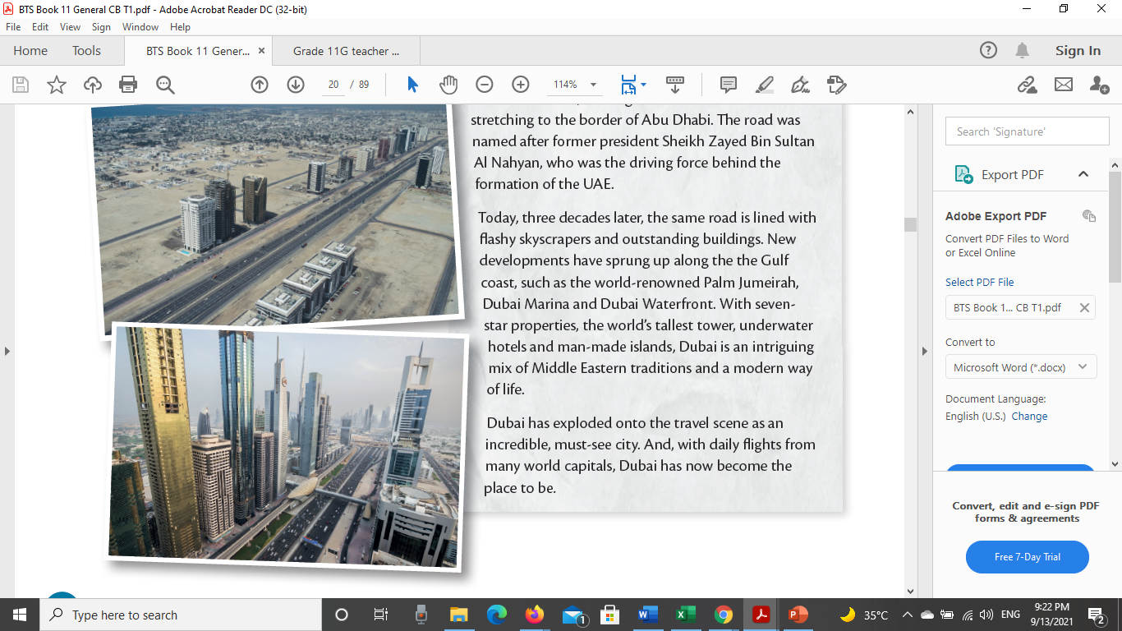

Slide 11
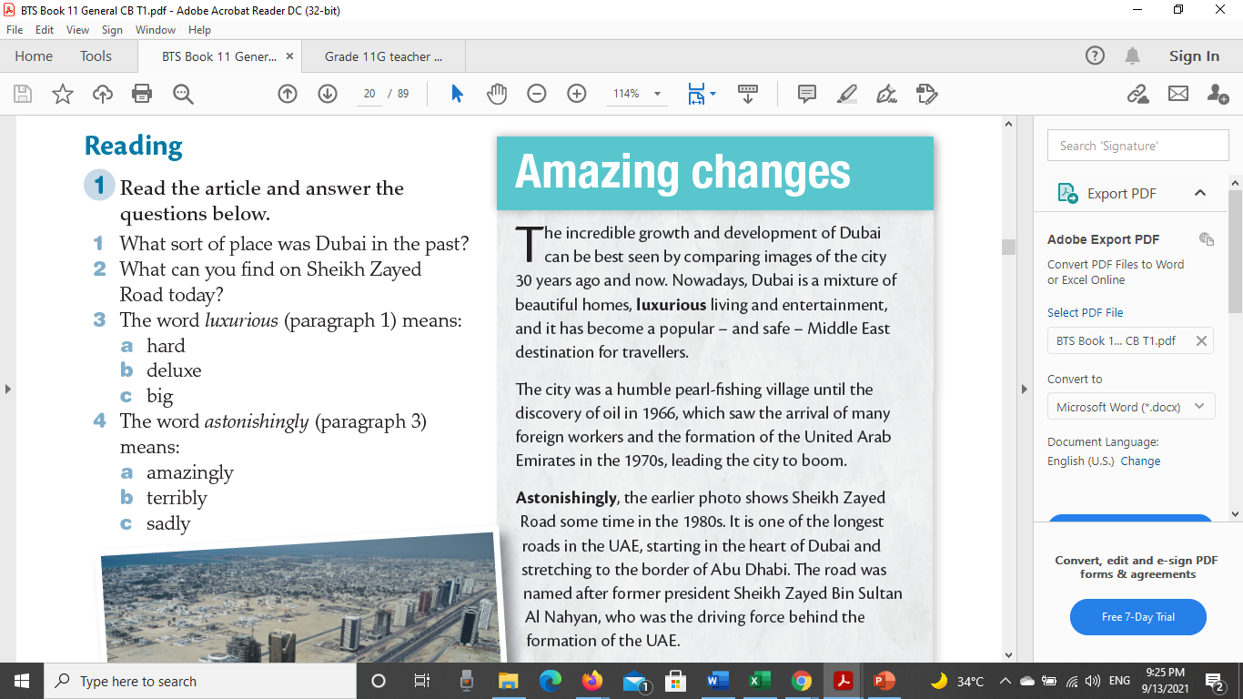

Slide 12







Slide 13
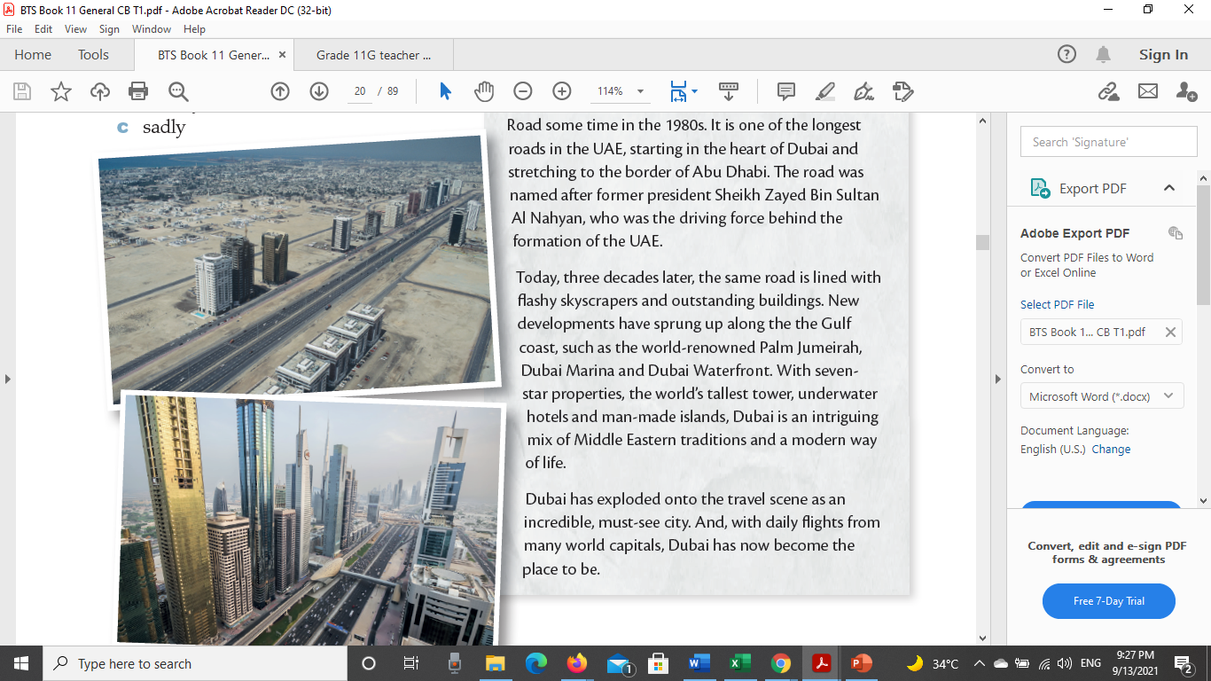


Slide 14
Part 2-15/09/2021

Slide 15

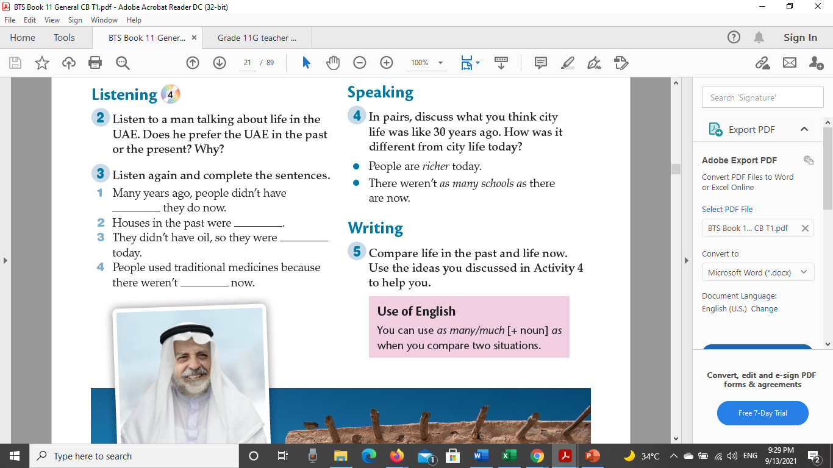

Slide 16
Part 3

Slide 17
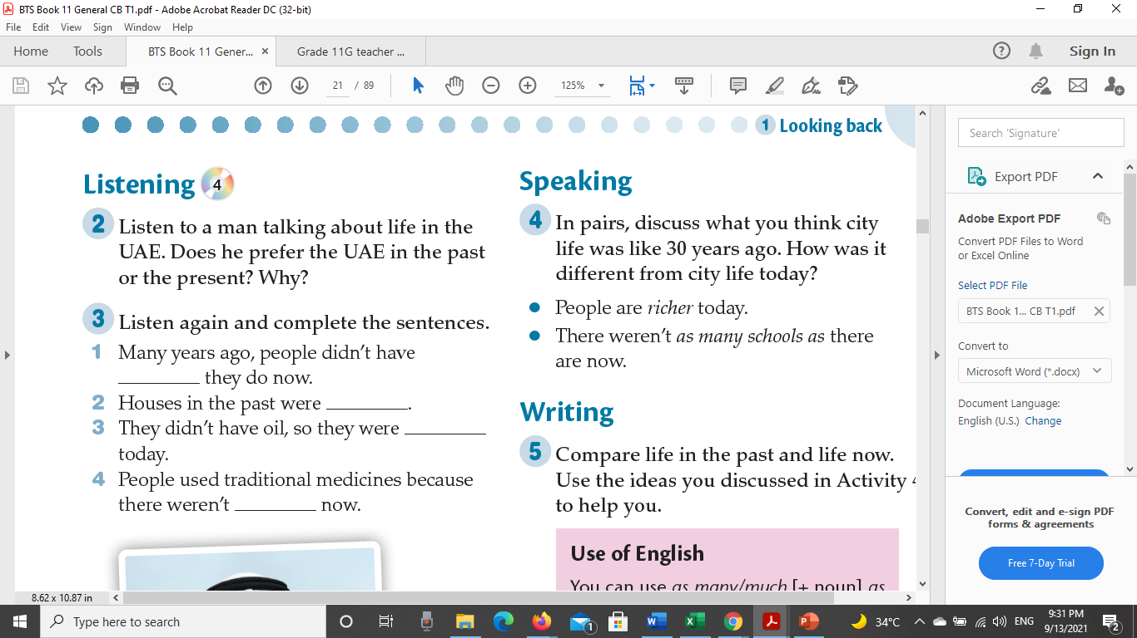

Slide 18
Part 4

Slide 19
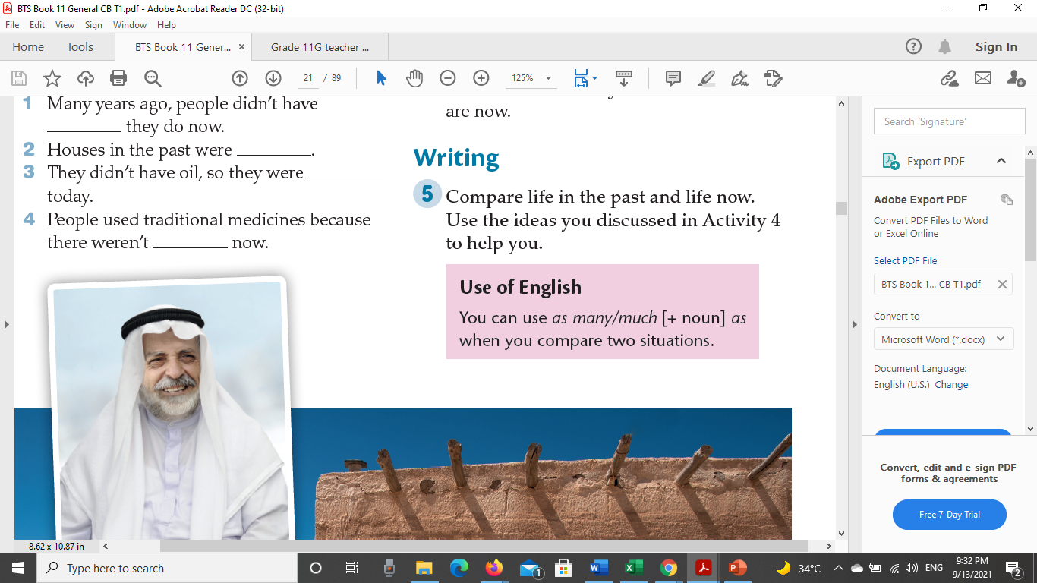



Slide 20
Workbook Lessons 13-14
Next slide

Slide 21
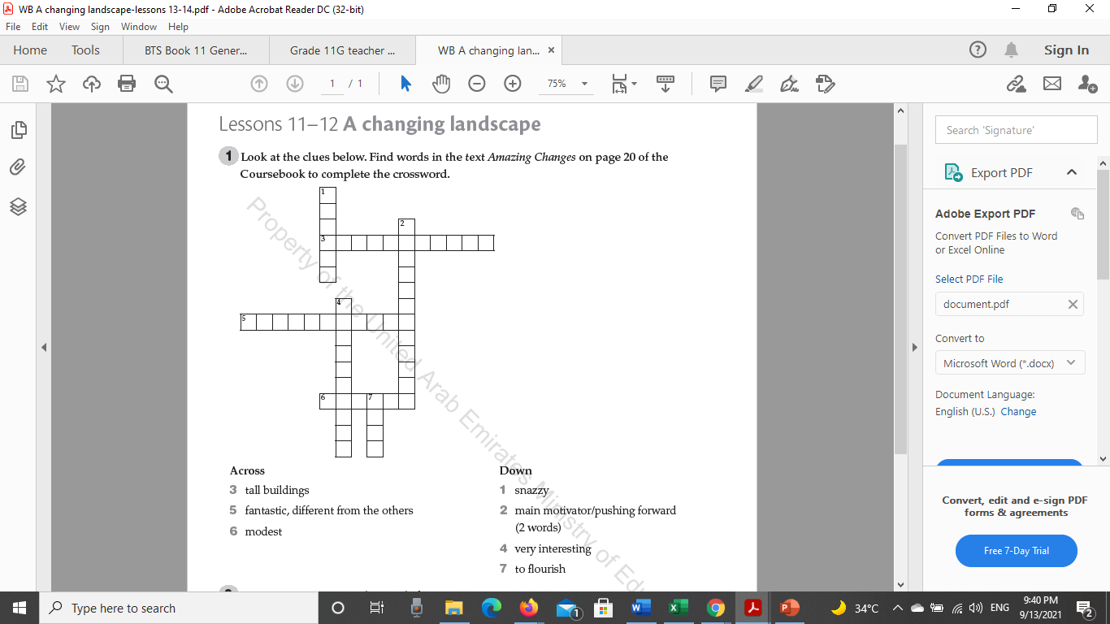

Slide 22
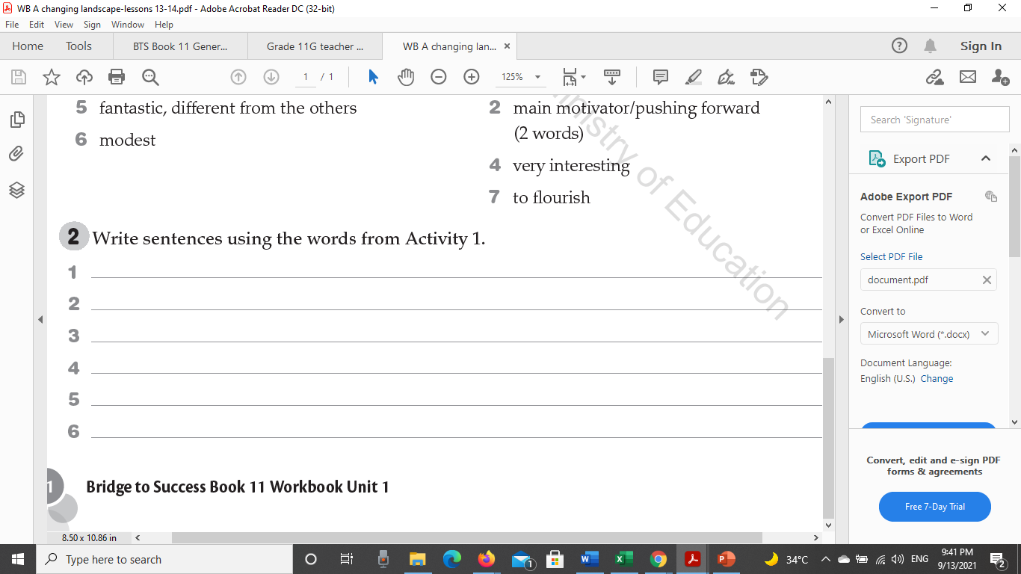

Slide 23
Alef Lesson 8-Using AS

Slide 24
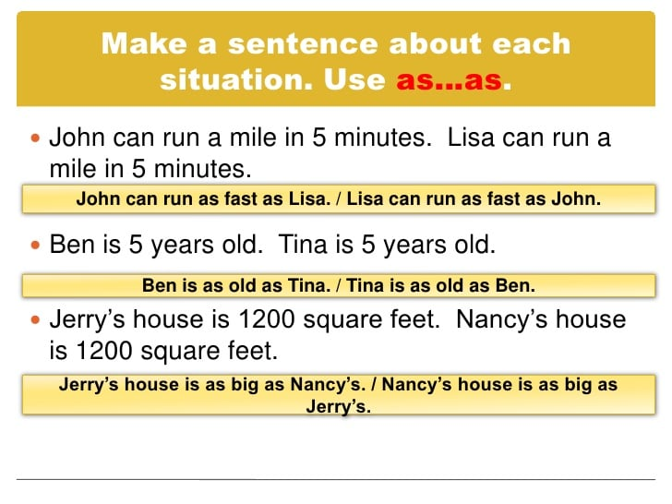

Slide 25


