Slide 1

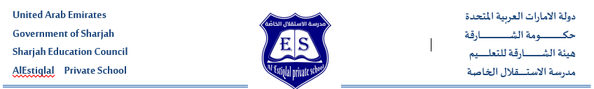

Reading texts
Grade 5 term 1
Done by
English Department

Slide 2
Khaled’s house
Khaled’s house is made of wood and has eight rooms. The windows and doors are made of glass. The roof is made of stone. He has one kitchen, five bedrooms and two living rooms. He lives in a villa with his mother, father and three sisters in Dubai. His grandfather and grandmother live in a small flat in Sharjah. They have a beautiful balcony. His aunt and cousin live in a villa in Ras Al Khaimah. They have a big garden and a swimming pool.
Read the text and answer the questions:-
1. What are the doors made of?
glass
stone
wood
2. Khaled’s ________ live in Sharjah.
sisters
aunt and cousin
grandfather and grandmother
3. Khaled’s grandmother’s house has a _____.
garden
balcony
swimming pool
4. What is this text about?
big families
small numbers
different homes

Slide 3
Khaled’s house
Khaled’s house is made of wood and has eight rooms. The windows and doors are made of glass. The roof is made of stone. He has one kitchen, five bedrooms and two living rooms. He lives in a villa with his mother, father and three sisters in Dubai. His grandfather and grandmother live in a small flat in Sharjah. They have a beautiful balcony. His aunt and cousin live in a villa in Ras Al Khaimah. They have a big garden and a swimming pool.
Read the text and answer the questions:-
1. What are the doors made of?
glass
stone
wood
2. Khaled’s ________ live in Sharjah.
sisters
aunt and cousin
grandfather and grandmother
3. Khaled’s grandmother’s house has a _____.
garden
balcony
swimming pool
4. What is this text about?
big families
small numbers
different homes

Slide 4
Robot
My cousins Mina and Alia have a robot. It is called Leela. Their robot cleans the kitchen and cooks dinner. Mina reads to Leela every day. Leela makes them hot drinks before school. Mina and Alia always have coffee or tea with lots of milk. My uncle Zain has coffee. Leela never puts milk in it. He doesn’t like milk. Leela plays volleyball with Alia and football with Mina. They don’t go horse riding with Leela.
Read the text and answer the questions:-
1. Leela can ________.
cook and read
read and clean
cook and clean
2. What does Uncle Zain have to drink?
tea with no milk
coffee with no milk
coffee with lots of milk
3. Leela ________ with Mina.
plays football
plays volleyball
goes horse riding
4. What is this text about?
a kind girl
a clever robot
a happy family

Slide 5
Robot
My cousins Mina and Alia have a robot. It is called Leela. Their robot cleans the kitchen and cooks dinner. Mina reads to Leela every day. Leela makes them hot drinks before school. Mina and Alia always have coffee or tea with lots of milk. My uncle Zain has coffee. Leela never puts milk in it. He doesn’t like milk. Leela plays volleyball with Alia and football with Mina. They don’t go horse riding with Leela.
Read the text and answer the questions:-
1. Leela can ________.
cook and read
read and clean
cook and clean
2. What does Uncle Zain have to drink?
tea with no milk
coffee with no milk
coffee with lots of milk
3. Leela ________ with Mina.
plays football
plays volleyball
goes horse riding
4. What is this text about?
a kind girl
a clever robot
a happy family

Slide 6
Read the texts.
Match the texts with the titles.
I always drink coffee before I go to school. I sometimes have it with my dinner too! I love my coffee with a little bit of milk.
The Pyramids
I live in a big villa with my three brothers and four sisters. There are seven rooms, eight bedrooms and three bathrooms.
My favorite Drink
The Giza Pyramids are in Egypt and are very big. They are very old and made of stone.
My Neighborhood
There are lots of beautiful houses and green trees. I play with my friends in the big park. There is a path that I follow to get home.
My house

Slide 7
Read the texts. Match the texts with the titles.
I always drink coffee before I go to school. I sometimes have it with my dinner too! I love my coffee with a little bit of milk.
The Pyramids
My Favourite Drink
My Neighbourhood
My House
I live in a big villa with my three brothers and four sisters. There are seven rooms, eight
bedrooms and three bathrooms.
The Giza Pyramids are in Egypt and are very big. They are very old and made of stone.
There are lots of beautiful houses and green trees. I play with my friends in the big park.
There is a path that I follow to get home.

Slide 8
Read the texts.
Match the texts with the titles.
I like playing when the weather is warm. My cousins and I love to swim at the beach. Sometimes I go camping in the desert with my dad. I like walking up the mountain with my friends too!
My Favourite Person
I want to interview Omar Ali and ask him to visit my class. He is my favourite celebrity. I like him because he is the best at horse riding. Who is your favourite celebrity?
What My Family Looks Like
My parents have long hair. My brother has short hair and my sister has curly hair. We all have brown hair.
A Nice Hotel
There is a tall building that was built in 2010. It has one hundred rooms. It is clean and fun. When I visit, I always play volleyball and tennis. At 7:00, I love to have breakfast in the restaurant.
Things To Do Outside

Slide 9
Read the texts. Match the texts with the titles.
I like playing when the weather is warm. My cousins and I love to swim at the beach. Sometimes I go
camping in the desert with my dad. I like walking up
the mountain with my friends too!
I want to interview Omar Ali and ask him to visit my
class. He is my favourite celebrity. I like him because he is the best at horse riding. Who is your favourite
celebrity?
My parents have long hair. My brother has short hair, and my sister has curly hair. We all have brown hair.
There is a tall building that was built in 2010. It has one hundred rooms. It is clean and fun. When I visit, I
always play volleyball and tennis. At 7:00, I love to
have breakfast in the restaurant.
My Favourite Person
What My Family Looks Like
A Nice Hotel
Things To Do Outside

Slide 10
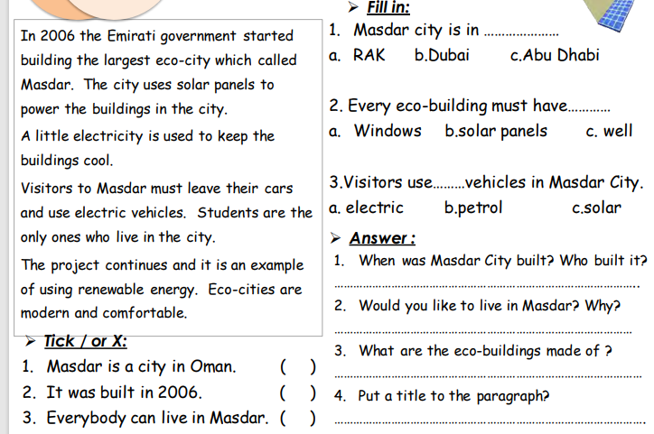

Slide 12
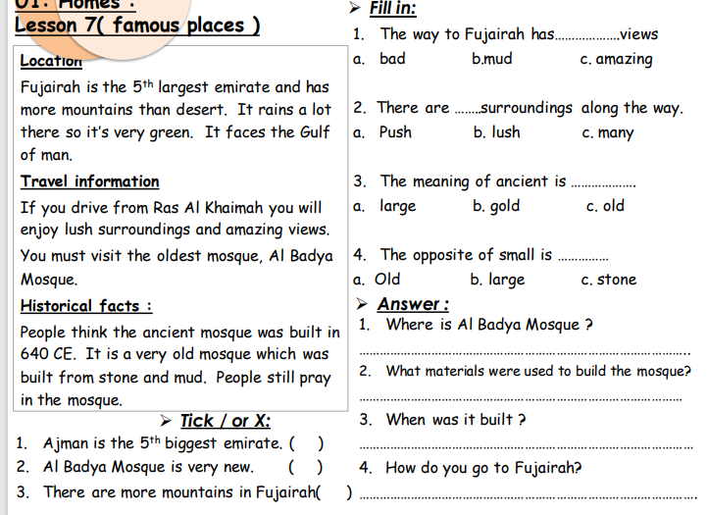

Slide 13
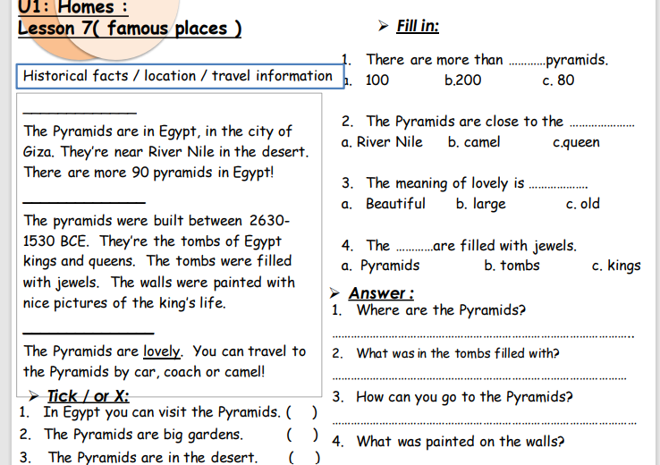

Slide 14
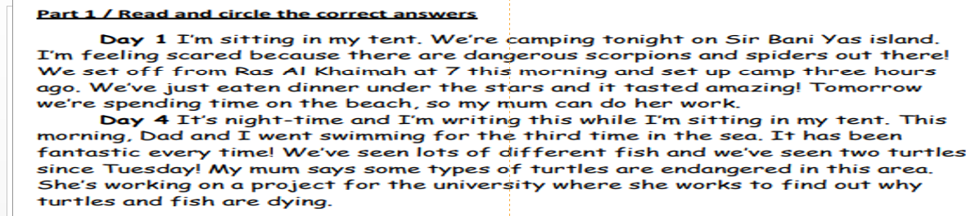
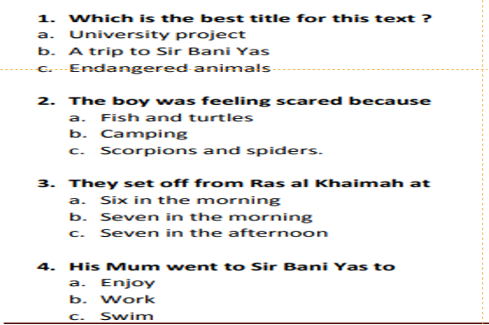

Slide 16
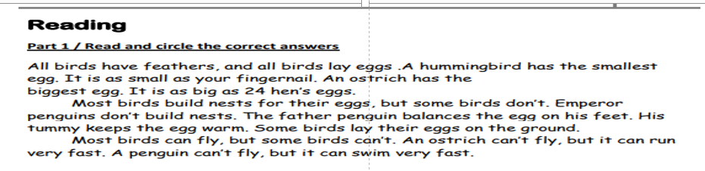
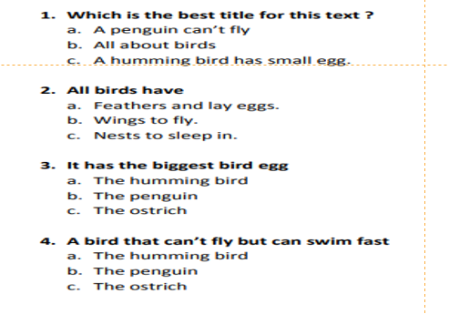

Slide 18
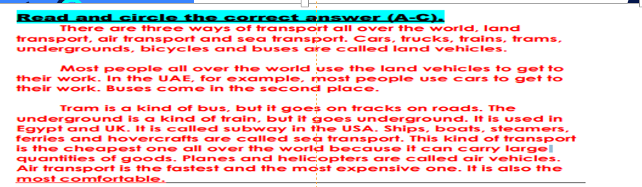
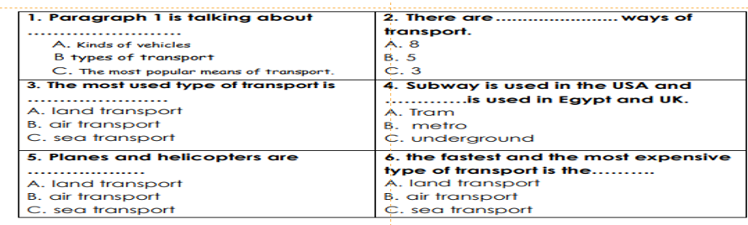

Slide 20
My Family
My family lives in a big 1. (roof / palace / table). My 2. (parents / student / teacher) are doctors. 3. (He / She / They) work at the 4. (fire station / hospital / police station). My 5. (mother / mothers / mother’s) name is Reem. Her husband is my 6. (aunt / father / daughter). My grandmother and grandfather are old and 7. (new / clever / curly). My cousins are from Dubai and they 8. (listen / writes / speak) Arabic. When they visit, we like to 9. (pets / play / park) with the toys in my bedroom.
Read the text and choose the correct word(s) to complete the sentences:-
1 | roof | palace | table
2 | parents | student | teacher
3 | He | She | They
4 | fire station | hospital | police station
5 | mother | mothers | mother’s
6 | aunt | father | daughter
7 | new | clever | curly
8 | listen | writes | speak
9 | pets | play | park

Slide 21
Read the text and choose the correct word(s) to complete the sentences.
My Family
My family lives in a big (roof / palace / table). My (parents / student / teacher) are doctors. (He / She / They) work
at the (fire station / hospital / police station). My (mother / mothers / mother’s) name is Reem. Her husband is my
(aunt / father / daughter). My grandmother and grandfather are old and (new / clever / curly). My cousins are from Dubai and they (listen / writes / speak) Arabic. When they visit, we like to (pets / play / park) with the toys in my
bedroom.

Slide 22
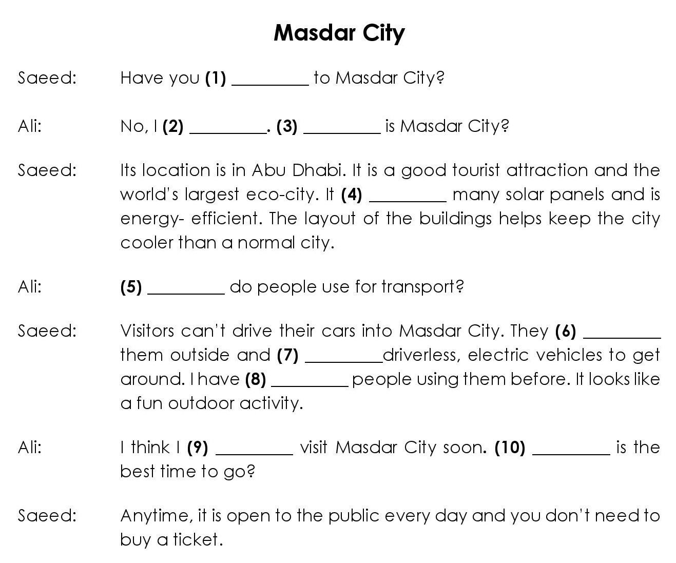
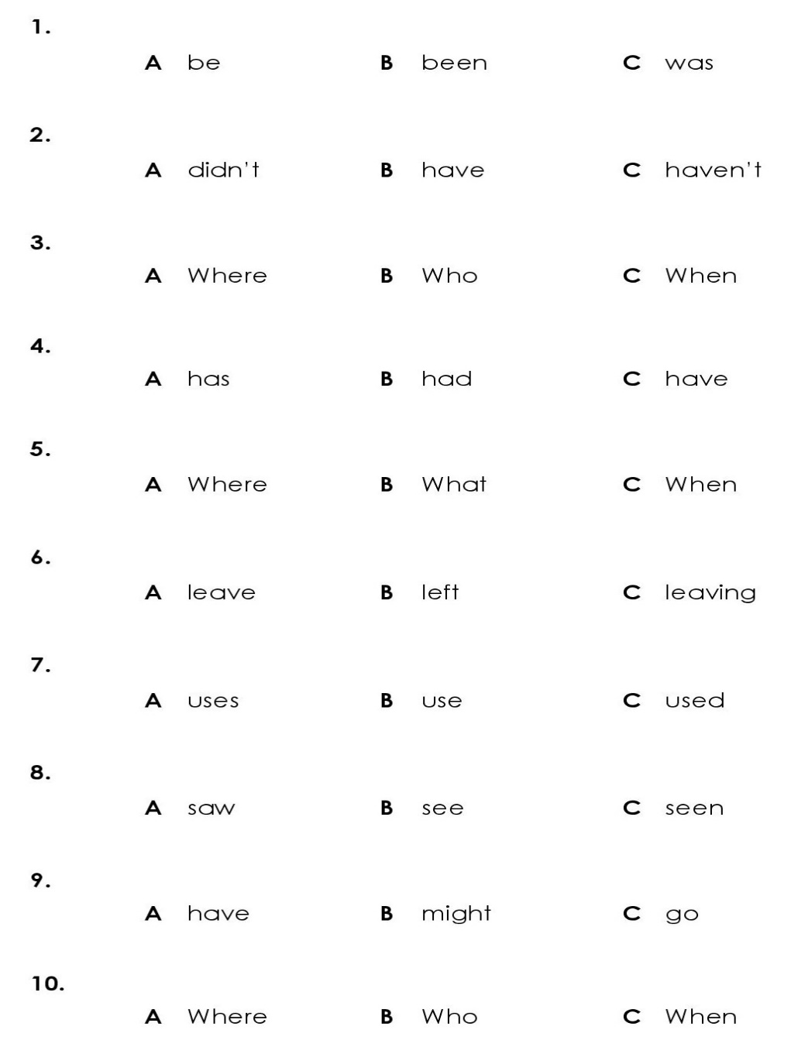
Read the text and choose the correct word(s) to complete the sentences:-

Slide 23
Read the text and choose the correct word(s) to complete the sentences:-

Slide 24
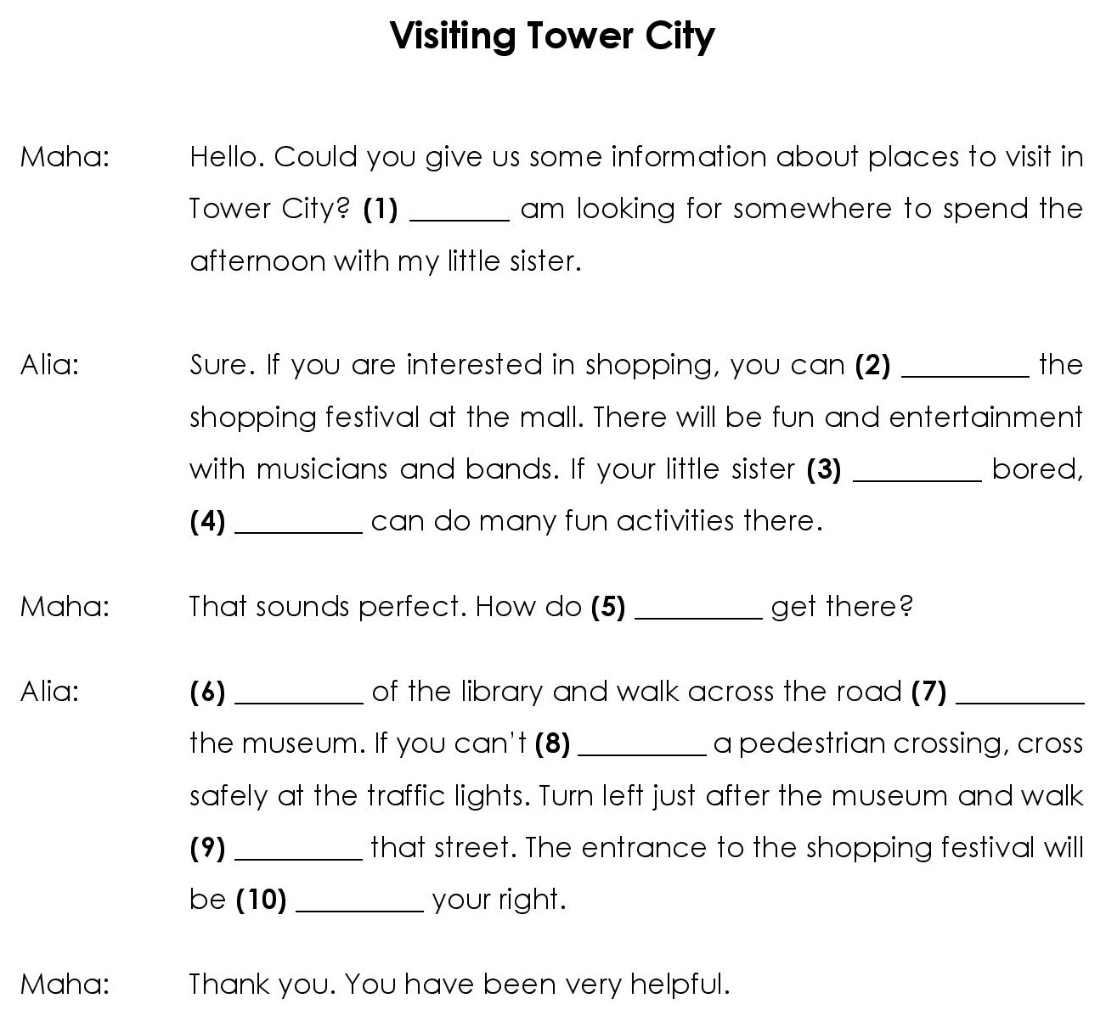
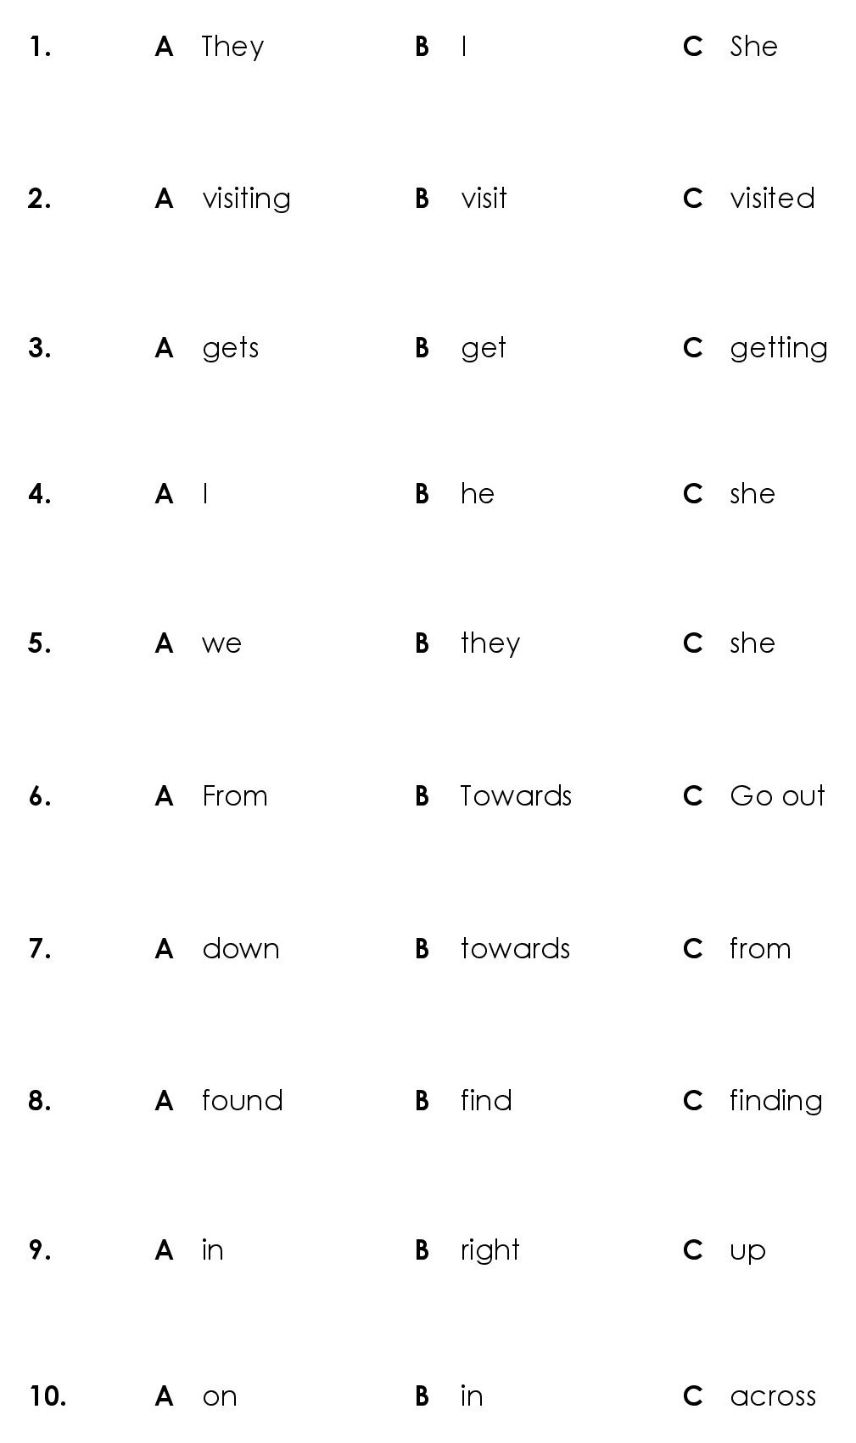
Read the text and choose the correct word(s) to complete the sentences:-

Slide 25
Read the text and choose the correct word(s) to complete the sentences:-

Slide 26
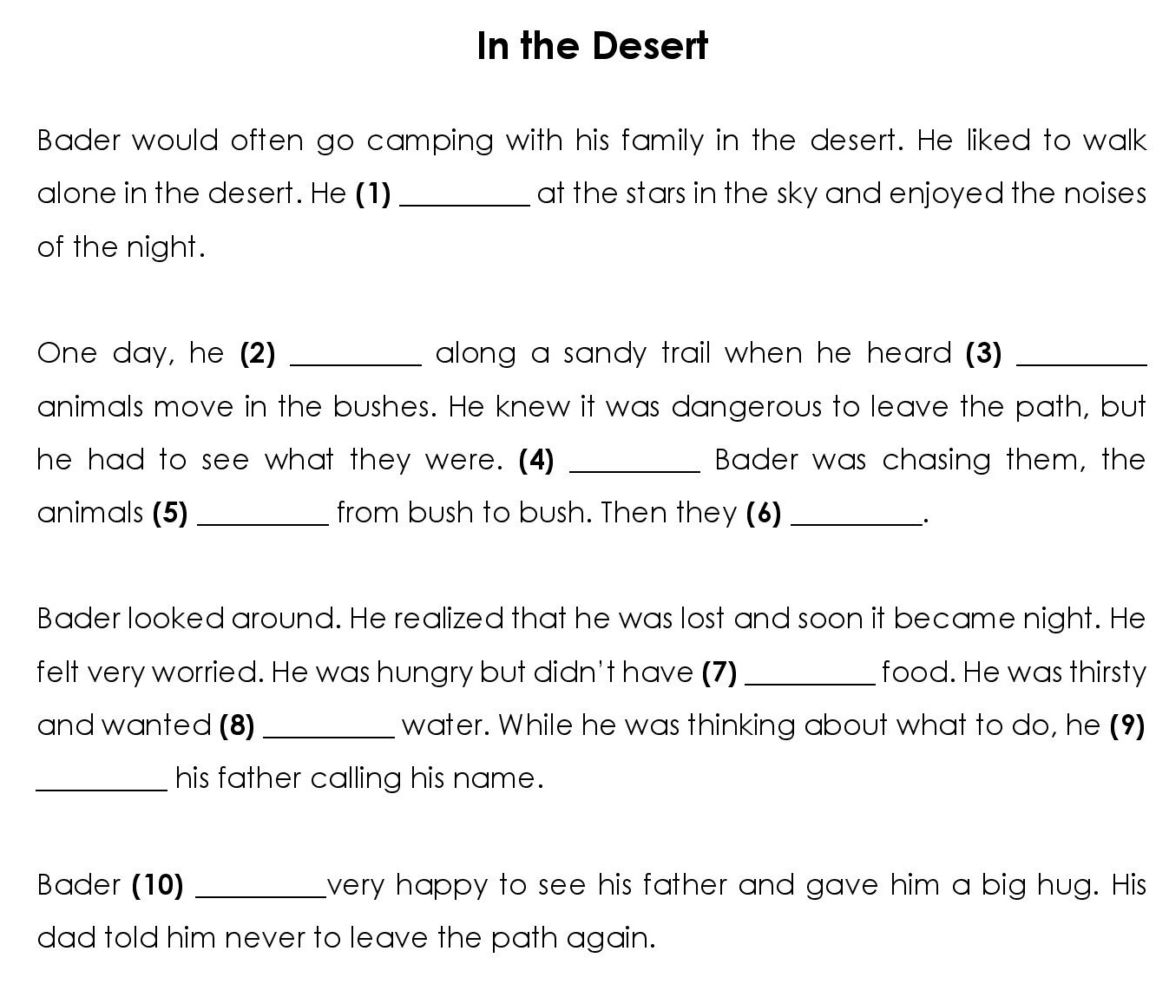
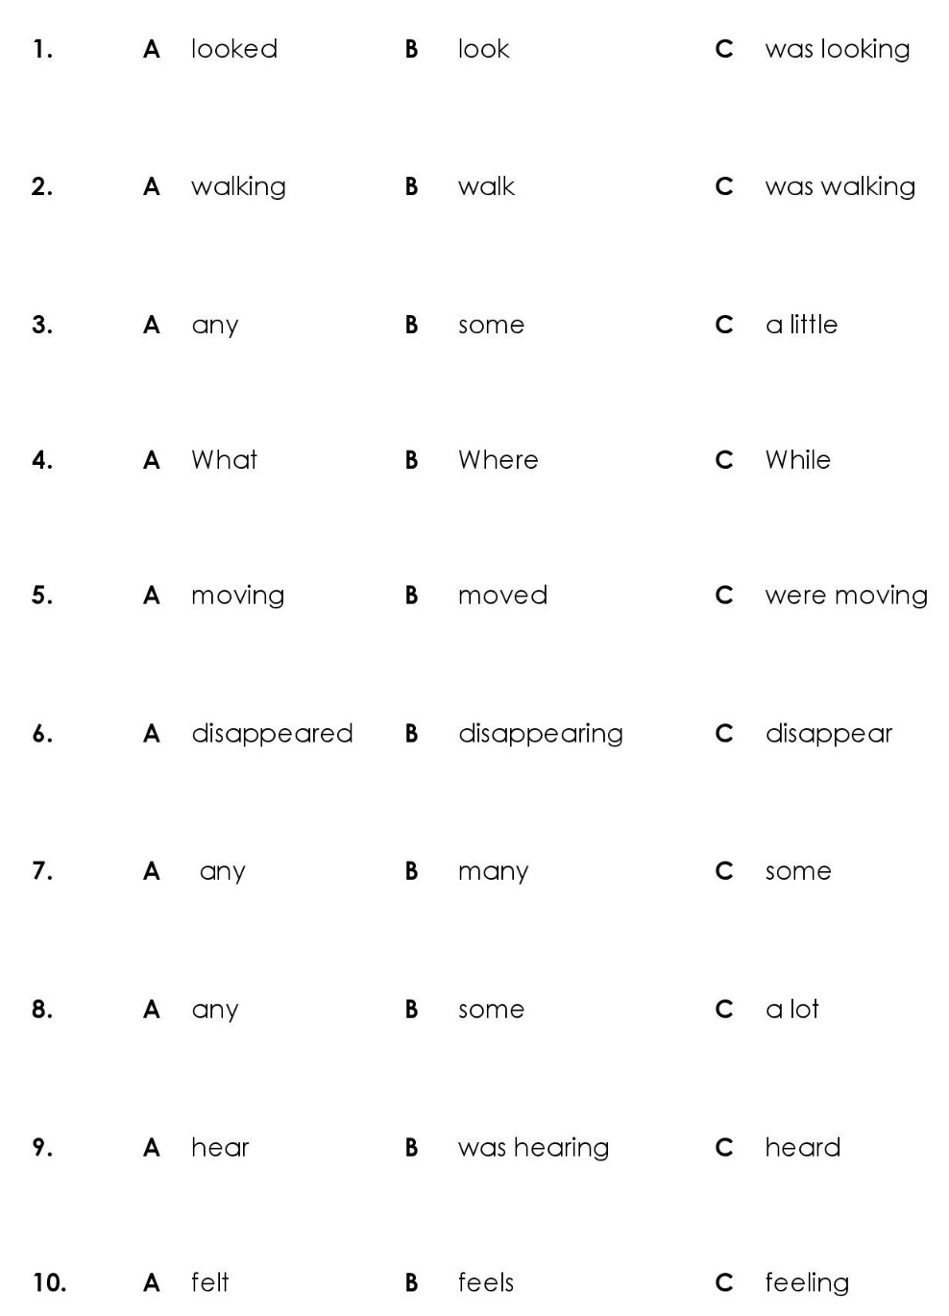
Read the text and choose the correct word(s) to complete the sentences:-

Slide 27
Read the text and choose the correct word(s) to complete the sentences:-

Slide 28
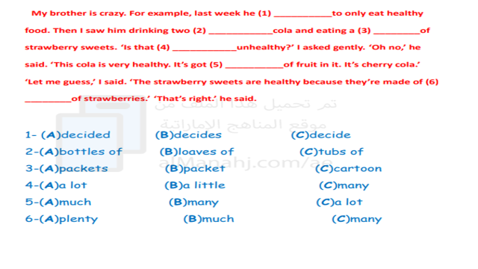
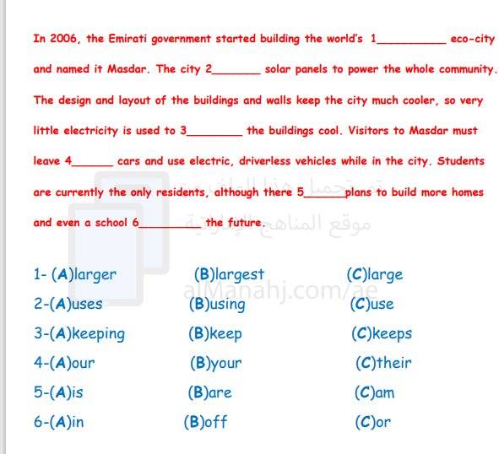

Slide 30


