Slide 1

Achievements file
Walaa Adel

Slide 2
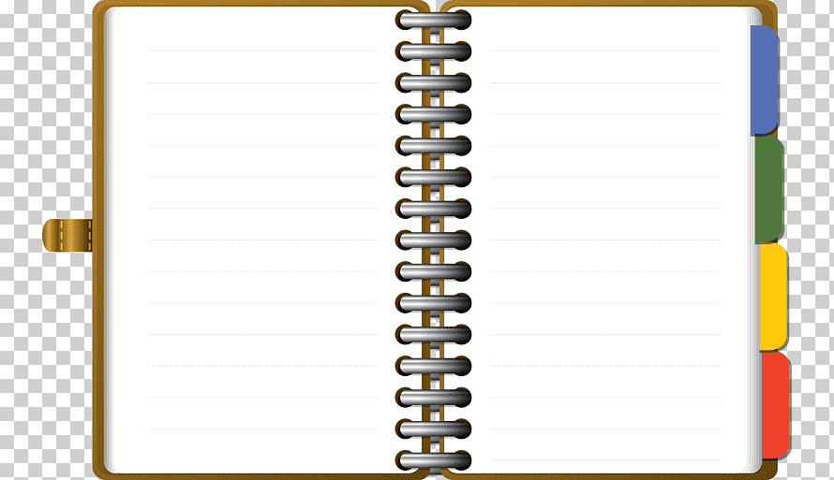

Teacher
Walaa Adel
EL Gafarawy
https://t.me/joinchat/TMTg2ulAA6MLLsJu
Telegram link

Slide 3
Teacher
Walaa Adel
EL Gafarawy
https://t.me/joinchat/TMTg2ulAA6MLLsJu
Telegram link

Slide 4
Teacher
Walaa Adel
EL Gafarawy
https://t.me/joinchat/TMTg2ulAA6MLLsJu
Telegram link

Slide 5
Teacher
Walaa Adel
EL Gafarawy
https://t.me/joinchat/TMTg2ulAA6MLLsJu
Telegram link

