Slide 1
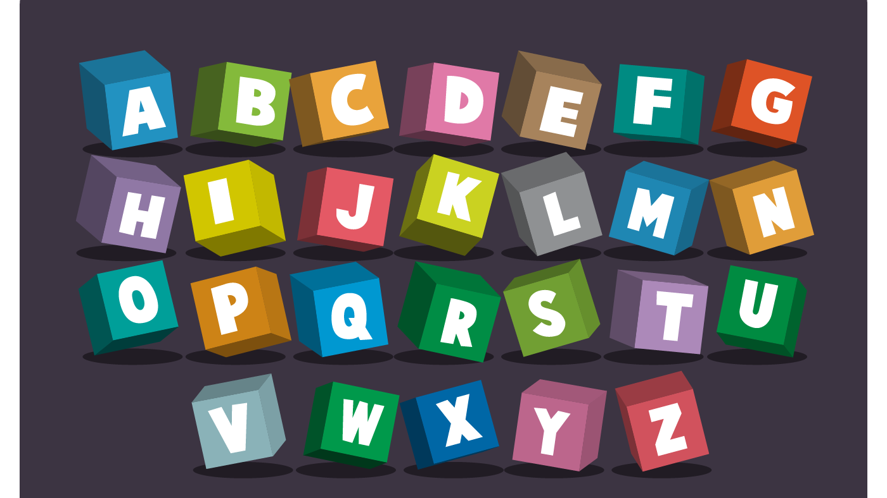
Drag the letters to build the word

Slide 2


o
d
t
a
c
g
Teacher Abrar AlEbrahim

Slide 3
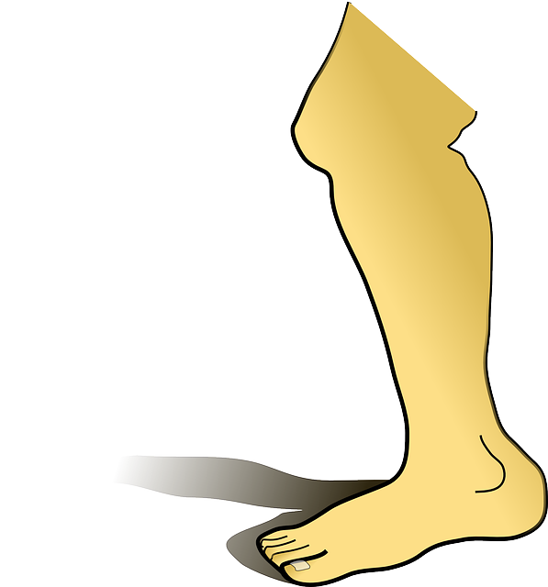
e
l
k
i
h
g
Teacher Abrar AlEbrahim

Slide 4

a
h
k
i
m
t
Teacher Abrar AlEbrahim

Slide 5

a
m
k
i
p
t
Teacher Abrar AlEbrahim

Slide 6

e
p
k
i
l
n
Teacher Abrar AlEbrahim

Slide 7
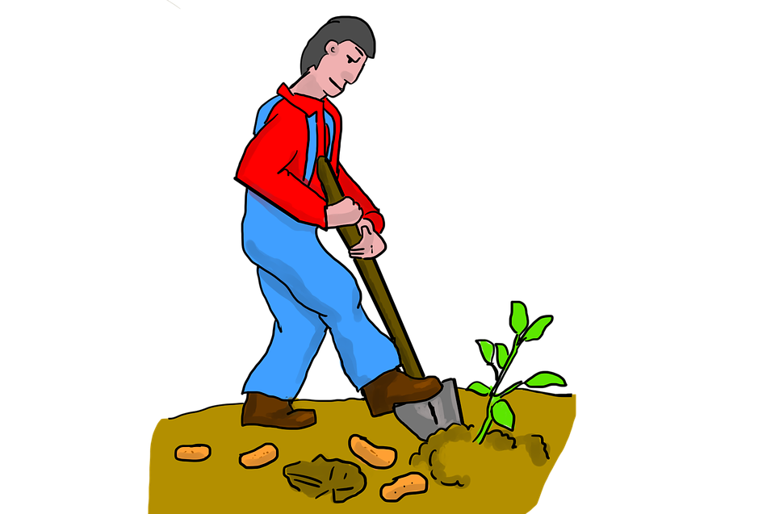
i
d
k
i
l
g
Teacher Abrar AlEbrahim

Slide 8

u
s
k
i
l
n
Teacher Abrar AlEbrahim

